Slide 1
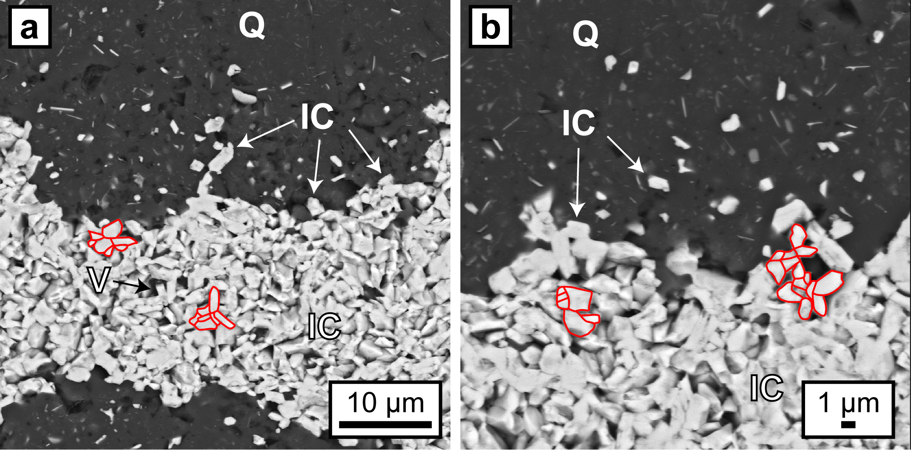
Egglseder et al.
Colloidal origin of microbands in banded iron formations
Figure 2 (a, b) BSE images of hematite particles along truncated quartz crystals forming dense aggregates (red outlines) with intergranular pores. Encapsulated colloidal hematite in chert and hematite particles in microbands show similar grain sizes and morphologies. IC: iron oxide colloids/particles, Q: quartz, V: void.
© 2018 The Authors
Published by the European Association of Geochemistry
under Creative Commons License CC BY-NC-ND 4.0
Egglseder et al. (2018) Geochem. Persp. Let. 6, 43-49 | doi: 10.7185/geochemlet.1808
Notes:
Figure 2 (a, b) BSE images of hematite particles along truncated quartz crystals forming dense aggregates (red outlines) with intergranular pores. Encapsulated colloidal hematite in chert and hematite particles in microbands show similar grain sizes and morphologies. IC: iron oxide colloids/particles, Q: quartz, V: void.

