Slide 1
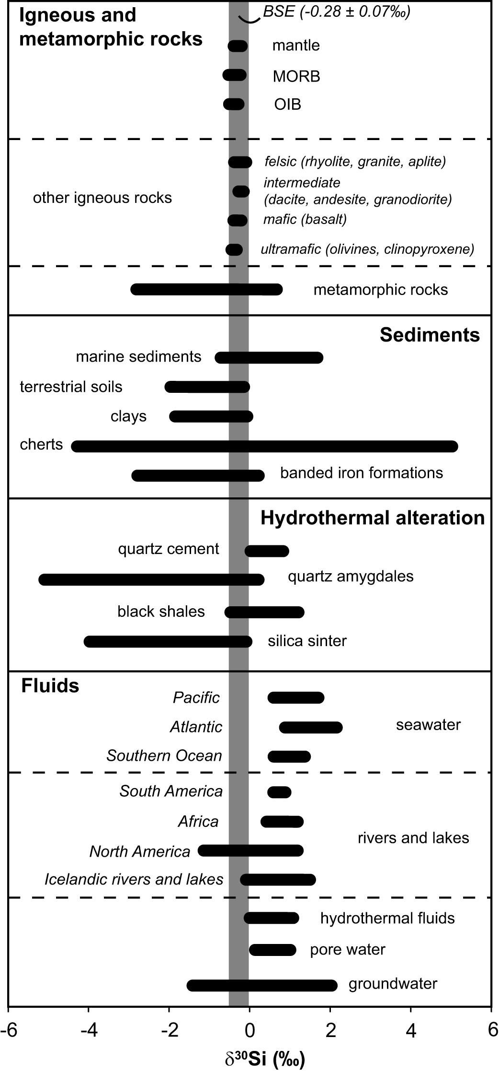
Kleine et al.
Silicon and oxygen isotopes unravel quartz formation processes in the Icelandic crust
Figure 1 Compilation of δ³⁰Si values for different rock types and fluids. Data taken from Douthitt (1982), De La Rocha et al. (2000), André et al. (2006), Robert and Chaussidon (2006), Georg et al. (2007a,b, 2009), Fitoussi et al. (2009), Steinhoefel, et al. (2009, 2010), Savage et al. (2010, 2011, 2012)…
© 2018 The Authors
Published by the European Association of Geochemistry
under Creative Commons License CC BY 4.0
Kleine et al. (2018) Geochem. Persp. Let. 7, 5-11 | doi: 10.7185/geochemlet.1811
Notes:
Figure 1 Compilation of δ³⁰Si values for different rock types and fluids. Data taken from Douthitt (1982), De La Rocha et al. (2000), André et al. (2006), Robert and Chaussidon (2006), Georg et al. (2007a,b, 2009), Fitoussi et al. (2009), Steinhoefel, et al. (2009, 2010), Savage et al. (2010, 2011, 2012), Van den Boorn et al. (2010), Abraham et al. (2011), Armytage et al. (2011), Heck et al. (2011), Chakrabarti et al. (2012), Delvigne et al. (2012), Marin-Carbonne et al. (2012, 2014), Opfergelt et al. (2012), von Strandmann et al. (2012), Fan et al. (2013), Zambardi et al. (2013), Geilert et al. (2015), Stefurak et al. (2015), Brengman et al. (2016), Chen et al. (2016), Pollington et al. (2016). BSE = bulk silica earth (see Supplementary Information for more details).

