Slide 1
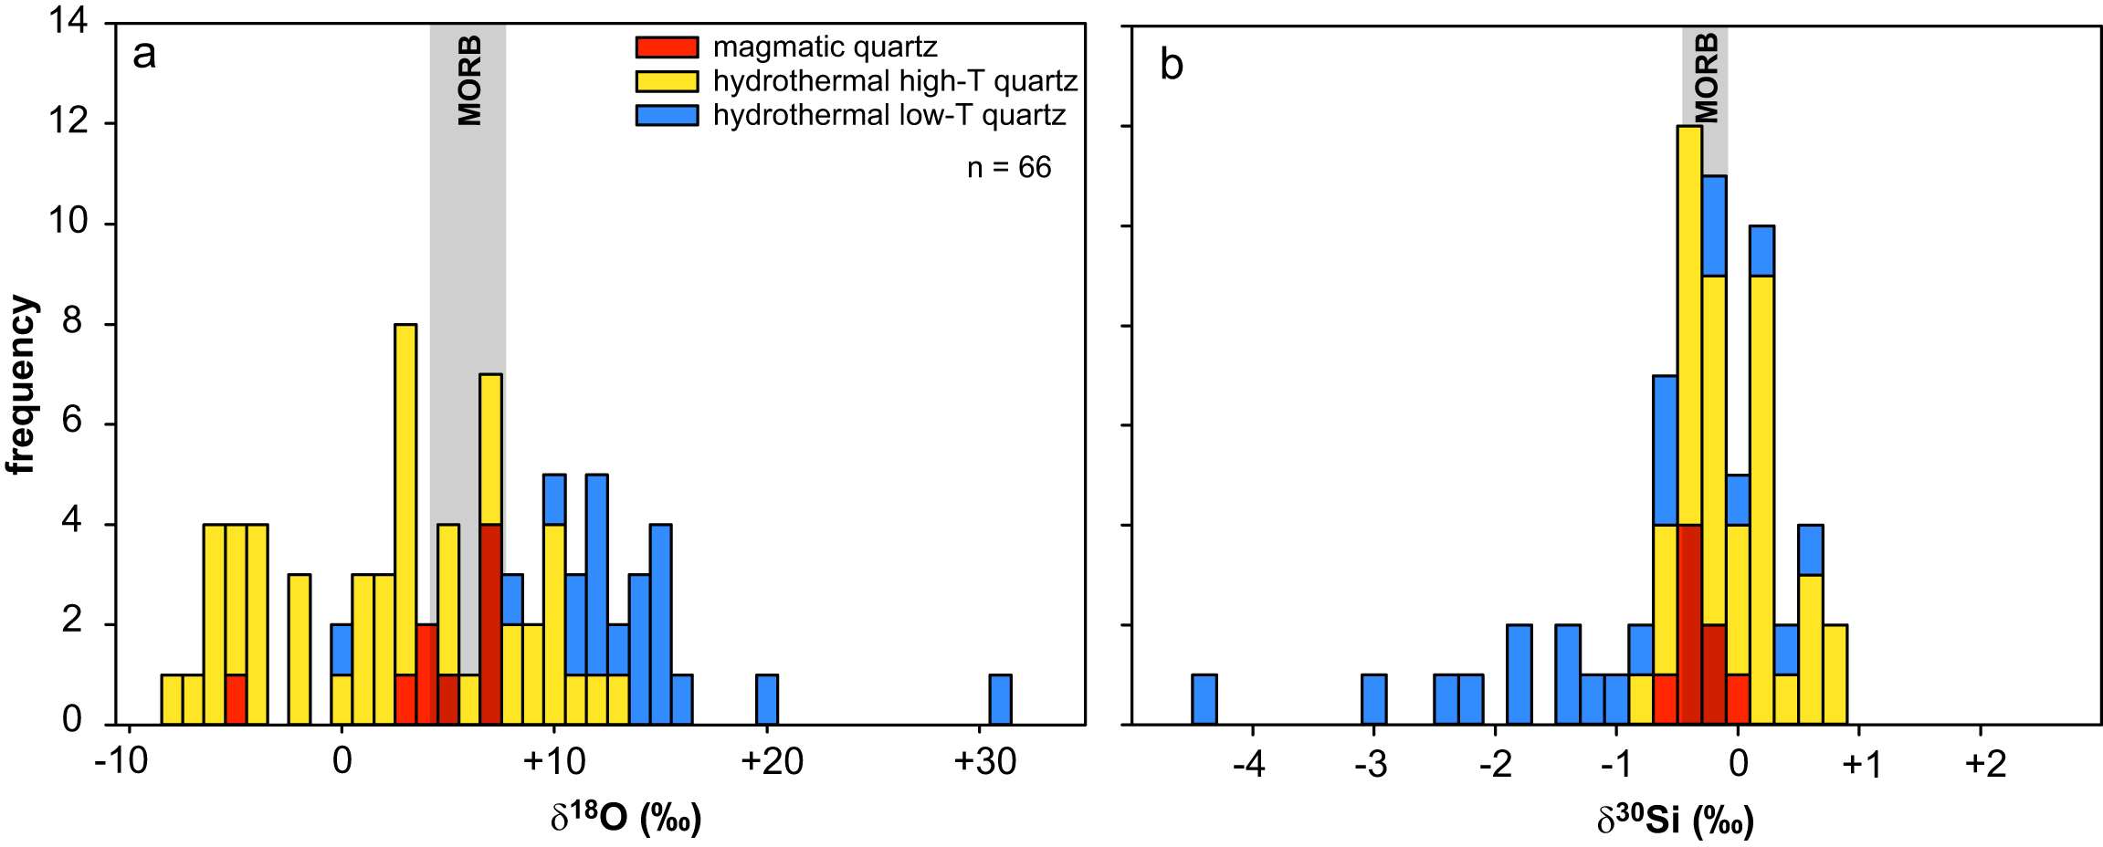
Kleine et al.
Silicon and oxygen isotopes unravel quartz formation processes in the Icelandic crust
Figure 2 Variation in (a) δ¹⁸O and (b) δ³⁰Si values of magmatic quartz (>550 °C), hydrothermal high-temperature (~200-400 °C) quartz and low-temperature (<150 °C) quartz and other silica polymorphs. The isotopic values are compared to δ¹⁸O and δ³⁰Si values for MORB (Eiler et al., 2000; Savage et al., 2010).
© 2018 The Authors
Published by the European Association of Geochemistry
under Creative Commons License CC BY 4.0
Kleine et al. (2018) Geochem. Persp. Let. 7, 5-11 | doi: 10.7185/geochemlet.1811
Notes:
Figure 2 Variation in (a) δ¹⁸O and (b) δ³⁰Si values of magmatic quartz (>550 °C), hydrothermal high-temperature (~200-400 °C) quartz and low-temperature (<150 °C) quartz and other silica polymorphs. The isotopic values are compared to δ¹⁸O and δ³⁰Si values for MORB (Eiler et al., 2000; Savage et al., 2010).

