Slide 1
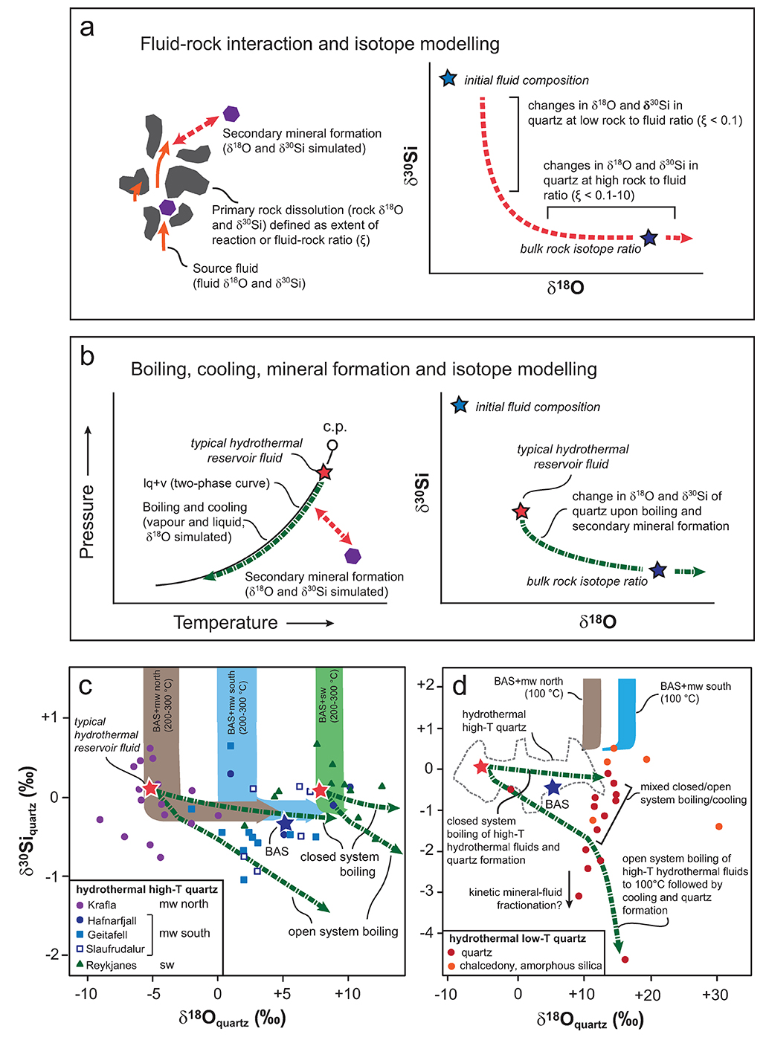
Kleine et al.
Silicon and oxygen isotopes unravel quartz formation processes in the Icelandic crust
Figure 3 The conceptual chemical and isotope model involves (a) fluid-rock interaction with various source fluids and (b) boiling followed by cooling and mineral formation; (c) isotope systematics in hydrothermal high-temperature quartz largely match the predicted reaction path for progressive fluid-rock interaction (shaded areas) and boiling (arrows). δ³⁰Si decreases with increasing rock-fluid ratio (ξ) whereas…
© 2018 The Authors
Published by the European Association of Geochemistry
under Creative Commons License CC BY 4.0
Kleine et al. (2018) Geochem. Persp. Let. 7, 5-11 | doi: 10.7185/geochemlet.1811
Notes:
Figure 3 The conceptual chemical and isotope model involves (a) fluid-rock interaction with various source fluids and (b) boiling followed by cooling and mineral formation; (c) isotope systematics in hydrothermal high-temperature quartz largely match the predicted reaction path for progressive fluid-rock interaction (shaded areas) and boiling (arrows). δ³⁰Si decreases with increasing rock-fluid ratio (ξ) whereas δ¹⁸O values in quartz both depend on the source water and rock-fluid ratio; (d) most of the isotope variations in hydrothermal low-temperature quartz and silica polymorphs can be explained by boiling and cooling of a hydrothermal fluid (arrows). Silica deposits with low δ³⁰Si and constant δ¹⁸O values may result from open system boiling of a high-temperature fluid followed by cooling and quartz or opal formation. BAS = basalt, mw = meteoric water, sw = seawater. Analytical uncertainties of δ³⁰Si and δ¹⁸O are listed in Tables S-7 and S-8.

