Slide 1
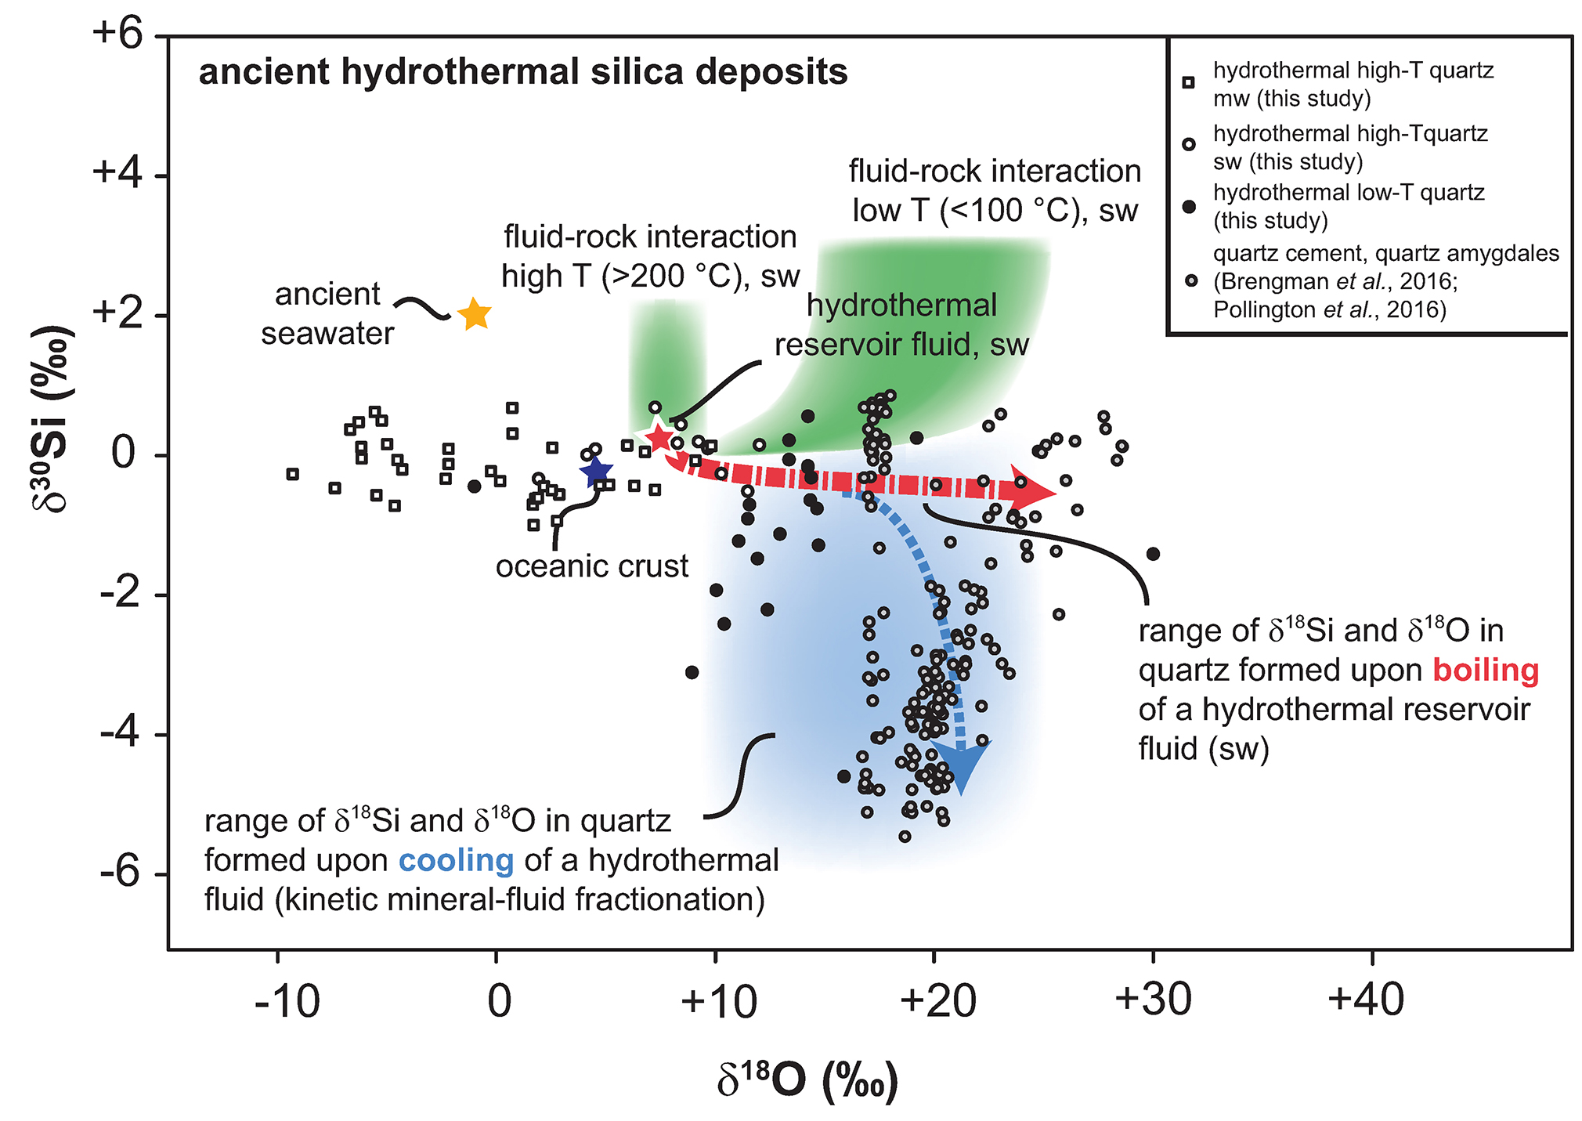
Kleine et al.
Silicon and oxygen isotopes unravel quartz formation processes in the Icelandic crust
Figure 4 δ³⁰Si versus δ¹⁸O values of ancient, hydrothermally altered quartz cement and amygdales (Brengman et al., 2016; Pollington et al., 2016). A highly variable but largely negative range in δ³⁰Si values is likely to result from quartz precipitating out of a boiling and cooling fluid involving kinetic fluid-quartz/opal fractionation during rapid temperature decrease. For modelling, the isotope composition of ancient seawater was used (Marin-Carbonne et al., 2014). mw = meteoric water, sw = seawater.
© 2018 The Authors
Published by the European Association of Geochemistry
under Creative Commons License CC BY 4.0
Kleine et al. (2018) Geochem. Persp. Let. 7, 5-11 | doi: 10.7185/geochemlet.1811
Notes:
Figure 4 δ³⁰Si versus δ¹⁸O values of ancient, hydrothermally altered quartz cement and amygdales (Brengman et al., 2016; Pollington et al., 2016). A highly variable but largely negative range in δ³⁰Si values is likely to result from quartz precipitating out of a boiling and cooling fluid involving kinetic fluid-quartz/opal fractionation during rapid temperature decrease. For modelling, the isotope composition of ancient seawater was used (Marin-Carbonne et al., 2014). mw = meteoric water, sw = seawater.

