Slide 1
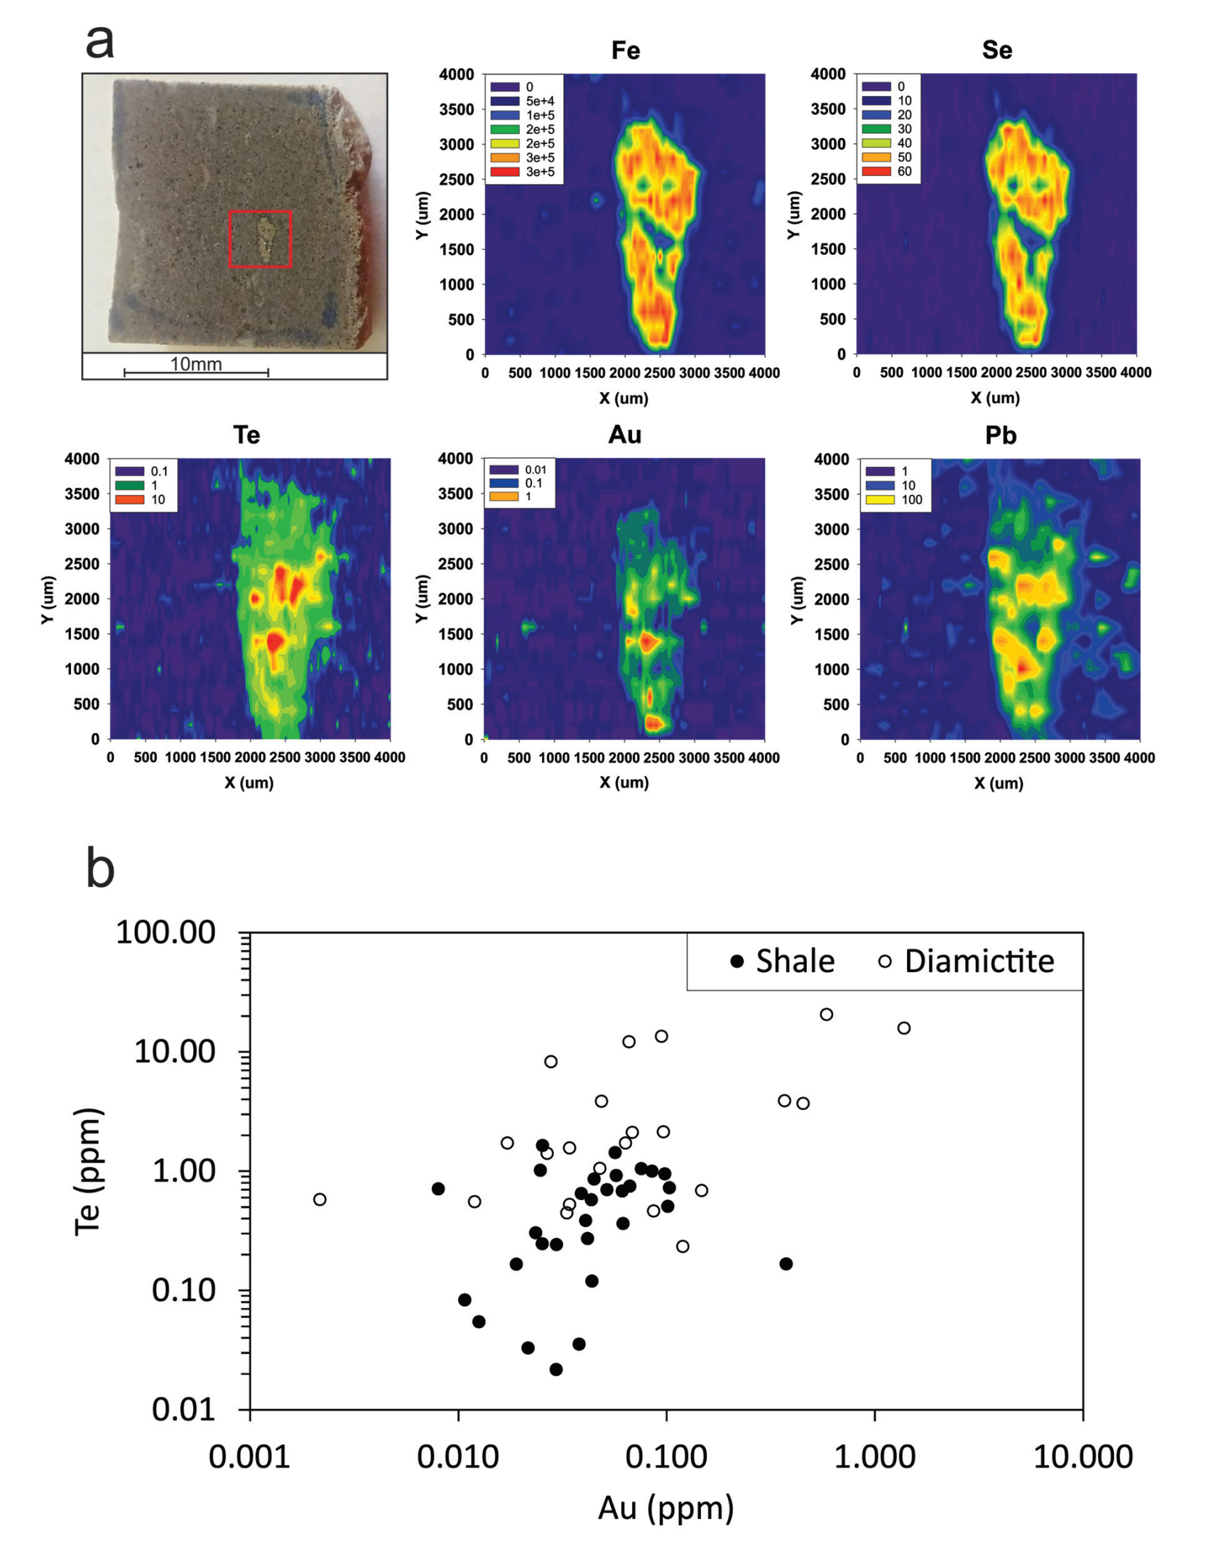
Parnell et al.
Geochemistry and metallogeny of Neoproterozoic pyrite in oxic and anoxic sediments
Figure 3 Gold in pyrite, determined by LA-ICP-MS. (a) Element maps for pyrite crystal in diamictite, Mull of Oa, Islay, Scotland. Counts in ppm, except Au counts per second. (b) Cross-plot of Au and Te contents in pyrite. 6 of 7 highest Au values recorded in diamictite.
© 2018 The Authors
Published by the European Association of Geochemistry
under Creative Commons License CC BY 4.0
Parnell et al. (2018) Geochem. Persp. Let. 7, 12-16 | doi: 10.7185/geochemlet.1812
Notes:
Figure 3 Gold in pyrite, determined by LA-ICP-MS. (a) Element maps for pyrite crystal in diamictite, Mull of Oa, Islay, Scotland. Counts in ppm, except Au counts per second. (b) Cross-plot of Au and Te contents in pyrite. 6 of 7 highest Au values recorded in diamictite.

