Slide 1
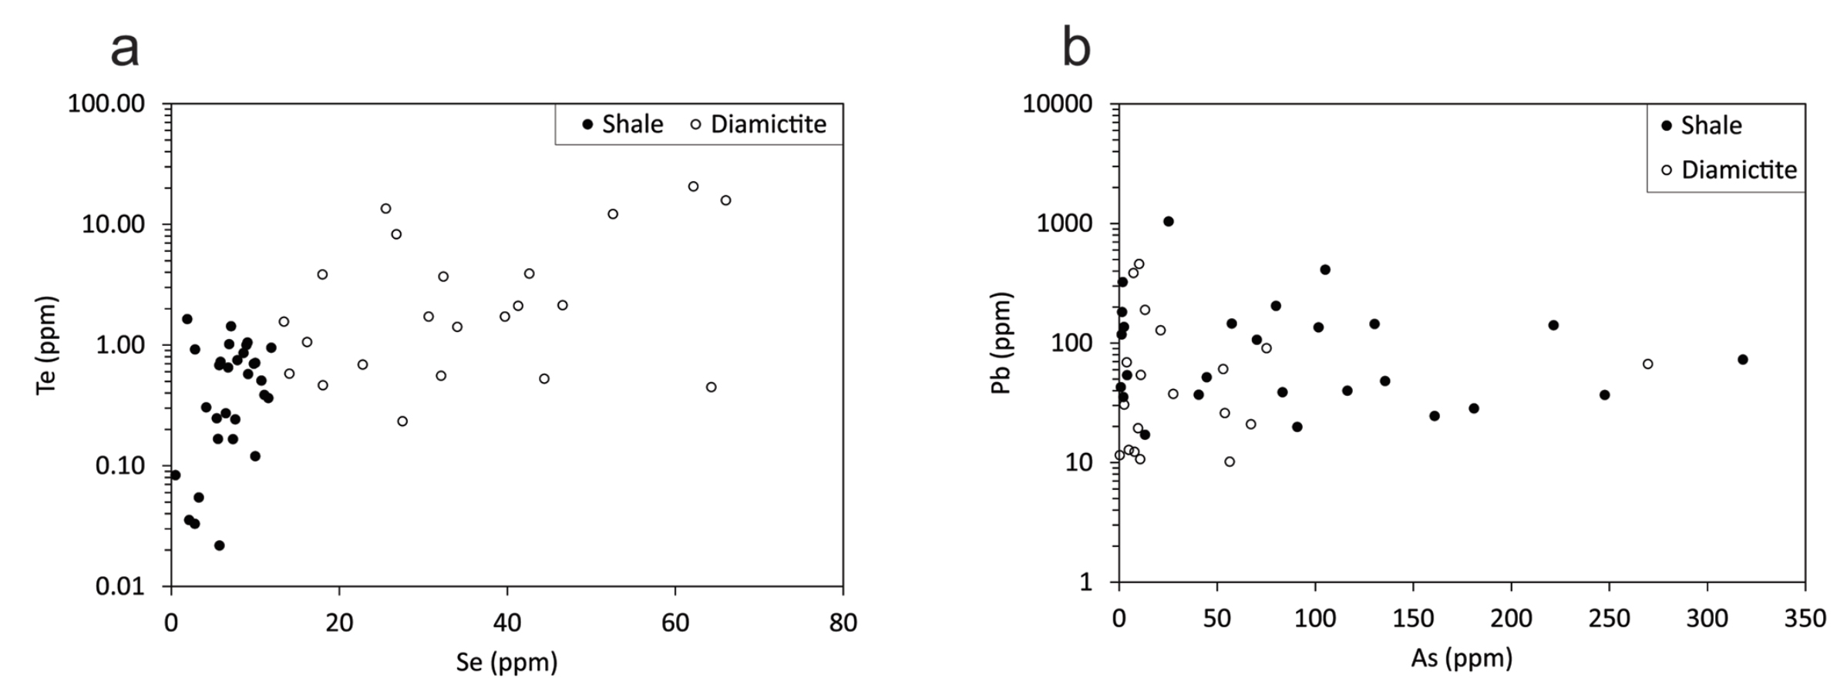
Parnell et al.
Geochemistry and metallogeny of Neoproterozoic pyrite in oxic and anoxic sediments
Figure 4 Cross-plots of (a) Te against Se contents, and (b) As and Pb contents in pyrite, measured by LA-ICP-MS. Highest concentrations of Te are in the diamictites. Arsenic contents are higher in the shales. Lead contents vary highly in both shales and diamictites, due to late addition by hydrothermal fluids.
© 2018 The Authors
Published by the European Association of Geochemistry
under Creative Commons License CC BY 4.0
Parnell et al. (2018) Geochem. Persp. Let. 7, 12-16 | doi: 10.7185/geochemlet.1812
Notes:
Figure 4 Cross-plots of (a) Te against Se contents, and (b) As and Pb contents in pyrite, measured by LA-ICP-MS. Highest concentrations of Te are in the diamictites. Arsenic contents are higher in the shales. Lead contents vary highly in both shales and diamictites, due to late addition by hydrothermal fluids.

