Slide 1
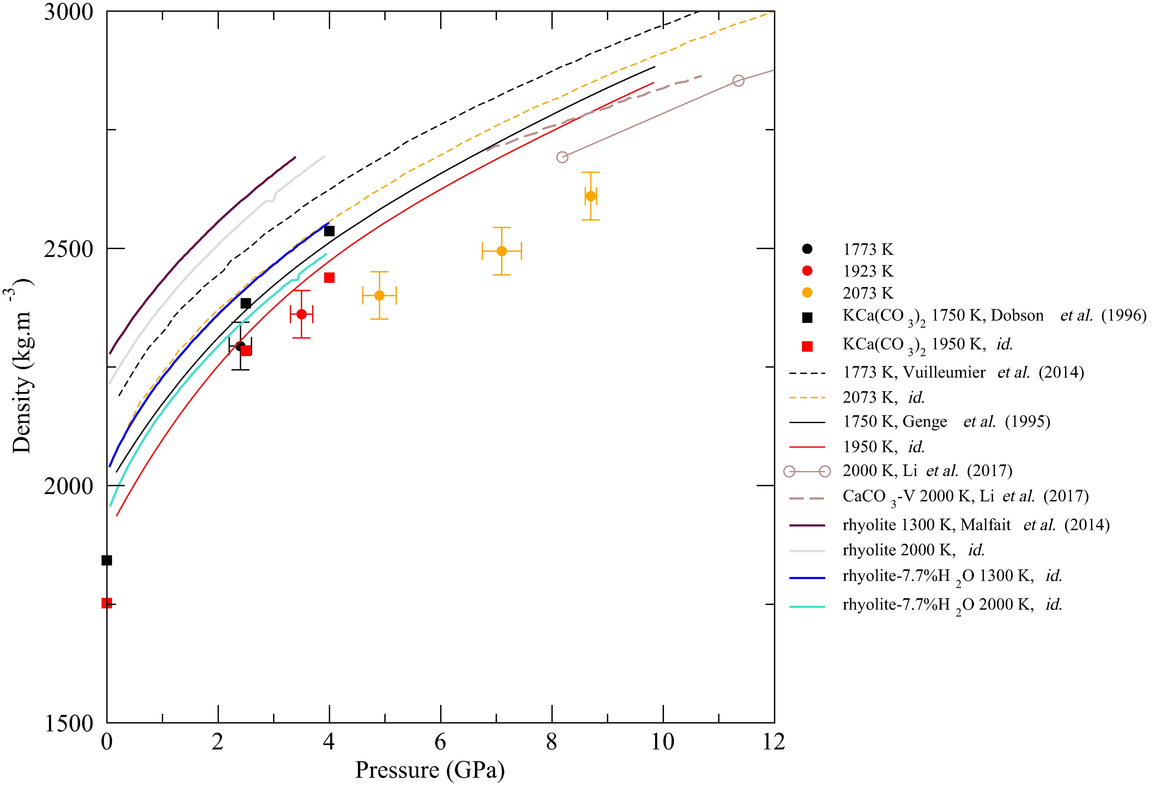
Hudspeth et al.
Properties of molten CaCO₃ at high pressure
Figure 2 Density of molten CaCO₃ from experiments (circles: this work, squares: Dobson et al., 1996) and theoretical calculations (Genge et al., 1995; Vuilleumier et al., 2014; Li et al., 2017), compared to the seismological PREM model (Dziewonski and Anderson, 1981), crystalline calcite V (Li et al., 2017), molten hydrous and dry rhyolite (Malfait et al., 2014), molten hydrous and dry basalt (Sakamaki et al., 2006).
© 2018 The Authors
Published by the European Association of Geochemistry
under Creative Commons License CC BY-NC-ND 4.0
Hudspeth et al. (2018) Geochem. Persp. Let. 7, 17-21 | doi: 10.7185/geochemlet.1813
Notes:
Figure 2 Density of molten CaCO₃ from experiments (circles: this work, squares: Dobson et al., 1996) and theoretical calculations (Genge et al., 1995; Vuilleumier et al., 2014; Li et al., 2017), compared to the seismological PREM model (Dziewonski and Anderson, 1981), crystalline calcite V (Li et al., 2017), molten hydrous and dry rhyolite (Malfait et al., 2014), molten hydrous and dry basalt (Sakamaki et al., 2006).

