Slide 1
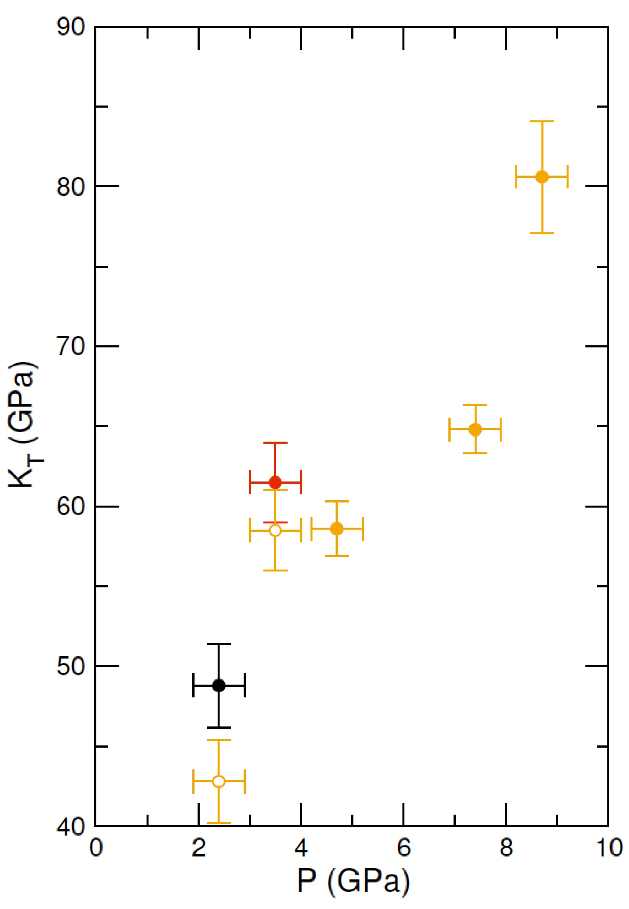
Hudspeth et al.
Properties of molten CaCO₃ at high pressure
Figure 3 Bulk modulus of molten CaCO₃ as a function of P (black: 1773 K, red: 1923 K, orange: 2073 K, orange empty circles: 1773 K and 1923 K data corrected for T = 2073 K).
© 2018 The Authors
Published by the European Association of Geochemistry
under Creative Commons License CC BY-NC-ND 4.0
Hudspeth et al. (2018) Geochem. Persp. Let. 7, 17-21 | doi: 10.7185/geochemlet.1813
Notes:
Figure 3 Bulk modulus of molten CaCO₃ as a function of P (black: 1773 K, red: 1923 K, orange: 2073 K, orange empty circles: 1773 K and 1923 K data corrected for T = 2073 K).

