Slide 1
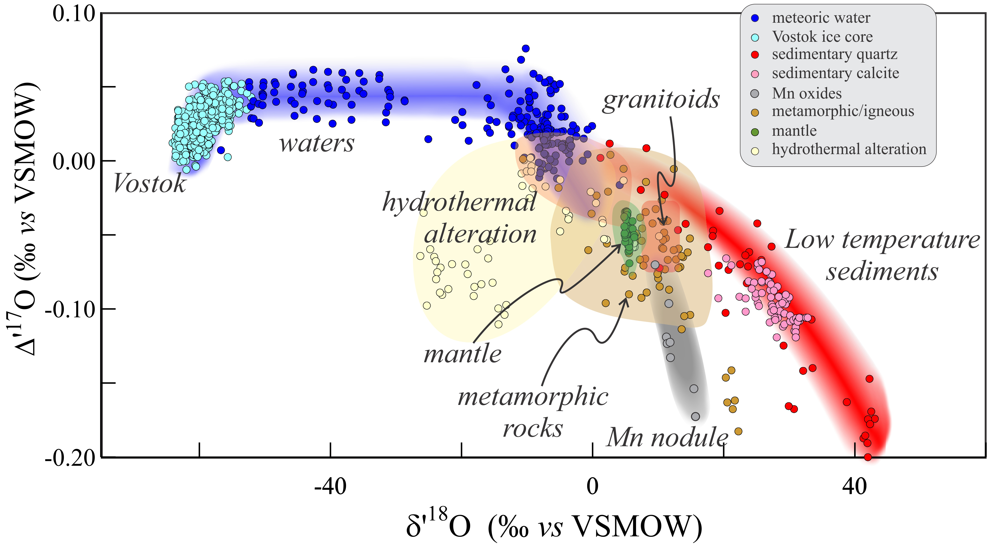
Sharp et al.
Mass-dependent triple oxygen isotope variations in terrestrial materials
Figure 1 Characteristic δ′¹⁸O – Δ′¹⁷O fields for different materials. Meteoric waters have uniquely high Δ′¹⁷O values and generally low δ′¹⁸O values. Marine carbonates and silica plot in a narrow band of high δ′¹⁸O and low Δ′¹⁷O values. Manganese oxides have unusually low Δ′¹⁷O values ...
.
© 2018 The Authors
Published by the European Association of Geochemistry
under Creative Commons License CC BY-NC-ND 4.0
Sharp et al. (2018) Geochem. Persp. Let. 7, 27-31 | doi: 10.7185/geochemlet.1815
Notes:
Figure 1 Characteristic δ′¹⁸O – Δ′¹⁷O fields for different materials. Meteoric waters have uniquely high Δ′¹⁷O values and generally low δ′¹⁸O values. Marine carbonates and silica plot in a narrow band of high δ′¹⁸O and low Δ′¹⁷O values. Manganese oxides have unusually low Δ′¹⁷O values due to incorporation of dissolved O₂. Hydrothermal alteration drives igneous and metamorphic rocks to lower δ′¹⁸O values. All data are standardised to VSMOW, where solid samples are normalised to Δ′¹⁷O of San Carlos olivine = -0.05 ‰. See Figure S-1 for data sources.

