Slide 1
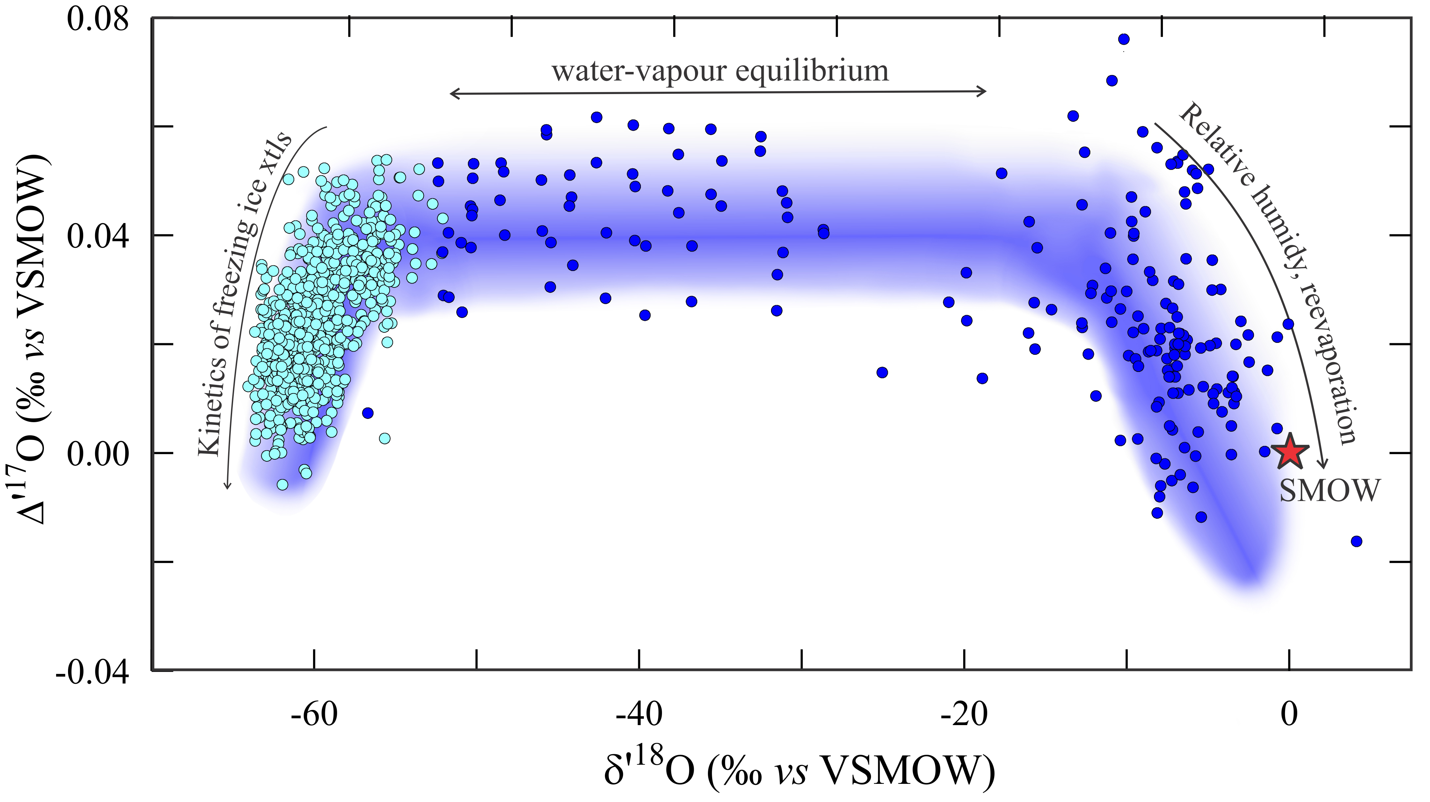
Sharp et al.
Mass-dependent triple oxygen isotope variations in terrestrial materials
Figure 2 δ′¹⁸O – Δ′¹⁷O values of meteoric waters. Waters can be divided into three segments: extreme low values with a λ of 0.5309 (Vostok ice core – pale blue symbols); light waters with δ′¹⁸O values between -60 and -30 ‰ from high latitudes and a λ of 0.528; and heavier waters (>-20 ‰) with a best fit λ of 0.5263.
.
© 2018 The Authors
Published by the European Association of Geochemistry
under Creative Commons License CC BY-NC-ND 4.0
Sharp et al. (2018) Geochem. Persp. Let. 7, 27-31 | doi: 10.7185/geochemlet.1815
Notes:
Figure 2 δ′¹⁸O – Δ′¹⁷O values of meteoric waters. Waters can be divided into three segments: extreme low values with a λ of 0.5309 (Vostok ice core – pale blue symbols); light waters with δ′¹⁸O values between -60 and -30 ‰ from high latitudes and a λ of 0.528; and heavier waters (>-20 ‰) with a best fit λ of 0.5263.

