Slide 1
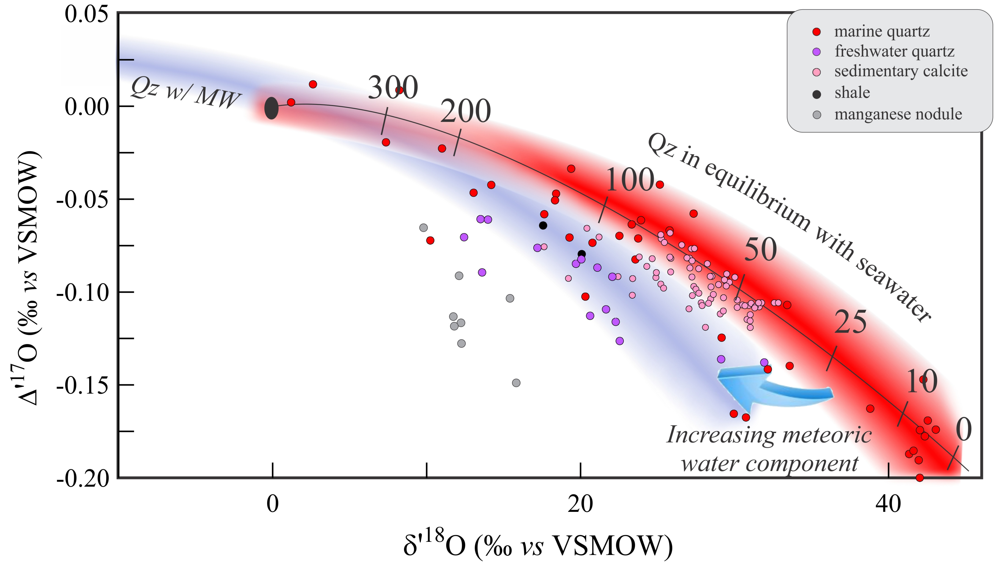
Sharp et al.
Mass-dependent triple oxygen isotope variations in terrestrial materials
Figure 3 δ′¹⁸O – Δ′¹⁷O plot of sedimentary materials. The red silica samples equilibrated with ocean water plot along the equilibrium fractionation curved line (Sharp et al., 2016) (tick marks indicate equilibrium temperature). Samples equilibrated with meteoric water plot to the left of the marine data….
© 2018 The Authors
Published by the European Association of Geochemistry
under Creative Commons License CC BY-NC-ND 4.0
Sharp et al. (2018) Geochem. Persp. Let. 7, 27-31 | doi: 10.7185/geochemlet.1815
Notes:
Figure 3 δ′¹⁸O – Δ′¹⁷O plot of sedimentary materials. The red silica samples equilibrated with ocean water plot along the equilibrium fractionation curved line (Sharp et al., 2016) (tick marks indicate equilibrium temperature). Samples equilibrated with meteoric water plot to the left of the marine data, consistent with a lower δ′¹⁸O and higher Δ′¹⁷O water value. Manganese oxide data plot with anomalously low Δ′¹⁷O values, suggestive of incorporation of dissolved O₂ (Mandernack et al., 1995).

