Slide 1
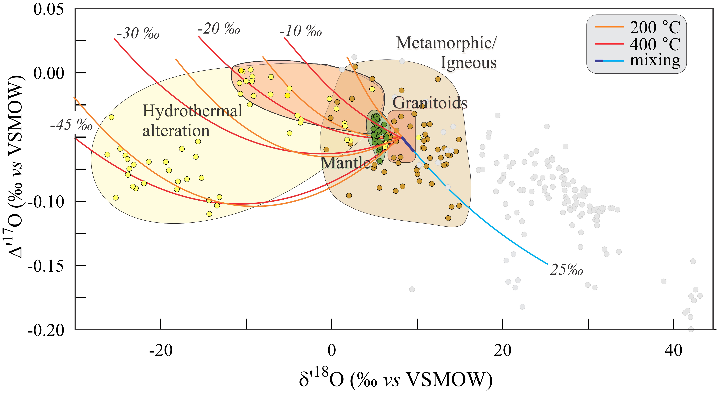
Sharp et al.
Mass-dependent triple oxygen isotope variations in terrestrial materials
Figure 4 δ′¹⁸O – Δ′¹⁷O values of hydrothermally altered samples (pale yellow field). Calculated alteration paths are shown for a typical granite (δ′¹⁸O = 8.5 ‰, Δ′¹⁷O = -0.05) equilibrating with different compositions of meteoric water at 200 °C (orange) and 400 °C (red). The curved line defines…
© 2018 The Authors
Published by the European Association of Geochemistry
under Creative Commons License CC BY-NC-ND 4.0
Sharp et al. (2018) Geochem. Persp. Let. 7, 27-31 | doi: 10.7185/geochemlet.1815
Notes:
Figure 4 δ′¹⁸O – Δ′¹⁷O values of hydrothermally altered samples (pale yellow field). Calculated alteration paths are shown for a typical granite (δ′¹⁸O = 8.5 ‰, Δ′¹⁷O = -0.05) equilibrating with different compositions of meteoric water at 200 °C (orange) and 400 °C (red). The curved line defines different fluid/rock ratios emanating from the initial rock isotope value (F/R = 0). At low fluid/rock ratios, δ′¹⁸O values decrease while Δ′¹⁷O values are essentially unchanged. Only above a fluid/rock ratio of ~1 does the Δ′¹⁷O value begin to increase. Most alteration will drive typical granitoids into the limited pale red region. Assimilation of sediments will drive samples in the direction indicated by the blue curve. However, even with 10 % assimilation, the samples will only be shifted the length of the dark blue curve.

