Slide 1
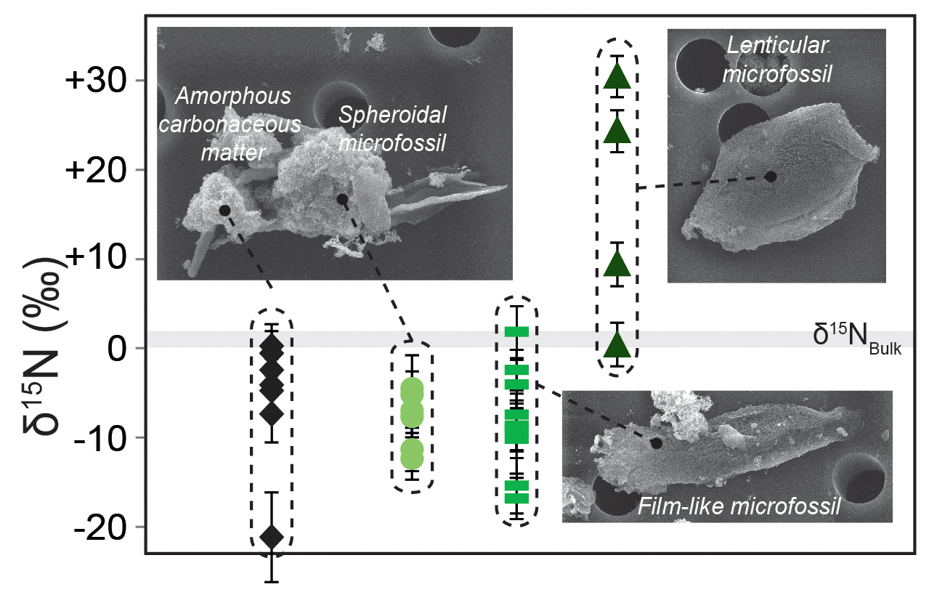
Delarue et al.
Nitrogen isotope signatures of microfossils suggest aerobic metabolism 3.0 Gyr ago
Figure 1 Nitrogen isotopic composition of amorphous carbonaceous matter, and of spheroidal, film-like and lenticular-like microfossils from the 3.0 Ga Farrel Quartzite formation. δ¹⁵N_{Bulk} values are provided for comparison with δ¹⁵N_{µm} values.
© 2018 The Authors
Published by the European Association of Geochemistry
under Creative Commons License CC BY-NC-ND 4.0
Delarue et al. (2018) Geochem. Persp. Let. 7, 32-36 | doi: 10.7185/geochemlet.1816
Notes:
Figure 1 Nitrogen isotopic composition of amorphous carbonaceous matter, and of spheroidal, film-like and lenticular-like microfossils from the 3.0 Ga Farrel Quartzite formation. δ¹⁵N_{Bulk} values are provided for comparison with δ¹⁵N_{µm} values.

