Slide 1
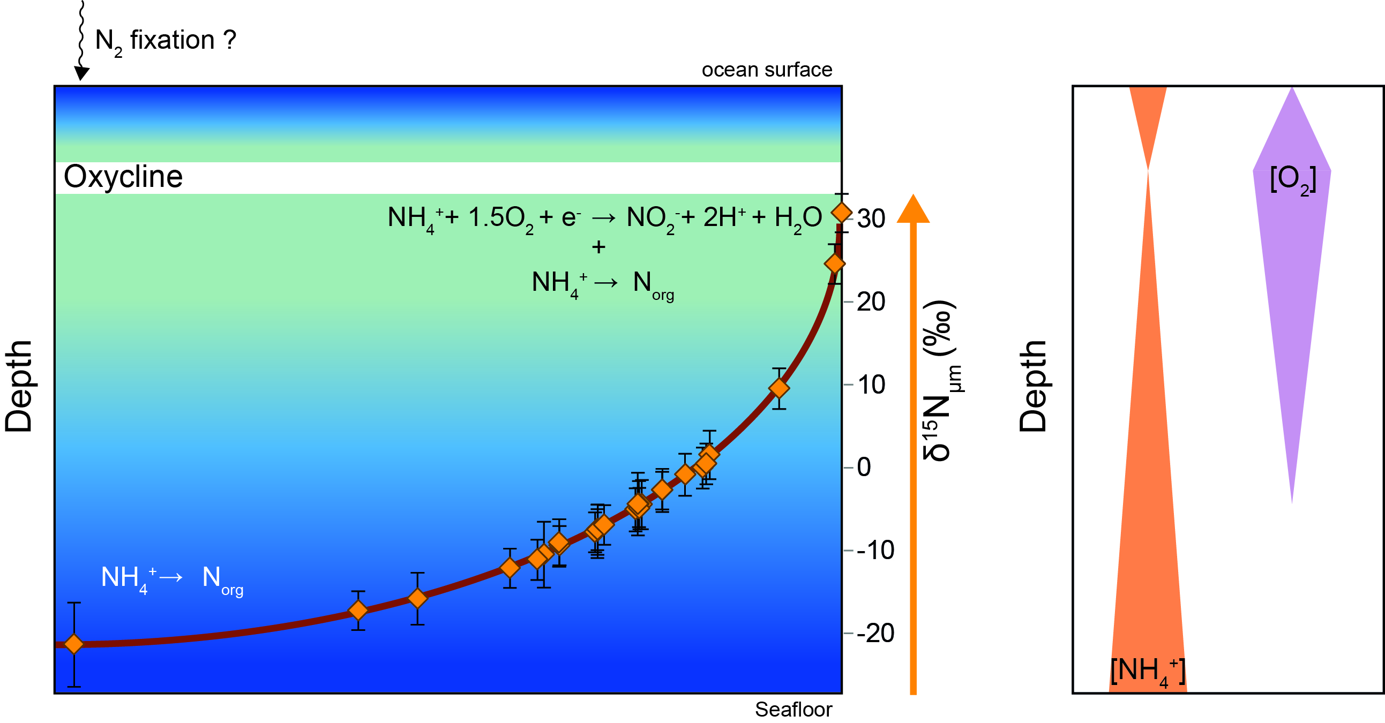
Delarue et al.
Nitrogen isotope signatures of microfossils suggest aerobic metabolism 3.0 Gyr ago
Figure 2 Cartoon illustrating the sedimentary conditions of the Farrel Quartzite formation. The blue gradient in the water column indicates change in NH₄⁺ concentration from high (dark) to low (light) concentrations in anoxic zones. δ¹⁵N_{µm} values determined at...
© 2018 The Authors
Published by the European Association of Geochemistry
under Creative Commons License CC BY-NC-ND 4.0
Delarue et al. (2018) Geochem. Persp. Let. 7, 32-36 | doi: 10.7185/geochemlet.1816
Notes:
Figure 2 Cartoon illustrating the sedimentary conditions of the Farrel Quartzite formation. The blue gradient in the water column indicates change in NH₄⁺ concentration from high (dark) to low (light) concentrations in anoxic zones. δ¹⁵N_{µm} values determined at the scale of individual microfossil and organic particle are represented by orange diamonds. In the proposed model, negative δ¹⁵N_{µm} values reflect assimilation of NH₄⁺ from benthic efflux whereas positive δ¹⁵N_{µm} values reflect ¹⁵N Rayleigh distillation of NH₄⁺ upward through ammonia oxidation when NH₄⁺ concentrations were too low to allow the isotopic fractionation of ammonia assimilation to be expressed (see main text).

