Slide 1
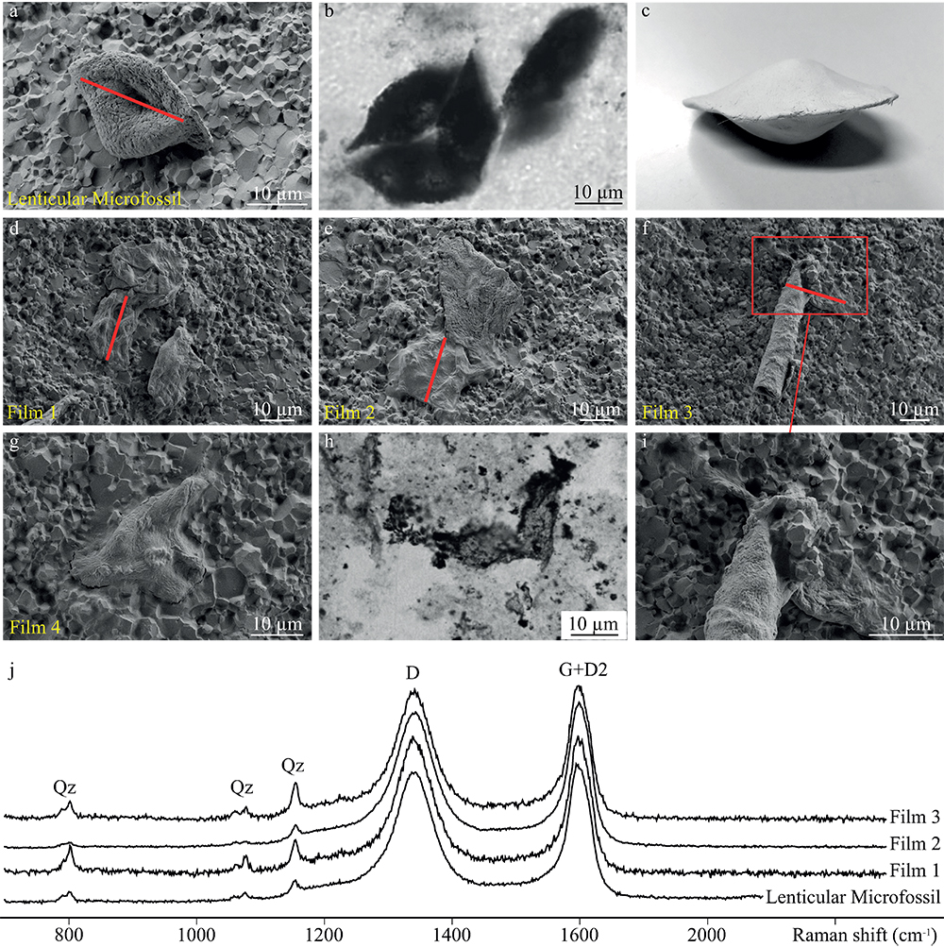
Alleon et al.
Chemical nature of the 3.4 Ga Strelley Pool microfossils
Figure 1 Optical photomicrographs, SEM images and Raman spectra of the 3.4 Ga Strelley Pool organic microfossils observed on a freshly fractured chert fragment. (a) SEM image of a lenticular Strelley Pool microfossil, (b) optical photomicrograph of Strelley Pool lenticular microfossils (Sugitani et al., 2013)…
© 2018 The Authors
Published by the European Association of Geochemistry
under Creative Commons License CC BY 4.0
Alleon et al. (2018) Geochem. Persp. Let. 7, 37-42 | doi: 10.7185/geochemlet.1817
Notes:
Figure 1 Optical photomicrographs, SEM images and Raman spectra of the 3.4 Ga Strelley Pool organic microfossils observed on a freshly fractured chert fragment. (a) SEM image of a lenticular Strelley Pool microfossil, (b) optical photomicrograph of Strelley Pool lenticular microfossils (Sugitani et al., 2013) and (c) model morphological reconstruction in clay. (d–g) SEM images of Strelley Pool film-like microfossils, (h) optical photomicrograph of a film-like Strelley Pool microfossil (Sugitani et al., 2013) and (i) an enlargement of the film-like microfossil shown in f that looks like a tubular structure. Red lines indicate where the FIB sections were extracted for TEM and STXM analyses (Film 1–4). (j) Raman spectra of the Strelley Pool organic microfossils These spectra are typical of disordered carbon having experienced 300 °C, with the D and composite G + D2 bands displaying similar intensities. Qz corresponds to quartz.

