Slide 1
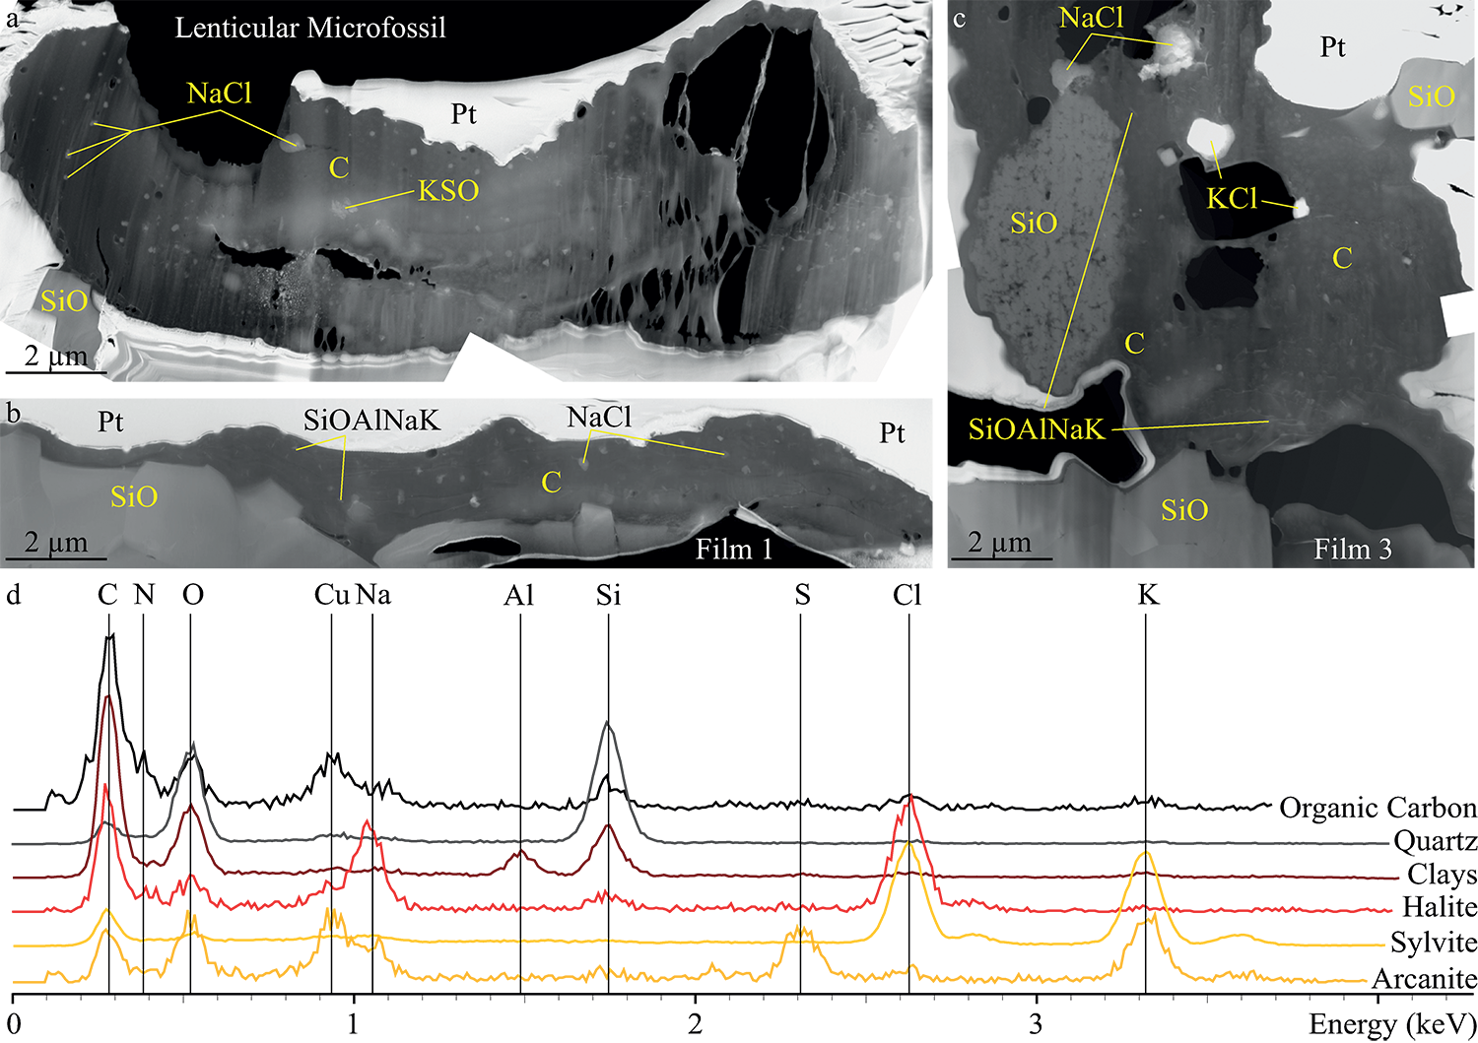
Alleon et al.
Chemical nature of the 3.4 Ga Strelley Pool microfossils
Figure 2 TEM analyses of the Strelley Pool organic microfossils. STEM image of the lenticular microfossil (a) shown in Figure 1a and of the two film-like microfossils (b–c) shown in Figure 1d and 1f, respectively. Organic carbon (which appears darker than mineral phases) is closely associated with micro-quartz, clays and crystals of chlorides and…
© 2018 The Authors
Published by the European Association of Geochemistry
under Creative Commons License CC BY 4.0
Alleon et al. (2018) Geochem. Persp. Let. 7, 37-42 | doi: 10.7185/geochemlet.1817
Notes:
Figure 2 TEM analyses of the Strelley Pool organic microfossils. STEM image of the lenticular microfossil (a) shown in Figure 1a and of the two film-like microfossils (b–c) shown in Figure 1d and 1f, respectively. Organic carbon (which appears darker than mineral phases) is closely associated with micro-quartz, clays and crystals of chlorides and sulphates. The main chemical elements are indicated. (d) TEM-EDX spectra of the organic microfossils and the associated mineral phases.

