Slide 1
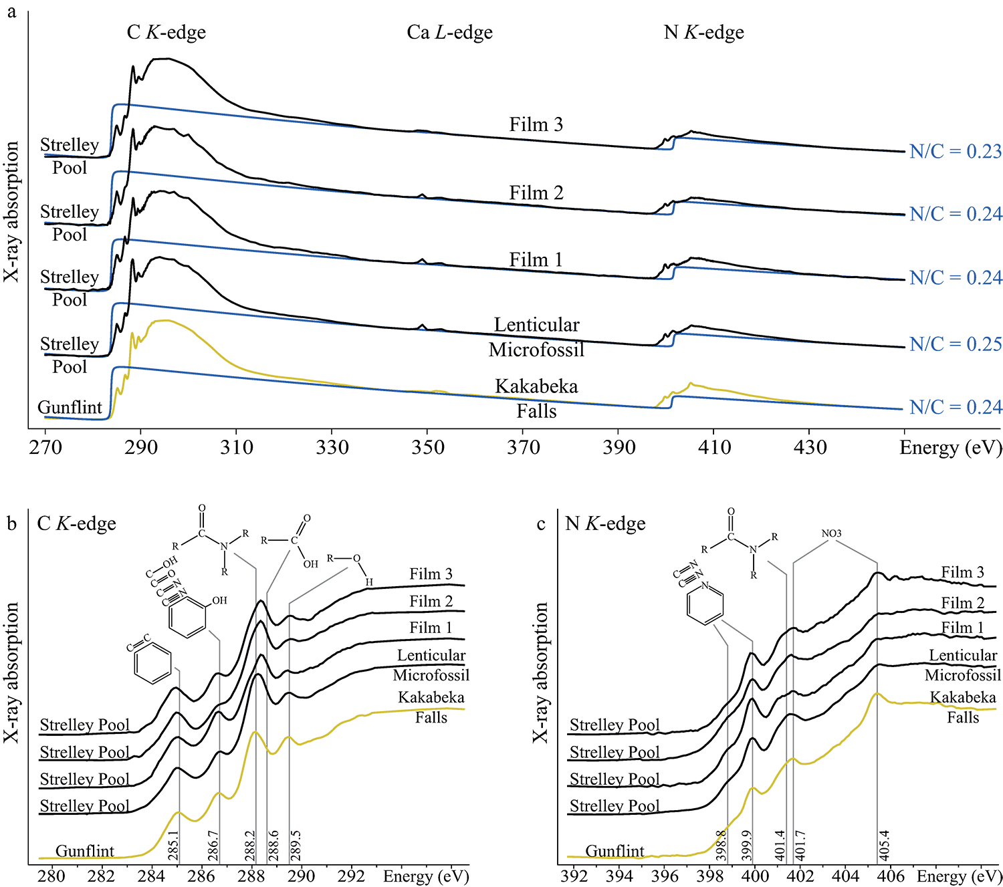
Alleon et al.
Chemical nature of the 3.4 Ga Strelley Pool microfossils
Figure 3 X-ray absorption analyses of the Strelley Pool organic microfossils shown in Figures 1 and 2 and corresponding N/C values. (a) X-ray absorption near edge structure (XANES) spectra at the carbon K-edge and (b) nitrogen K-edge. (c) Diagnostic absorption…
© 2018 The Authors
Published by the European Association of Geochemistry
under Creative Commons License CC BY 4.0
Alleon et al. (2018) Geochem. Persp. Let. 7, 37-42 | doi: 10.7185/geochemlet.1817
Notes:
Figure 3 X-ray absorption analyses of the Strelley Pool organic microfossils shown in Figures 1 and 2 and corresponding N/C values. (a) X-ray absorption near edge structure (XANES) spectra at the carbon K-edge and (b) nitrogen K-edge. (c) Diagnostic absorption features include: 285.1 eV for aromatic/olefinic groups, 286.7 eV for imine/nitrile/carbonyl/phenol groups, 288.2 eV for amide groups, 288.6 eV for carboxyl/ester/acetal groups, 289.4 eV for hydroxyl groups, 398.8–399.9 eV - imine/nitrile/aromatic groups, 401.4 eV for amide groups, 401.7 and 405.4 eV for potassium and/or calcium nitrates. A spectrum of a 1.9 Ga Gunflint microfossil (Alleon et al., 2016a) is shown for comparison.

