Slide 1
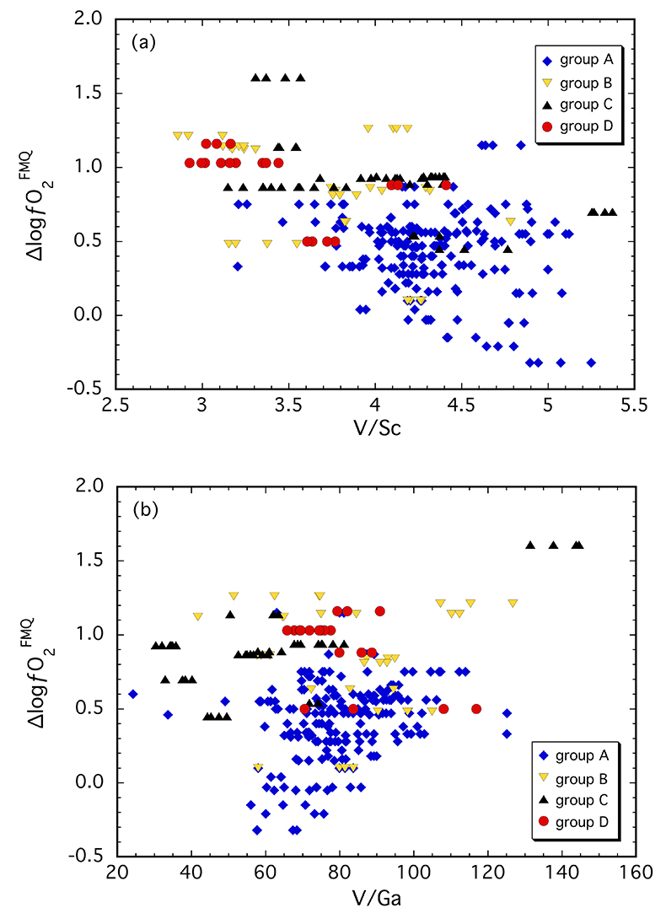
Woodland et al.
Influence of metasomatism on vanadium-based redox proxies for mantle peridotite
Figure 2 (a) V/Sc and (b) V/Ga of clinopyroxene plotted as a function of ∆logƒO₂ determined by spinel-based Fe³⁺-Fe²⁺ oxybarometry (see Supplementary Information).
© 2018 The Authors
Published by the European Association of Geochemistry
under Creative Commons License CC BY 4.0
Woodland et al. (2018) Geochem. Persp. Let. 8, 11-16 | doi: 10.7185/geochemlet.1822
Notes:
Figure 2 (a) V/Sc and (b) V/Ga of clinopyroxene plotted as a function of ∆logƒO₂ determined by spinel-based Fe³⁺-Fe²⁺ oxybarometry (see Supplementary Information).

