Slide 1
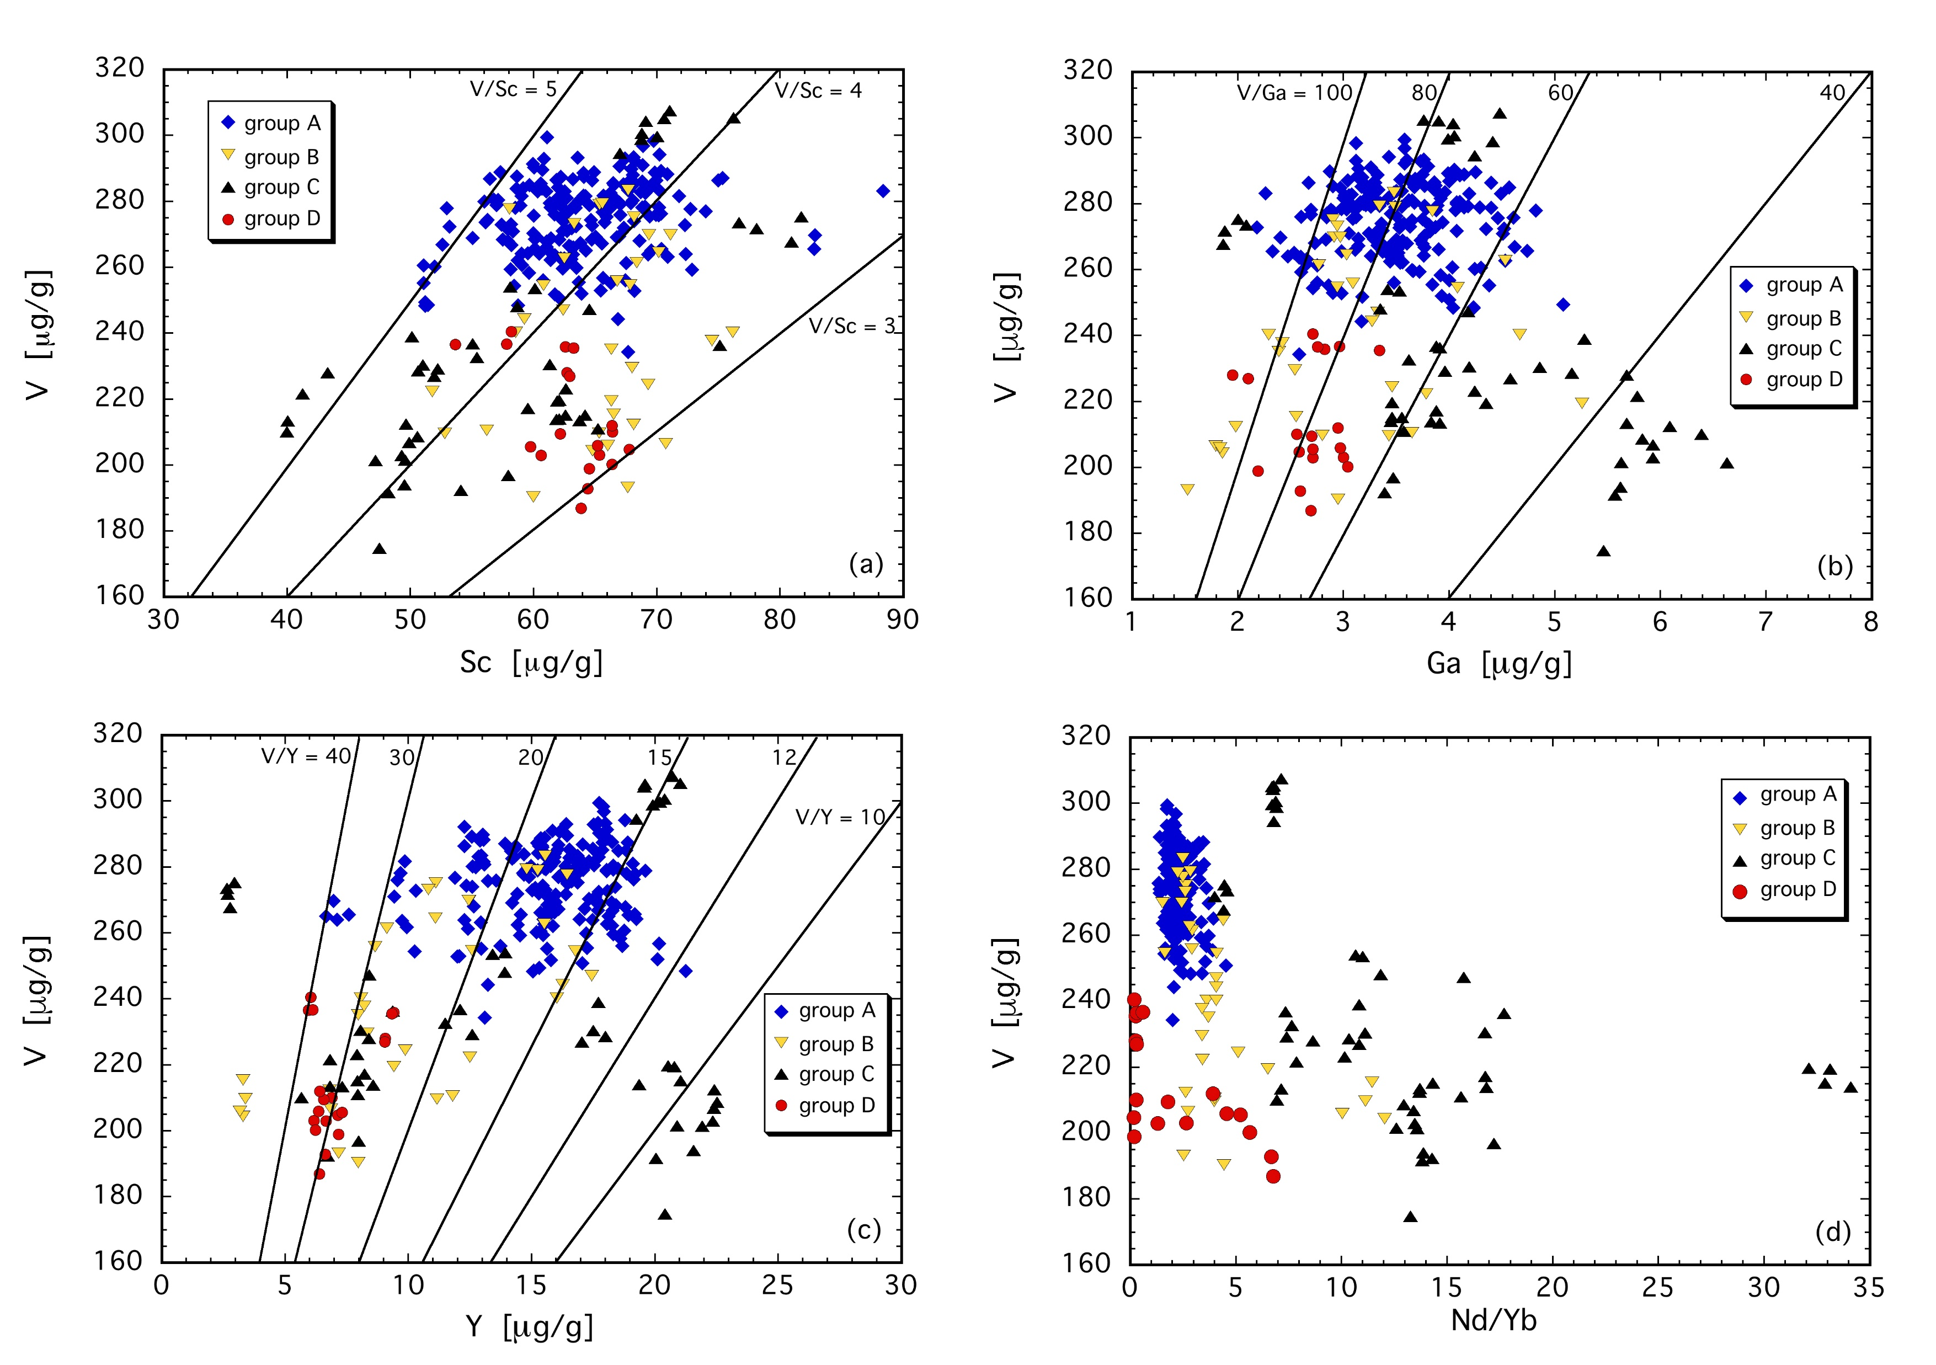
Woodland et al.
Influence of metasomatism on vanadium-based redox proxies for mantle peridotite
Figure 3 V concentration in different types of clinopyroxene plotted against their corresponding (a) Sc, (b) Ga and (c) Y contents, as well as (d) their Nd/Yb ratio.
© 2018 The Authors
Published by the European Association of Geochemistry
under Creative Commons License CC BY 4.0
Woodland et al. (2018) Geochem. Persp. Let. 8, 11-16 | doi: 10.7185/geochemlet.1822
Notes:
Figure 3 V concentration in different types of clinopyroxene plotted against their corresponding (a) Sc, (b) Ga and (c) Y contents, as well as (d) their Nd/Yb ratio.

