Slide 1
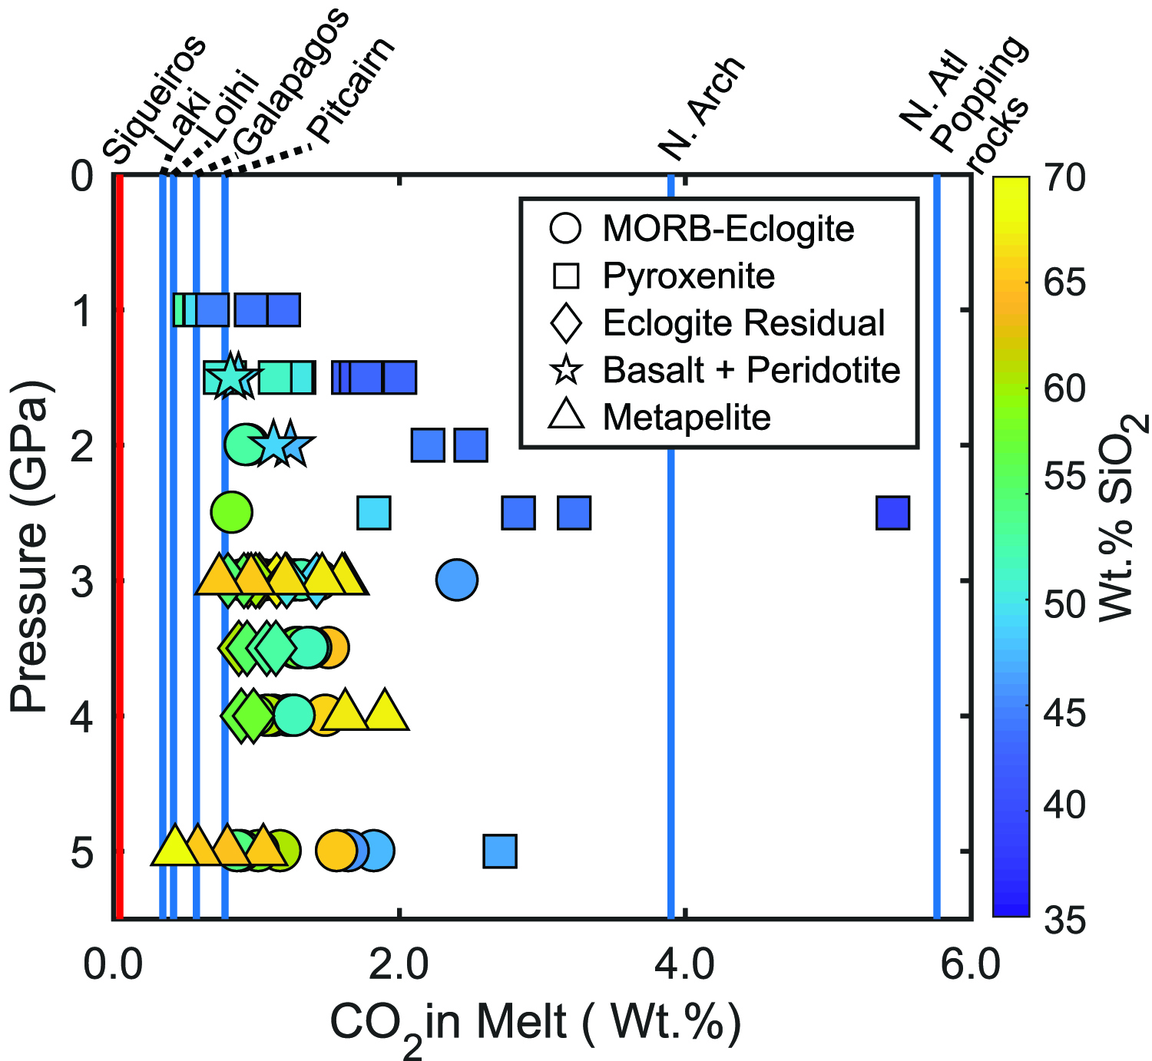
Eguchi and Dasgupta
Redox state of the convective mantle from CO₂-trace element systematics of oceanic basalts
Figure 2 CO₂ concentrations calculated at the CCO buffer for each experiment in Figure 1. Vertical blue lines are highest CO₂ concentrations measured in natural oceanic basalts from different locations (Table S-2) that are thought to receive contributions from subducted lithologies. Red band is for CO₂ contents…
© 2018 The Authors
Published by the European Association of Geochemistry
under Creative Commons License CC BY-NC-ND 4.0
Eguchi and Dasgupta (2018) Geochem. Persp. Let. 8, 17-21 | doi: 10.7185/geochemlet.1823
Notes:
Figure 2 CO₂ concentrations calculated at the CCO buffer for each experiment in Figure 1. Vertical blue lines are highest CO₂ concentrations measured in natural oceanic basalts from different locations (Table S-2) that are thought to receive contributions from subducted lithologies. Red band is for CO₂ contents expected in depleted peridotite-derived partial melts based on undegassed melt inclusions from Siqueiros (Saal et al., 2002) and calculations using an experimental bulk partition coefficient for CO₂ and source CO₂ estimate of ~75 ppm at F = 10 % (Rosenthal et al., 2015).

