Slide 1
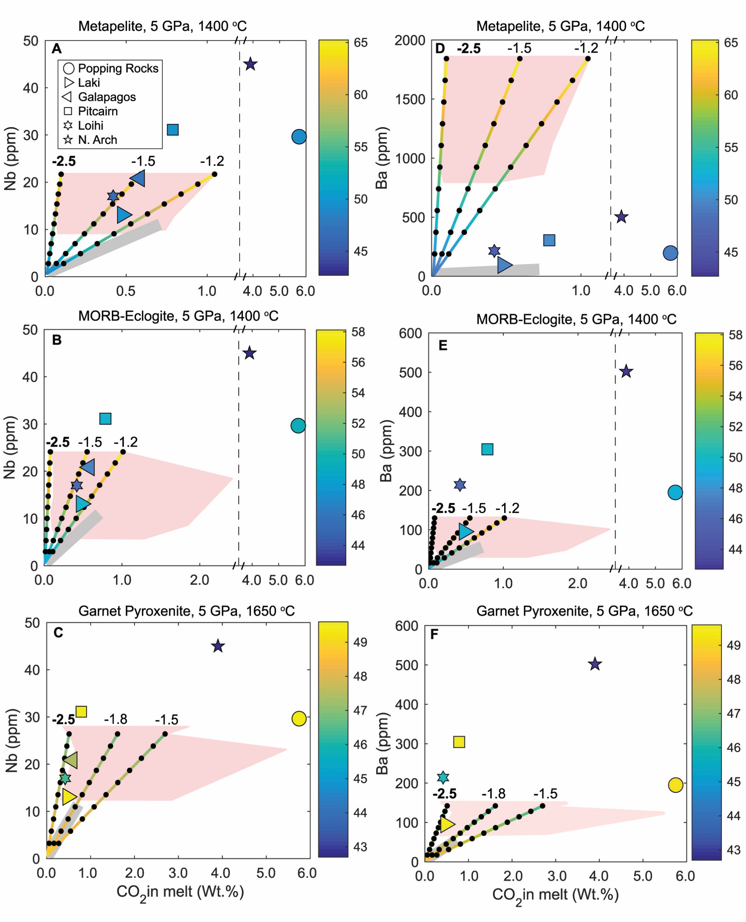
Eguchi and Dasgupta
Redox state of the convective mantle from CO₂-trace element systematics of oceanic basalts
Figure 3 CO₂-Nb and CO₂-Ba mixing lines between depleted peridotite melts and graphite-saturated melts of subducted lithologies. Mixing lines are calculated at different logfO₂s relative to FMQ up to the CCO buffer as denoted by numbers above mixing line (the average fO₂ of eclogites based on CLM xenoliths at this pressure is marked with bold text). Each marker along a …
© 2018 The Authors
Published by the European Association of Geochemistry
under Creative Commons License CC BY-NC-ND 4.0
Eguchi and Dasgupta (2018) Geochem. Persp. Let. 8, 17-21 | doi: 10.7185/geochemlet.1823
Notes:
Figure 3 CO₂-Nb and CO₂-Ba mixing lines between depleted peridotite melts and graphite-saturated melts of subducted lithologies. Mixing lines are calculated at different logfO₂s relative to FMQ up to the CCO buffer as denoted by numbers above mixing line (the average fO₂ of eclogites based on CLM xenoliths at this pressure is marked with bold text). Each marker along a mixing line represents 10 wt. % incremental contribution from subducted lithology partial melt. Data points are the CO₂-Nb/CO₂-Ba concentrations recorded in the least degassed natural basalts at each location. Data point and mixings lines coloured for melt SiO₂ (wt. %) contents. Pink shaded region shows CO₂-Nb-Ba contents at graphite-saturation from CCO to FMQ-2.5 for all relevant experimental partial melts for a particular lithology from Figure 1. Gray band shows CO₂-Nb-Ba calculations for a depleted peridotite from 1-10 % melting degree (see also Fig. S-1). Data for generation of Figure 3 given in Supplementary Information.

