Slide 1
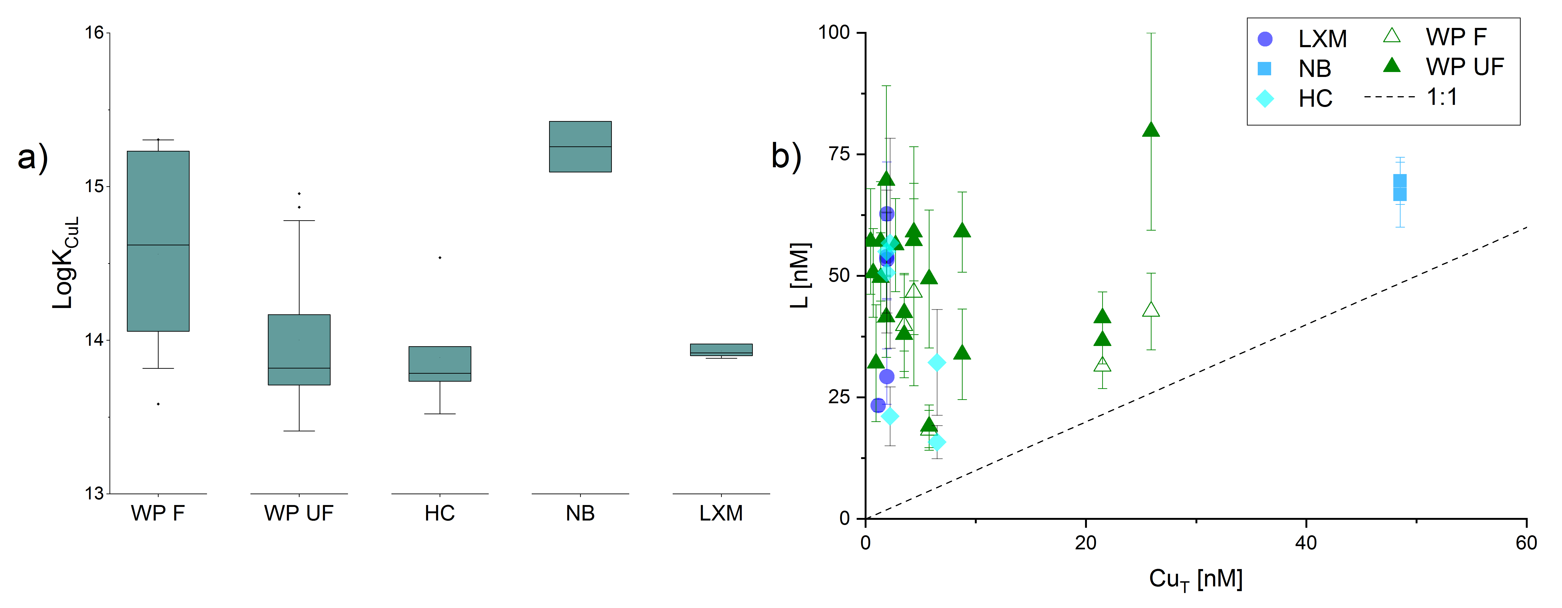
Hartland and Zitoun
Transition metal availability to speleothems controlled by organic binding ligands
Figure 1 (a) Box plots of conditional stability constants (logK_{CuL}) of CuL complexes in cave samples. Values calculated using ProMCC (Omanović et al., 2015). Error bars are 1 standard deviation. (b) Correlation between the total Cu concentration ([Cu_{T}]) and corresponding Cu ligand concentration. For all samples which plot above the 1:1 dashed diagonal line, one can assume that all available Cu is strongly complexed to organic ligands…
© 2018 The Authors
Published by the European Association of Geochemistry
under Creative Commons License CC BY-NC-ND 4.0
Hartland and Zitoun (2018) Geochem. Persp. Let. 8, 22-25 | doi: 10.7185/geochemlet.1824
Notes:
Figure 1 (a) Box plots of conditional stability constants (logK_{CuL}) of CuL complexes in cave samples. Values calculated using ProMCC (Omanović et al., 2015). Error bars are 1 standard deviation. (b) Correlation between the total Cu concentration ([Cu_{T}]) and corresponding Cu ligand concentration. For all samples which plot above the 1:1 dashed diagonal line, one can assume that all available Cu is strongly complexed to organic ligands. Vertical error bars represent the fitting error in [L₁]. WP = Waipuna Cave (n = 24), F = filtered, UF = unfiltered; HC = Hodges Creek Cave (n = 6); NB = Nettlebed Cave (n = 2); LXM = Mt Luxmore Caves; Daves Cave (n = 3) and Calcite Cave (n = 2).

