Slide 1
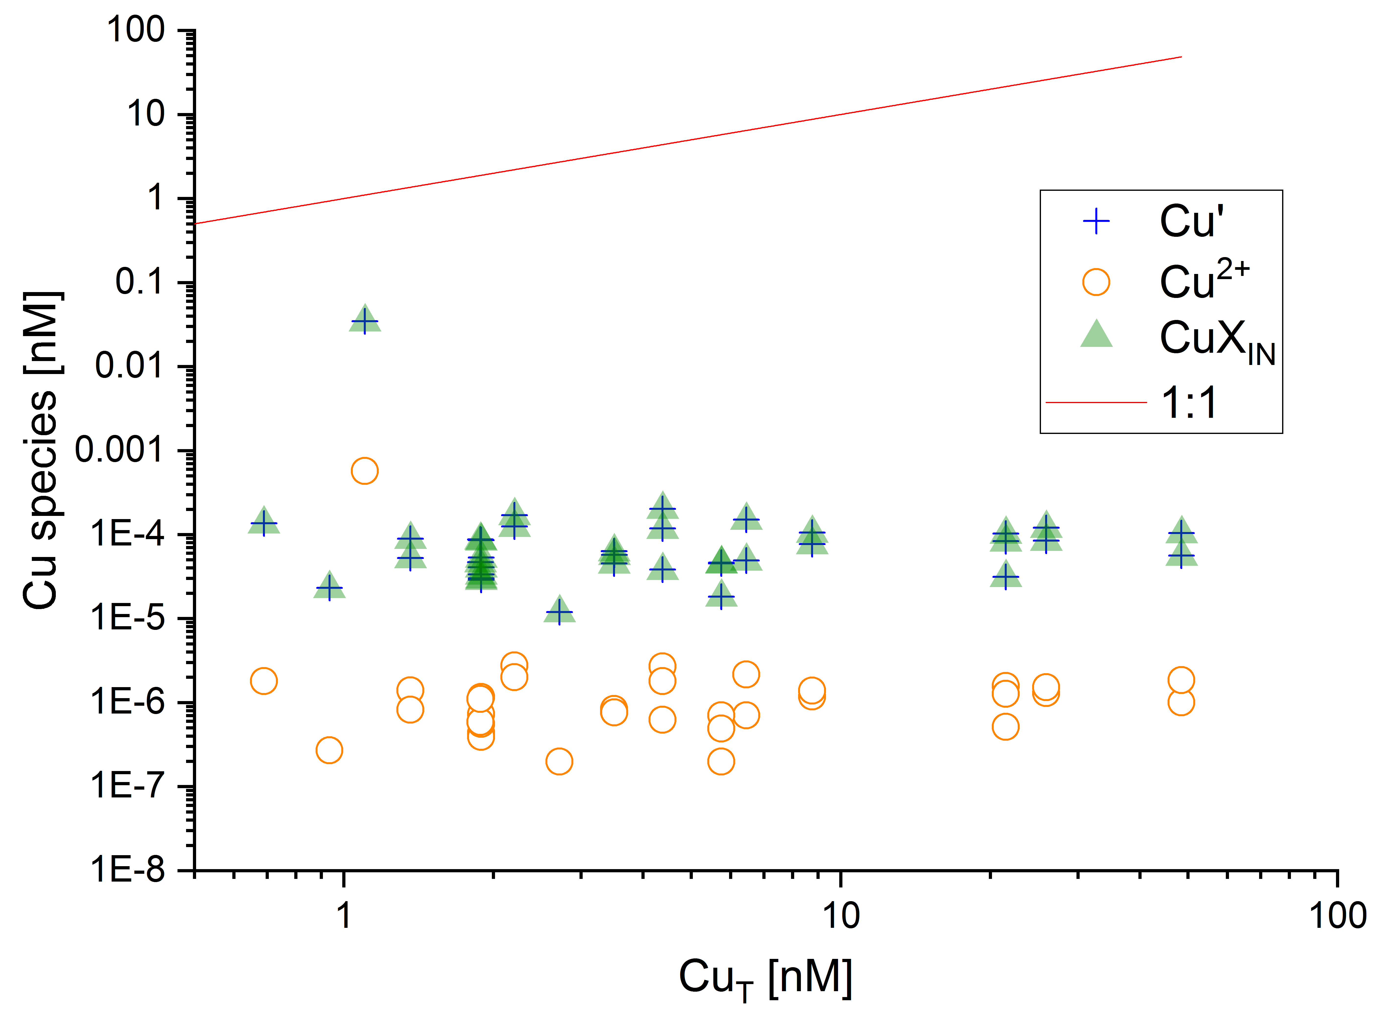
Hartland and Zitoun
Transition metal availability to speleothems controlled by organic binding ligands
Figure 2 Available (Cu’), inorganic (CuX_{IN}) and free (Cu²⁺) copper concentrations plotted against [Cu_{T}] in cave samples calculated using ProMCC (Omanović et al., 2015). [Cu’] are consistently low despite widely varying [Cu_{T}] demonstrating the dominant influence of organic ligands in these samples.
© 2018 The Authors
Published by the European Association of Geochemistry
under Creative Commons License CC BY-NC-ND 4.0
Hartland and Zitoun (2018) Geochem. Persp. Let. 8, 22-25 | doi: 10.7185/geochemlet.1824
Notes:
Figure 2 Available (Cu’), inorganic (CuX_{IN}) and free (Cu²⁺) copper concentrations plotted against [Cu_{T}] in cave samples calculated using ProMCC (Omanović et al., 2015). [Cu’] are consistently low despite widely varying [Cu_{T}] demonstrating the dominant influence of organic ligands in these samples.

