Slide 1
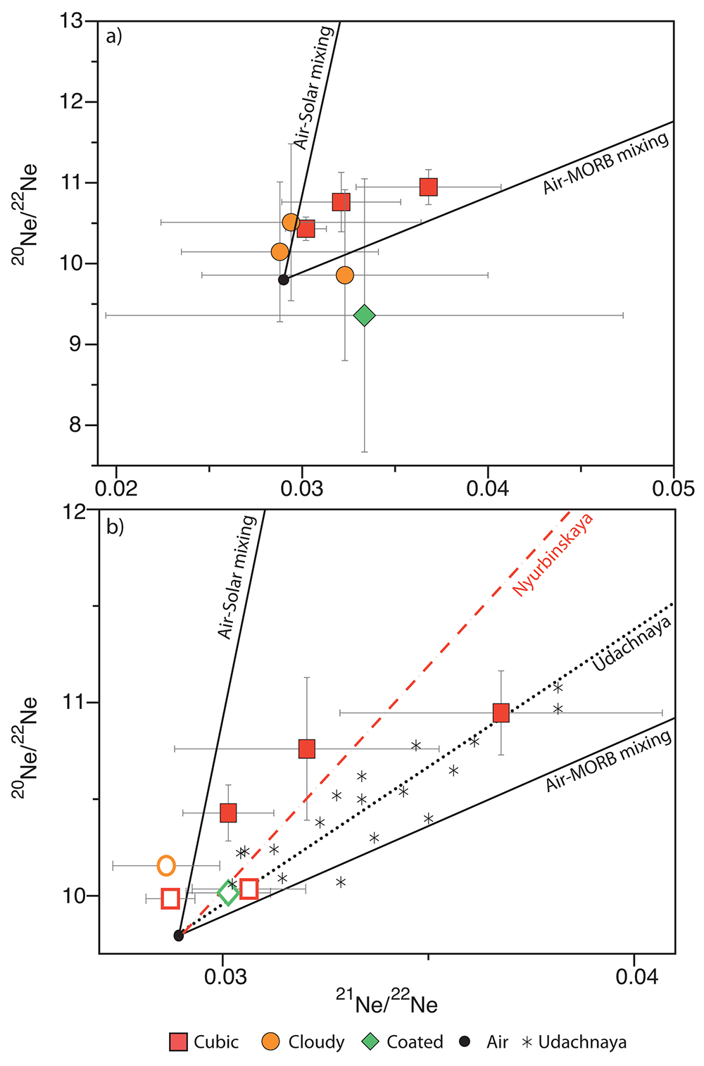
Broadley et al.
Plume-lithosphere interaction, and the formation of fibrous diamonds
Figure 3 (a) Neon three-isotope plot for crushing of Nyurbinskaya diamonds. (b) Zoomed in section showing data from laser extraction (open symbols) plus the crushing data from the cubic diamonds. Diamonds show excess in ²⁰Ne/²²Ne and ²¹Ne/²²Ne relative to air and plot intermediate…
© 2018 The Authors
Published by the European Association of Geochemistry
under Creative Commons License CC BY-NC-ND 4.0
Broadley et al. (2018) Geochem. Persp. Let. 8, 26-30 | doi: 10.7185/geochemlet.1825
Notes:
Figure 3 (a) Neon three-isotope plot for crushing of Nyurbinskaya diamonds. (b) Zoomed in section showing data from laser extraction (open symbols) plus the crushing data from the cubic diamonds. Diamonds show excess in ²⁰Ne/²²Ne and ²¹Ne/²²Ne relative to air and plot intermediate between the MORB-Air mixing line and the Solar-Air mixing line. Dashed red line is a regression line fitted through all the Nyurbinskaya diamond data and forced through the atmospheric values. Dashed black line is the trend for Udachnaya olivine xenocrysts (Sumino et al., 2006). Uncertainties are 1σ.

