Slide 1
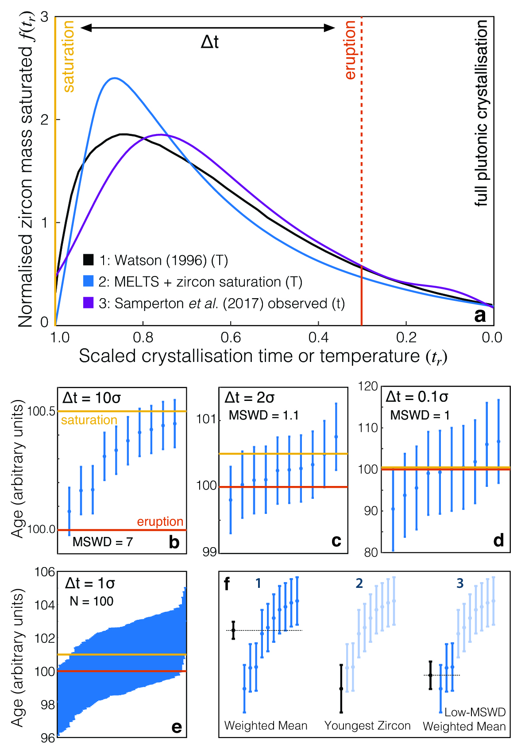
Keller et al.
A stochastic sampling approach to zircon eruption age interpretation
Figure 1 Zircon distributions. (a) Theoretical and empirical relative zircon crystallisation distributions f(t_{r}), scaled from initiation to termination of zircon crystallisation. 1: Kinetic model of Watson (1996), based on zirconium diffusion constraints. 2: Thermodynamic model of Keller et al. (2017) using MELTS calculations. 3: Observed zircon crystallisation distributions of Samperton et al. (2017), shown as a kernel density estimate for all autocrystic zircons, truncated at +/- 1 kernel bandwidth. (b-d) Representative synthetic zircon age datasets for a variety of ∆t/σ at N = 10. (e) Example dataset with N = 100 at ∆t = 1σ; note the range is greater than in c despite lower ∆t. (f) Schematic illustration of the three most common volcanic zircon age interpretations.
© 2018 The Authors
Published by the European Association of Geochemistry
under Creative Commons License CC BY 4.0
Keller et al. (2018) Geochem. Persp. Let. 8, 31-35 | doi: 10.7185/geochemlet.1826
Notes:
Figure 1 Zircon distributions. (a) Theoretical and empirical relative zircon crystallisation distributions f(t_{r}), scaled from initiation to termination of zircon crystallisation. 1: Kinetic model of Watson (1996), based on zirconium diffusion constraints. 2: Thermodynamic model of Keller et al. (2017) using MELTS calculations. 3: Observed zircon crystallisation distributions of Samperton et al. (2017), shown as a kernel density estimate for all autocrystic zircons, truncated at +/- 1 kernel bandwidth. (b-d) Representative synthetic zircon age datasets for a variety of ∆t/σ at N = 10. (e) Example dataset with N = 100 at ∆t = 1σ; note the range is greater than in c despite lower ∆t. (f) Schematic illustration of the three most common volcanic zircon age interpretations.

