Slide 1
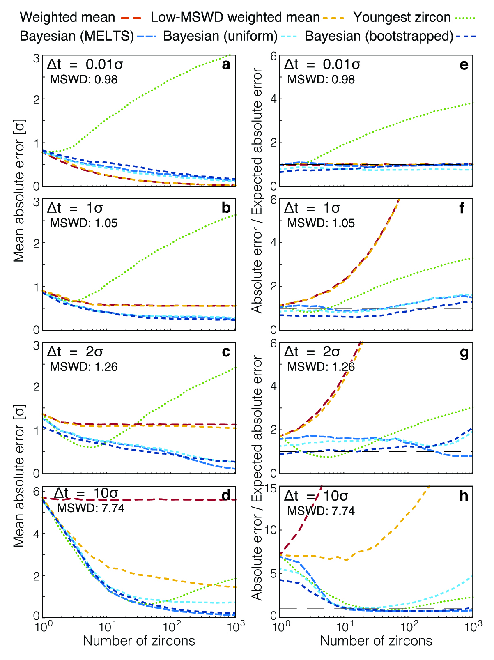
Keller et al.
A stochastic sampling approach to zircon eruption age interpretation
Figure 2 Performance of each age interpretation as a function of N and ∆t/σ. (a-d) Mean absolute error is the mean absolute deviation of the model result from the true value; lower absolute errors are better. (e-h) Accuracy of the model uncertainty for each age interpretation. A value greater than 1.0 indicates an under-estimation of the model uncertainty (i.e. over-precision), while a value lower than 1.0 indicates an over-estimation of the model uncertainty. MSWD in each panel is the average mean square of weighted deviation (also known as the reduced chi squared statistic) for that ∆t/σ over all N. Each datum reflects the mean of 1200 synthetic dataset tests; standard error of the mean is on the order of the line width.
© 2018 The Authors
Published by the European Association of Geochemistry
under Creative Commons License CC BY 4.0
Keller et al. (2018) Geochem. Persp. Let. 8, 31-35 | doi: 10.7185/geochemlet.1826
Notes:
Figure 2 Performance of each age interpretation as a function of N and ∆t/σ. (a-d) Mean absolute error is the mean absolute deviation of the model result from the true value; lower absolute errors are better. (e-h) Accuracy of the model uncertainty for each age interpretation. A value greater than 1.0 indicates an under-estimation of the model uncertainty (i.e. over-precision), while a value lower than 1.0 indicates an over-estimation of the model uncertainty. MSWD in each panel is the average mean square of weighted deviation (also known as the reduced chi squared statistic) for that ∆t/σ over all N. Each datum reflects the mean of 1200 synthetic dataset tests; standard error of the mean is on the order of the line width.

