Slide 1
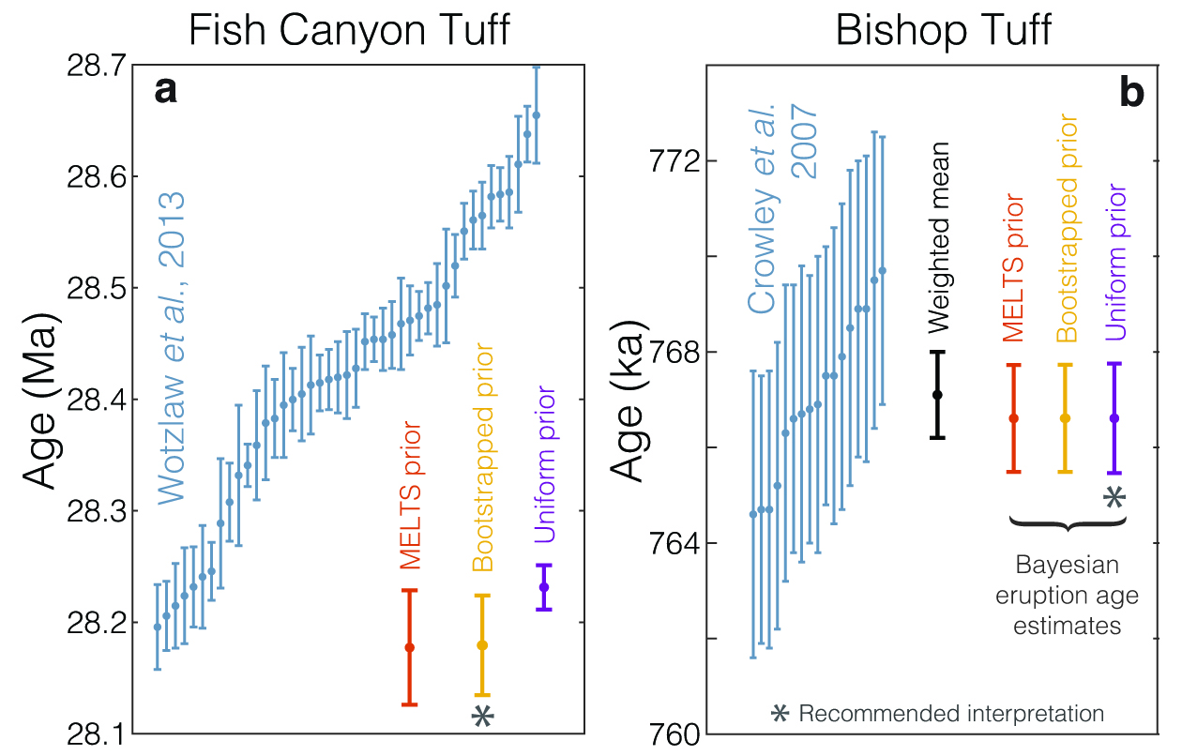
Keller et al.
A stochastic sampling approach to zircon eruption age interpretation
Figure 3 Bayesian eruption age estimates for two well known volcanic zircon populations. For age spectra with well-resolved dispersion (a), a kernel density estimate may recover a close approximation of f(t_{r}), obviating the need to identify and reject antecrysts. However, for age spectra where igneous dispersion is not well resolved (b), assuming a uniform f(t_{r}) may be more parsimonious.
© 2018 The Authors
Published by the European Association of Geochemistry
under Creative Commons License CC BY 4.0
Keller et al. (2018) Geochem. Persp. Let. 8, 31-35 | doi: 10.7185/geochemlet.1826
Notes:
Figure 3 Bayesian eruption age estimates for two well known volcanic zircon populations. For age spectra with well-resolved dispersion (a), a kernel density estimate may recover a close approximation of f(t_{r}), obviating the need to identify and reject antecrysts. However, for age spectra where igneous dispersion is not well resolved (b), assuming a uniform f(t_{r}) may be more parsimonious.

