Slide 1
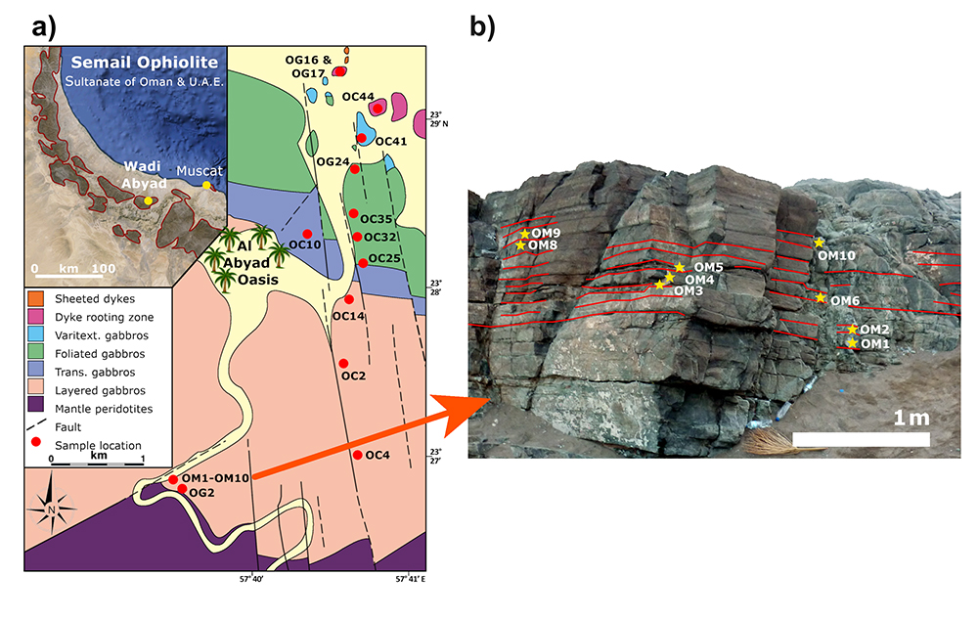
Jansen et al.
Isotopic variation in Semail Ophiolite lower crust reveals crustal-level melt aggregation
Figure 1 (a) Geological map of the lower crustal section at Wadi Abyad, in the Semail Ophiolite, Oman, with sample locations indicated (after MacLeod and Yaouancq, 2000; sample names were shortened by omitting the numerals ‘95’ preceding the letters ‘OC’ and ‘OG’ and ‘14’ preceding ‘OM’). (b) An outcrop at the base of the layered gabbros was sampled at ~15 cm intervals (one sample per modal layer).
© 2018 The Authors
Published by the European Association of Geochemistry
under Creative Commons License CC BY 4.0
Jansen et al. (2018) Geochem. Persp. Let. 8, 37-42 | doi: 10.7185/geochemlet.1827
Notes:
Figure 1 (a) Geological map of the lower crustal section at Wadi Abyad, in the Semail Ophiolite, Oman, with sample locations indicated (after MacLeod and Yaouancq, 2000; sample names were shortened by omitting the numerals ‘95’ preceding the letters ‘OC’ and ‘OG’ and ‘14’ preceding ‘OM’). (b) An outcrop at the base of the layered gabbros was sampled at ~15 cm intervals (one sample per modal layer).

