Slide 1
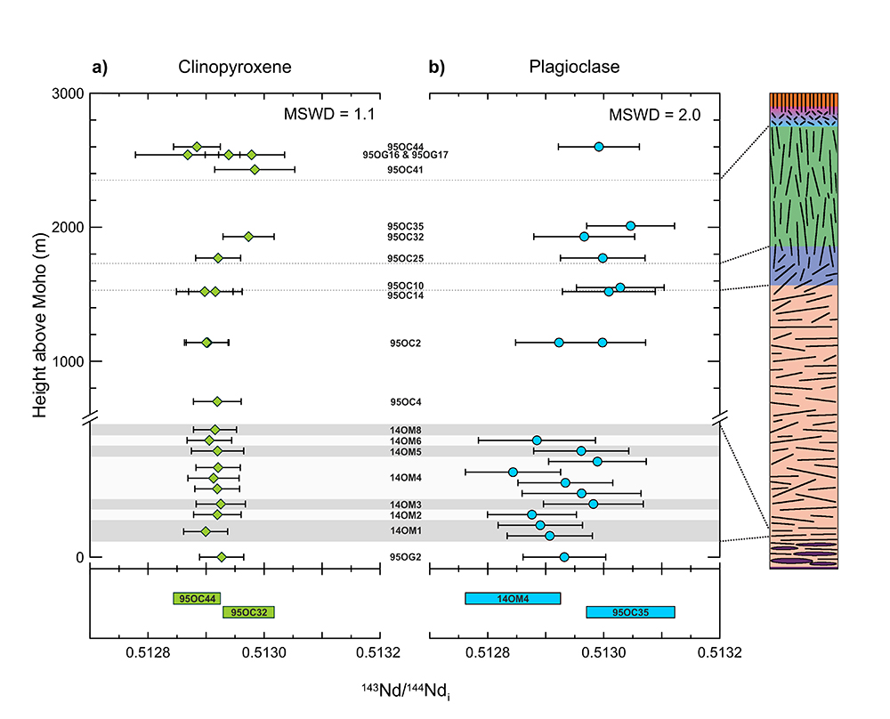
Jansen et al.
Isotopic variation in Semail Ophiolite lower crust reveals crustal-level melt aggregation
Figure 2 Age-corrected ¹⁴³Nd/¹⁴⁴Nd_{i} of (a) single clinopyroxene and (b) plagioclase crystals in the Abyad section. Clinopyroxene has a near uniform composition whereas plagioclase shows variability outside analytical uncertainty. Grey and white alternating bars at the base of the section indicate the individual modal layers of the sampled layered gabbro outcrop (not to scale). Coloured bars at the bottom of the figure represent the uncertainty for the two most extreme samples.
© 2018 The Authors
Published by the European Association of Geochemistry
under Creative Commons License CC BY 4.0
Jansen et al. (2018) Geochem. Persp. Let. 8, 37-42 | doi: 10.7185/geochemlet.1827
Notes:
Figure 2 Age-corrected ¹⁴³Nd/¹⁴⁴Nd_{i} of (a) single clinopyroxene and (b) plagioclase crystals in the Abyad section. Clinopyroxene has a near uniform composition whereas plagioclase shows variability outside analytical uncertainty. Grey and white alternating bars at the base of the section indicate the individual modal layers of the sampled layered gabbro outcrop (not to scale). Coloured bars at the bottom of the figure represent the uncertainty for the two most extreme samples.

