Slide 1
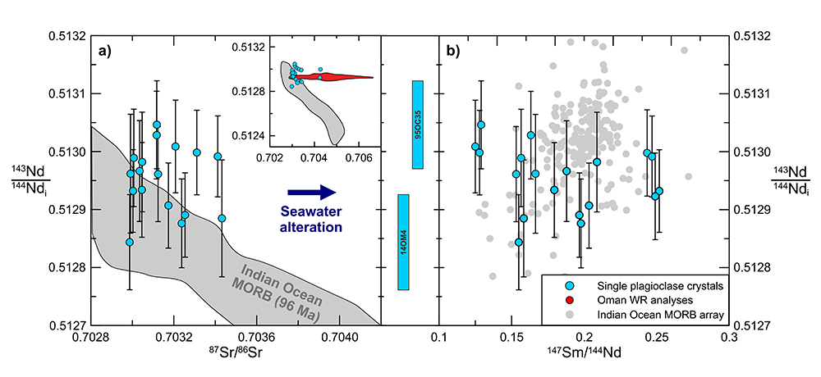
Jansen et al.
Isotopic variation in Semail Ophiolite lower crust reveals crustal-level melt aggregation
Figure 3 (a) Age-corrected ¹⁴³Nd/¹⁴⁴Nd_{i} and ⁸⁷Sr/⁸⁶Sr compositions of plagioclase samples. Indian Ocean MORB data from the PetDB database and age-corrected to 96 Ma using model Sm/Nd and Rb/Sr ratios for depleted MORB mantle (Workman and Hart, 2005). The ranges of whole rock age-corrected Sr and Nd isotope analyses of the plutonic and extrusive series of the Semail Ophiolite are shown in the inset (McCulloch et al., 1980; Godard et al., 2006; Rioux et al., 2012, 2013; de Graaff, 2016). (b) Age-corrected ¹⁴³Nd/¹⁴⁴Nd_{i} and ¹⁴⁷Sm/¹⁴⁴Nd ratios show no correlation, whereas the present day Indian Ocean MORB array, shown for comparison, displays a broad positive correlation. Coloured bars in the centre panel represent the uncertainty in ¹⁴³Nd/¹⁴⁴Nd_{i} for the two most extreme samples.
© 2018 The Authors
Published by the European Association of Geochemistry
under Creative Commons License CC BY 4.0
Jansen et al. (2018) Geochem. Persp. Let. 8, 37-42 | doi: 10.7185/geochemlet.1827
Notes:
Figure 3 (a) Age-corrected ¹⁴³Nd/¹⁴⁴Nd_{i} and ⁸⁷Sr/⁸⁶Sr compositions of plagioclase samples. Indian Ocean MORB data from the PetDB database and age-corrected to 96 Ma using model Sm/Nd and Rb/Sr ratios for depleted MORB mantle (Workman and Hart, 2005). The ranges of whole rock age-corrected Sr and Nd isotope analyses of the plutonic and extrusive series of the Semail Ophiolite are shown in the inset (McCulloch et al., 1980; Godard et al., 2006; Rioux et al., 2012, 2013; de Graaff, 2016). (b) Age-corrected ¹⁴³Nd/¹⁴⁴Nd_{i} and ¹⁴⁷Sm/¹⁴⁴Nd ratios show no correlation, whereas the present day Indian Ocean MORB array, shown for comparison, displays a broad positive correlation. Coloured bars in the centre panel represent the uncertainty in ¹⁴³Nd/¹⁴⁴Nd_{i} for the two most extreme samples.

