Slide 1
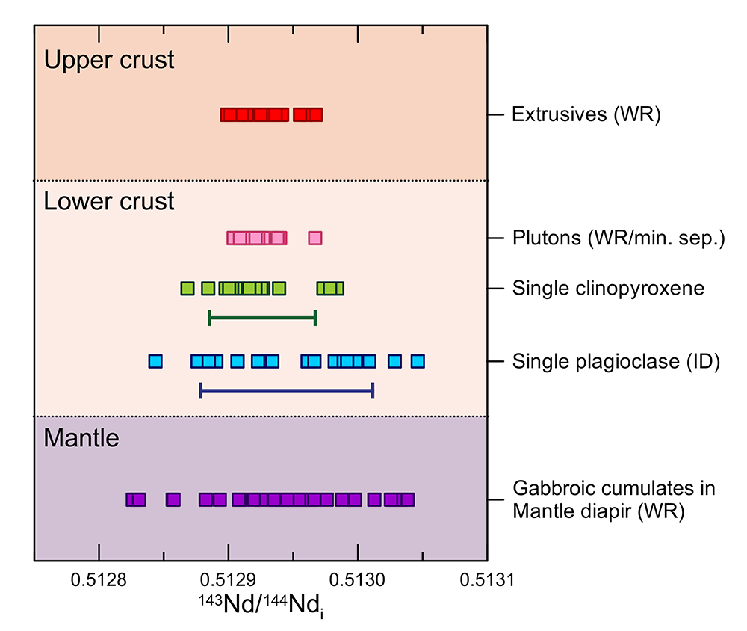
Jansen et al.
Isotopic variation in Semail Ophiolite lower crust reveals crustal-level melt aggregation
Figure 4 Comparison of the ranges in Nd isotopes found in this study with previous results of the Semail Ophiolite (McCulloch et al., 1980; Benoit et al., 1996; Godard et al., 2006; Rioux et al., 2012, 2013; de Graaff, 2016). Range for repeated analyses of BCR-2 reference material is indicated by the green (1.9-2.6 ng Nd) and blue (0.15-0.34 ng Nd) bars (displayed at an arbitrary position on the x-axis).
© 2018 The Authors
Published by the European Association of Geochemistry
under Creative Commons License CC BY 4.0
Jansen et al. (2018) Geochem. Persp. Let. 8, 37-42 | doi: 10.7185/geochemlet.1827
Notes:
Figure 4 Comparison of the ranges in Nd isotopes found in this study with previous results of the Semail Ophiolite (McCulloch et al., 1980; Benoit et al., 1996; Godard et al., 2006; Rioux et al., 2012, 2013; de Graaff, 2016). Range for repeated analyses of BCR-2 reference material is indicated by the green (1.9-2.6 ng Nd) and blue (0.15-0.34 ng Nd) bars (displayed at an arbitrary position on the x-axis).

