Slide 1
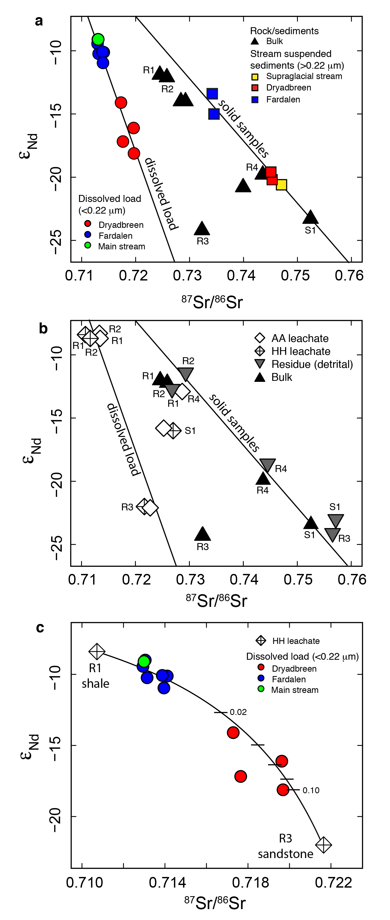
Hindshaw et al.
Decoupling of dissolved and bedrock neodymium isotopes during sedimentary cycling
Figure 1 Dissolved (<0.22 µm) and solid samples (rock, sediment and stream suspended sediment) form distinct arrays in Sr-Nd space. (a) A linear regression is fitted for the dissolved samples (r² = 0.93, p < 0.001). The linear line for the solid samples is the mixing line between a Greenlandic (⁸⁷Sr/⁸⁶Sr = 0.78059, εNd = -37.1) and Siberian (⁸⁷Sr/⁸⁶Sr = 0.70626, εNd = -0.4) sediment source with identical Sr/Nd mass ratios (Hindshaw et al., 2018). The four rock and one glacial sediment sample subjected to the leaching procedure are labelled. (b) The isotopic compositions of the leachates, residual and bulk samples. The dissolved load array is bound by leachates of the sandstone (R3) at one end and leachates of the shale samples (R1 and R2) at the other end. (c) The dissolved samples can be fitted with a mixing line between the HH leachate end members. The best fit line uses the concentration and isotopic values measured in R3-HH and R1-HH (Table S-3). The numbers on the mixing line refer to the mass fraction of the sandstone end member in the mixture. Error bars are smaller than symbol size.
© 2018 The Authors
Published by the European Association of Geochemistry
under Creative Commons License CC BY 4.0
Hindshaw et al. (2018) Geochem. Persp. Let. 8, 43-46 | doi: 10.7185/geochemlet.1828
Notes:
Figure 1 Dissolved (<0.22 µm) and solid samples (rock, sediment and stream suspended sediment) form distinct arrays in Sr-Nd space. (a) A linear regression is fitted for the dissolved samples (r² = 0.93, p < 0.001). The linear line for the solid samples is the mixing line between a Greenlandic (⁸⁷Sr/⁸⁶Sr = 0.78059, εNd = -37.1) and Siberian (⁸⁷Sr/⁸⁶Sr = 0.70626, εNd = -0.4) sediment source with identical Sr/Nd mass ratios (Hindshaw et al., 2018). The four rock and one glacial sediment sample subjected to the leaching procedure are labelled. (b) The isotopic compositions of the leachates, residual and bulk samples. The dissolved load array is bound by leachates of the sandstone (R3) at one end and leachates of the shale samples (R1 and R2) at the other end. (c) The dissolved samples can be fitted with a mixing line between the HH leachate end members. The best fit line uses the concentration and isotopic values measured in R3-HH and R1-HH (Table S-3). The numbers on the mixing line refer to the mass fraction of the sandstone end member in the mixture. Error bars are smaller than symbol size.

