Slide 1
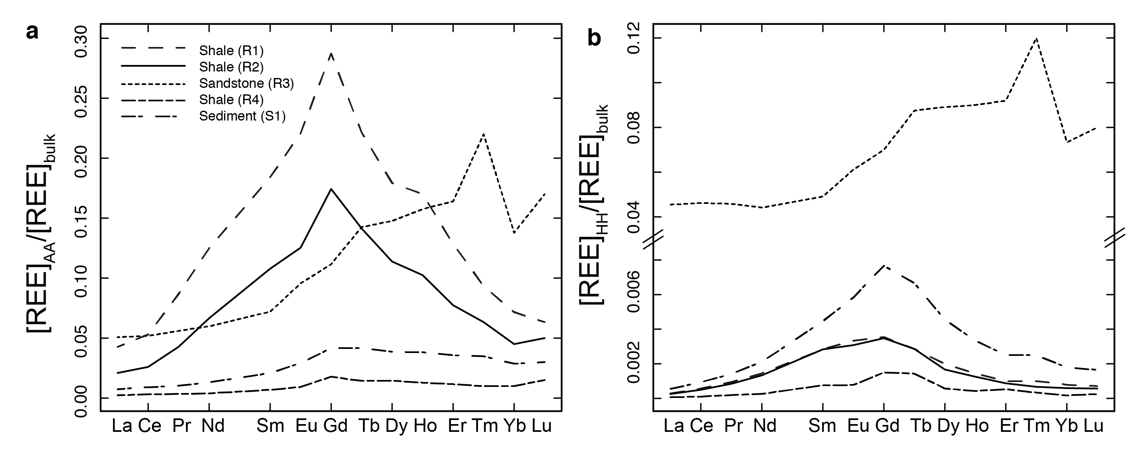
Hindshaw et al.
Decoupling of dissolved and bedrock neodymium isotopes during sedimentary cycling
Figure 2 REE concentrations of the leachates normalised to bulk. (a) AA leach. (b) HH leach. REE concentrations are normalised against the bulk REE concentrations of the same sample. Note the scale break in (b). The sandstone sample (R3) has a HREE enriched pattern for both leachates. Shale samples R1 and R2 have MREE enriched patterns for both leachates. REE data is reported in Table S-5.
© 2018 The Authors
Published by the European Association of Geochemistry
under Creative Commons License CC BY 4.0
Hindshaw et al. (2018) Geochem. Persp. Let. 8, 43-46 | doi: 10.7185/geochemlet.1828
Notes:
Figure 2 REE concentrations of the leachates normalised to bulk. (a) AA leach. (b) HH leach. REE concentrations are normalised against the bulk REE concentrations of the same sample. Note the scale break in (b). The sandstone sample (R3) has a HREE enriched pattern for both leachates. Shale samples R1 and R2 have MREE enriched patterns for both leachates. REE data is reported in Table S-5.

