Slide 1
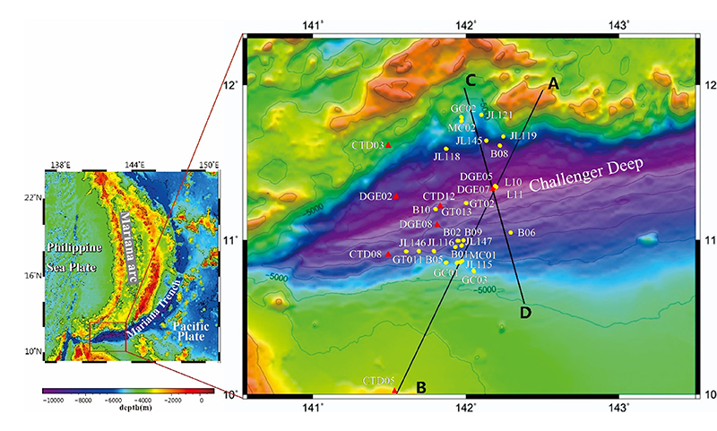
Peng et al.
Microplastics contaminate the deepest part of the world’s ocean
Figure 1 Sampling location map of Mariana Trench seawater (in red triangles) and sediments (in yellow circles). Please see Tables S-1 and S-2 for sampling details.
© 2018 The Authors
Published by the European Association of Geochemistry
under Creative Commons License CC BY-NC-ND 4.0
Peng et al. (2018) Geochem. Persp. Let. 9, 1-5 | doi: 10.7185/geochemlet.1829
Notes:
Figure 1 Sampling location map of Mariana Trench seawater (in red triangles) and sediments (in yellow circles). Please see Tables S-1 and S-2 for sampling details.

