Slide 1
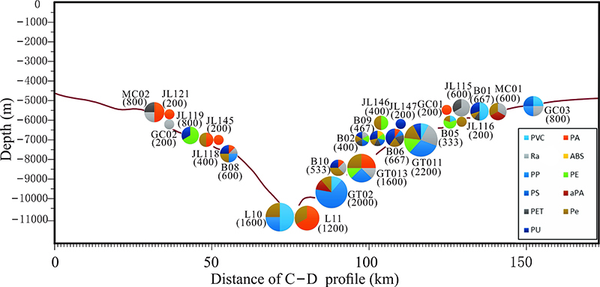
Peng et al.
Microplastics contaminate the deepest part of the world’s ocean
Figure 3 Profile of microplastic abundances and compositions in sediment samples from Mariana Trench. Pie charts represent the microplastic compositions and numbers in the bracket are the microplastic abundances with units of pieces per litre. PVC-polyvinyl chloride, PA-polyamide, Ra-rayon, ABS-acrylonitrile butadiene styrene, PP-polypropylene, PE-polyethylene, PS-polystyrene, aPA-aromatic polyamide, PET-polyethylene terephthalate, Pe-polyester, PU-polyurethane. The X-axis corresponds to the crossline from point C (12 ºN, 141.9 ºE) to point D (10.5 ºN, 141.3 ºE) in Figure 1.
© 2018 The Authors
Published by the European Association of Geochemistry
under Creative Commons License CC BY-NC-ND 4.0
Peng et al. (2018) Geochem. Persp. Let. 9, 1-5 | doi: 10.7185/geochemlet.1829
Notes:
Figure 3 Profile of microplastic abundances and compositions in sediment samples from Mariana Trench. Pie charts represent the microplastic compositions and numbers in the bracket are the microplastic abundances with units of pieces per litre. PVC-polyvinyl chloride, PA-polyamide, Ra-rayon, ABS-acrylonitrile butadiene styrene, PP-polypropylene, PE-polyethylene, PS-polystyrene, aPA-aromatic polyamide, PET-polyethylene terephthalate, Pe-polyester, PU-polyurethane. The X-axis corresponds to the crossline from point C (12 ºN, 141.9 ºE) to point D (10.5 ºN, 141.3 ºE) in Figure 1.

