Slide 1
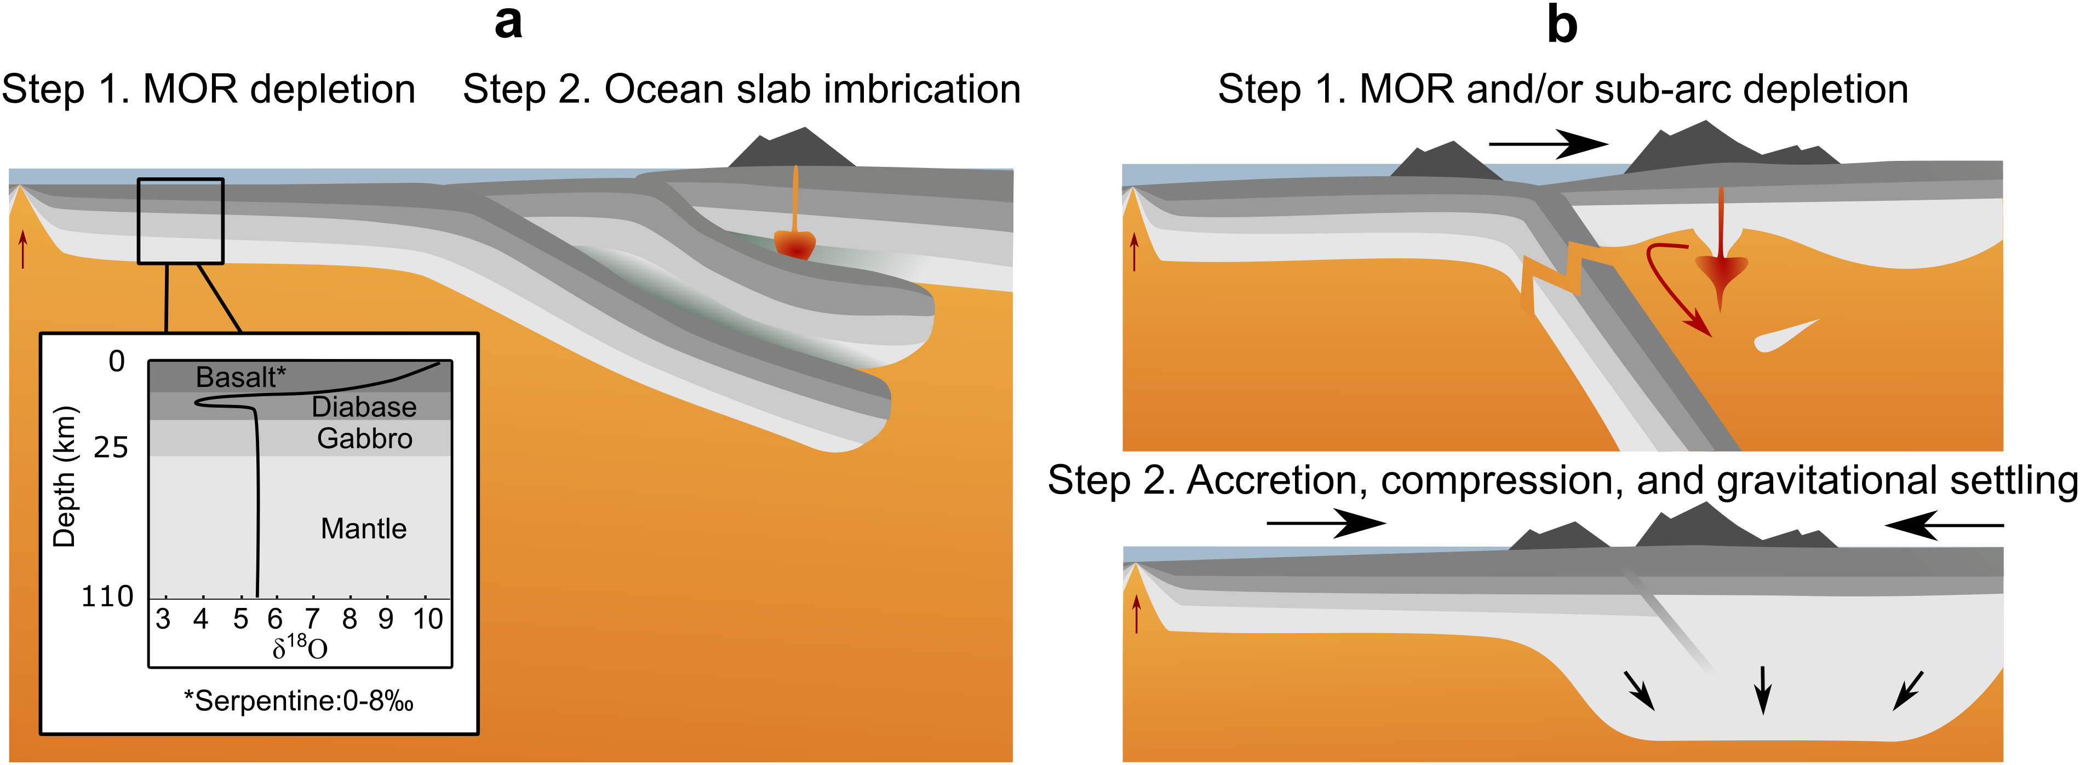
Regier et al.
An oxygen isotope test for the origin of Archean mantle roots
Figure 1 Popular models of cratonic mantle formation. (a) Imbrication of MOR sequences to form a thick lithosphere. An estimated oxygen isotope profile through Neoarchean oceanic lithosphere is inset. (b) Depleted cratonic mantle protoliths produced at MOR and in sub-arc environments are compressed via pure shear into a thick lithospheric root.
© 2018 The Authors
Published by the European Association of Geochemistry
under Creative Commons License CC BY 4.0
Regier et al. (2018) Geochem. Persp. Let. 9, 6-10 | doi: 10.7185/geochemlet.1830
Notes:
Figure 1 Popular models of cratonic mantle formation. (a) Imbrication of MOR sequences to form a thick lithosphere. An estimated oxygen isotope profile through Neoarchean oceanic lithosphere is inset. (b) Depleted cratonic mantle protoliths produced at MOR and in sub-arc environments are compressed via pure shear into a thick lithospheric root.

