Slide 1
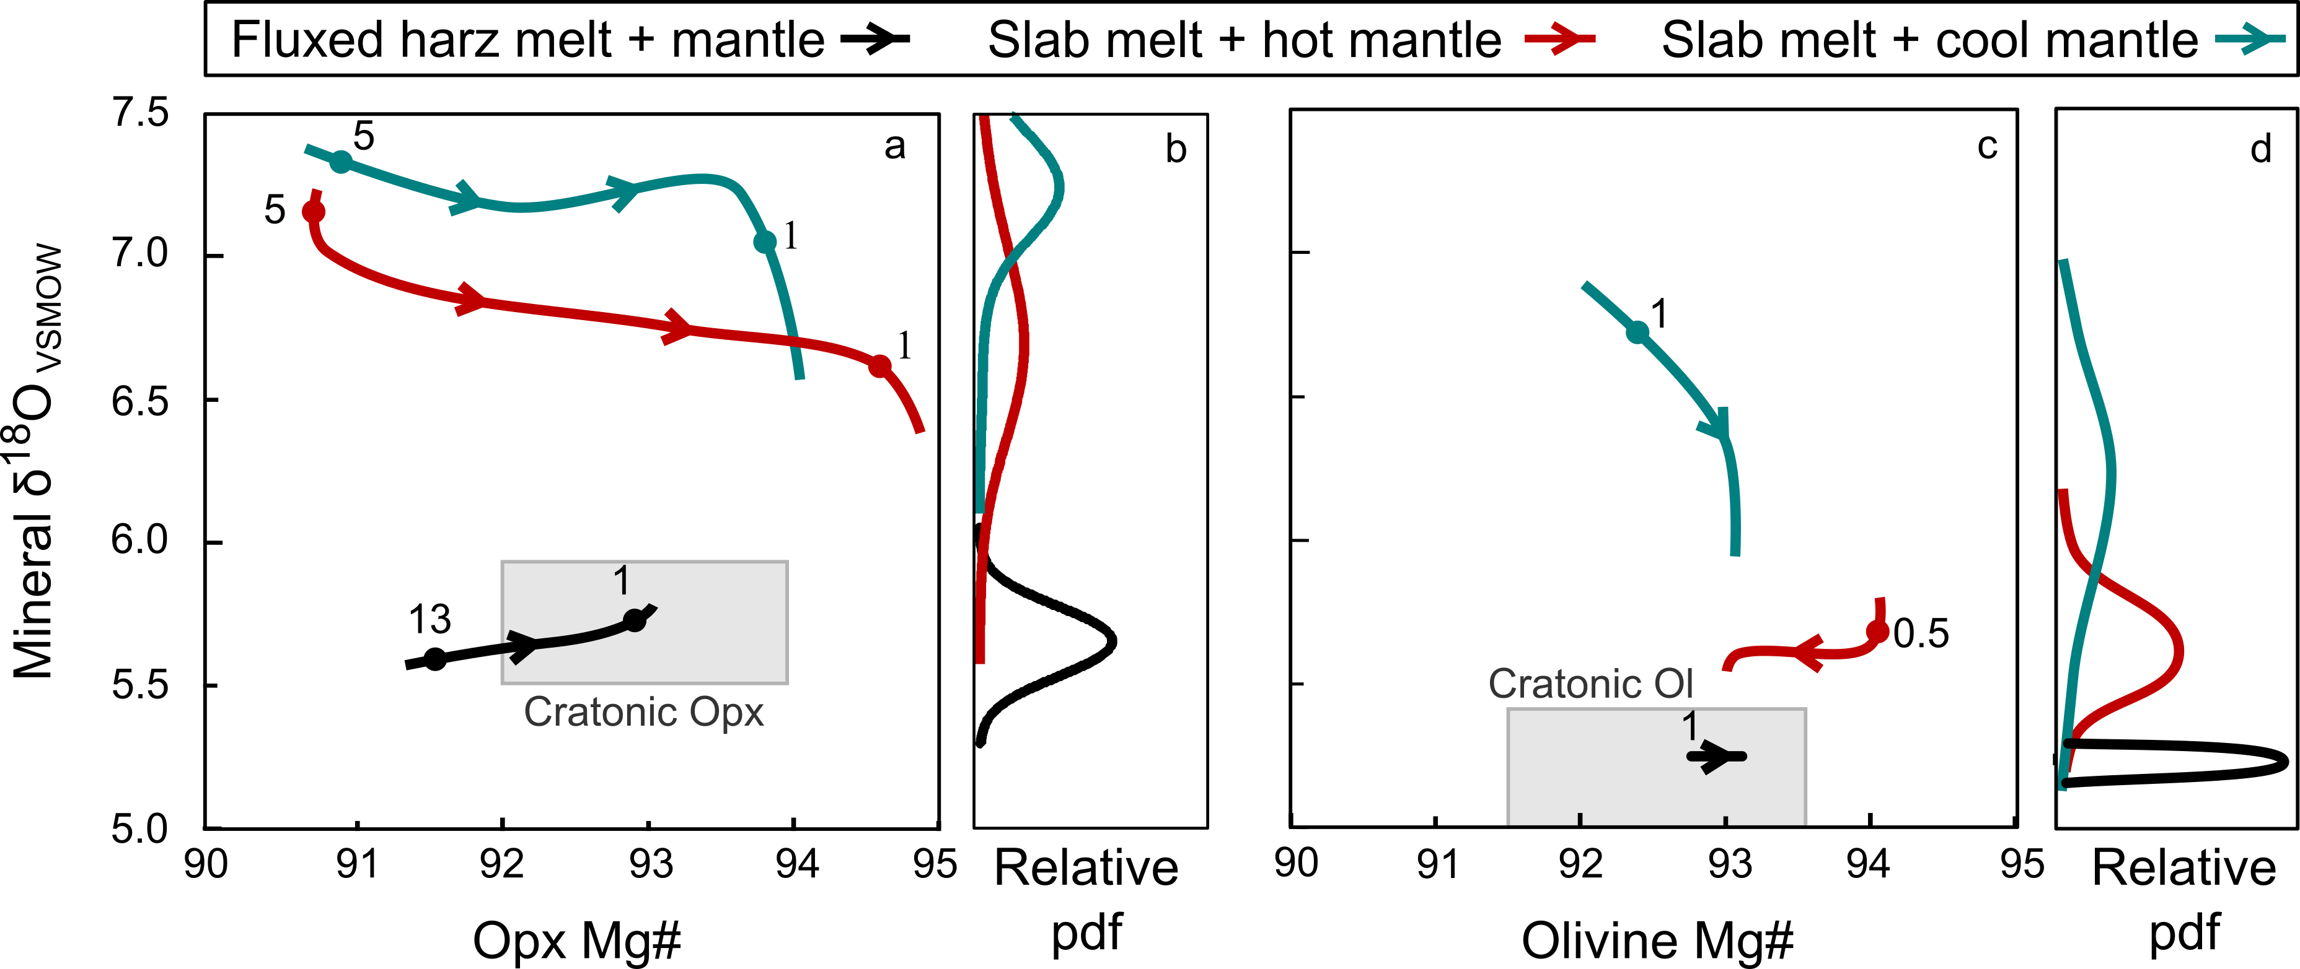
Regier et al.
An oxygen isotope test for the origin of Archean mantle roots
Figure 4 pMELTS modelling of slab melts (δ¹⁸O of +8 ‰) reacting with 900 ℃ (blue) and 1500 °C (red) harzburgite, as well as a water-fluxed harzburgitic (harz) melt (δ¹⁸O of +5.6 ‰) reacting with 1300 ℃ harzburgite (black). The major element and isotopic evolution of crystallising Opx (a) and olivine (c) is indicated by smoothed curves. Numbers indicate the slab melt/assimilated peridotite ratio. Typical cratonic mantle Opx and olivine (Ol) is outlined in gray fields. Relative Kernel estimations of the probability density function (pdf) for Opx (b) and olivine (d) δ¹⁸O are included.
© 2018 The Authors
Published by the European Association of Geochemistry
under Creative Commons License CC BY 4.0
Regier et al. (2018) Geochem. Persp. Let. 9, 6-10 | doi: 10.7185/geochemlet.1830
Notes:
Figure 4 pMELTS modelling of slab melts (δ¹⁸O of +8 ‰) reacting with 900 ℃ (blue) and 1500 °C (red) harzburgite, as well as a water-fluxed harzburgitic (harz) melt (δ¹⁸O of +5.6 ‰) reacting with 1300 ℃ harzburgite (black). The major element and isotopic evolution of crystallising Opx (a) and olivine (c) is indicated by smoothed curves. Numbers indicate the slab melt/assimilated peridotite ratio. Typical cratonic mantle Opx and olivine (Ol) is outlined in gray fields. Relative Kernel estimations of the probability density function (pdf) for Opx (b) and olivine (d) δ¹⁸O are included.

