Slide 1
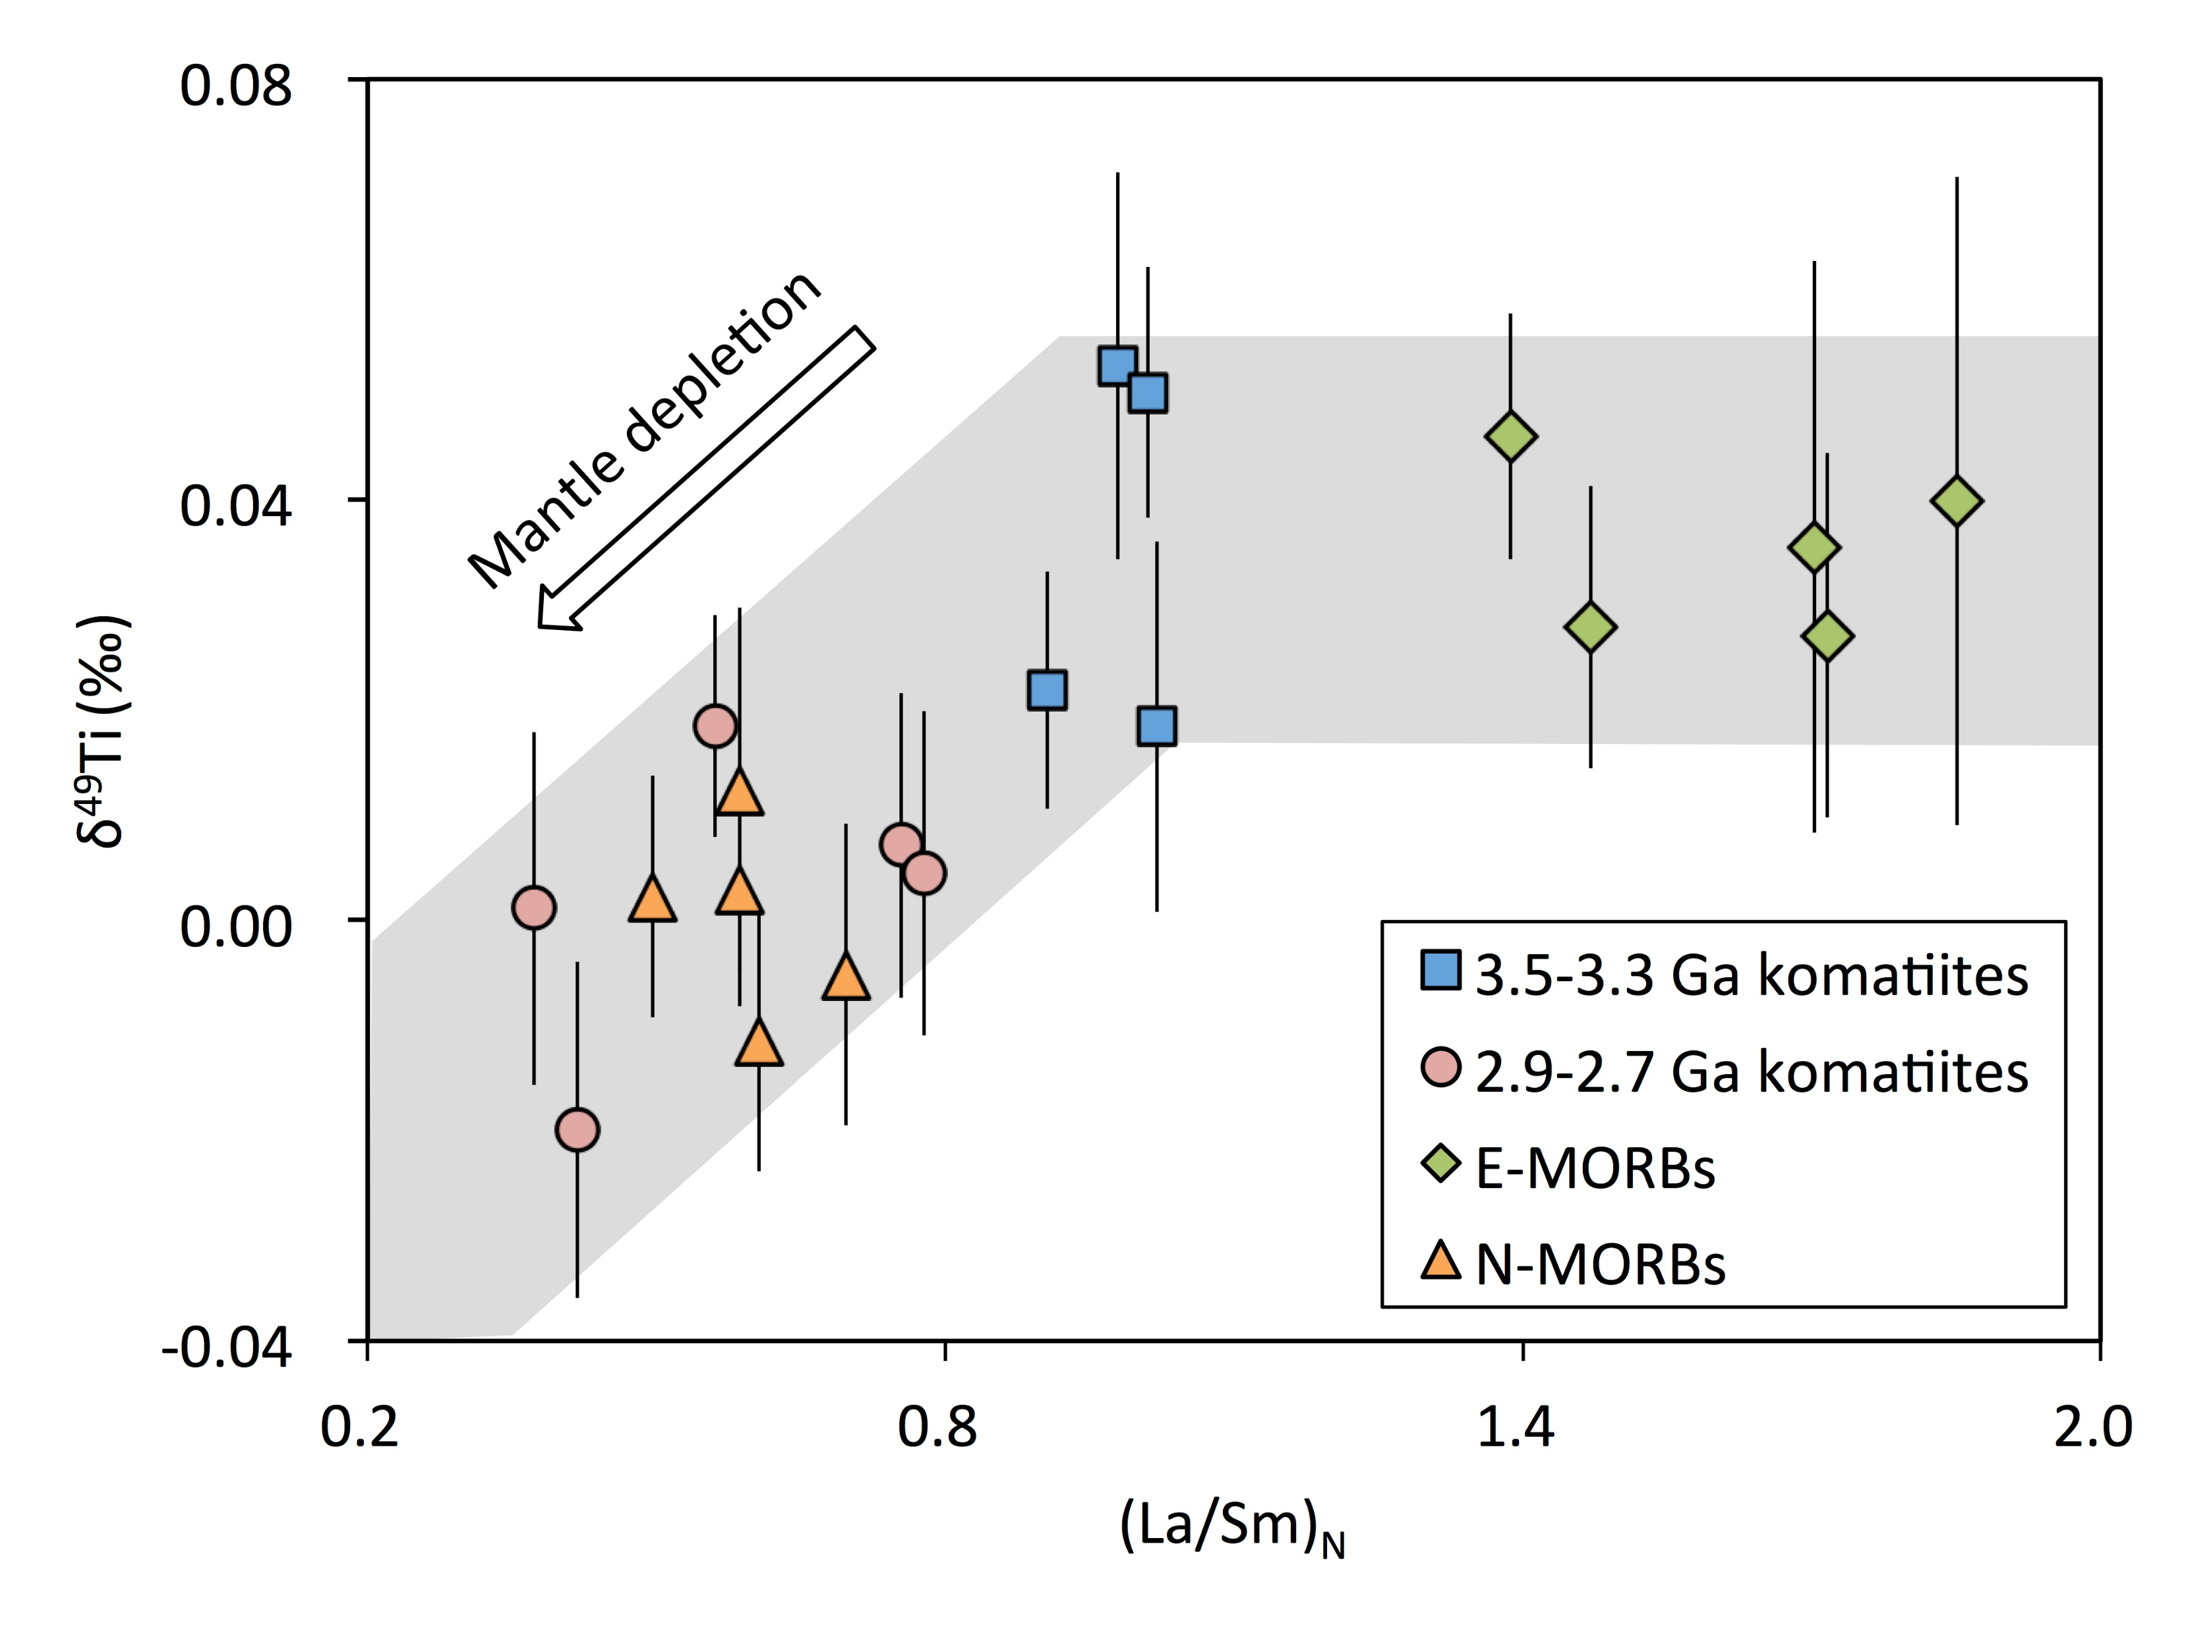
Deng et al.
Bridging the depleted MORB mantle and the continental crust using titanium isotopes
Figure 1 Positive correlation between δ⁴⁹Ti and (La/Sm)_{N} values for the komatiite and MORB samples.
© 2018 The Authors
Published by the European Association of Geochemistry
under Creative Commons License CC BY-NC-ND.
Deng et al. (2018) Geochem. Persp. Let. 9, 11-15 | doi: 10.7185/geochemlet.1831
Notes:
Figure 1 Positive correlation between δ⁴⁹Ti and (La/Sm)_{N} values for the komatiite and MORB samples.

