Slide 1
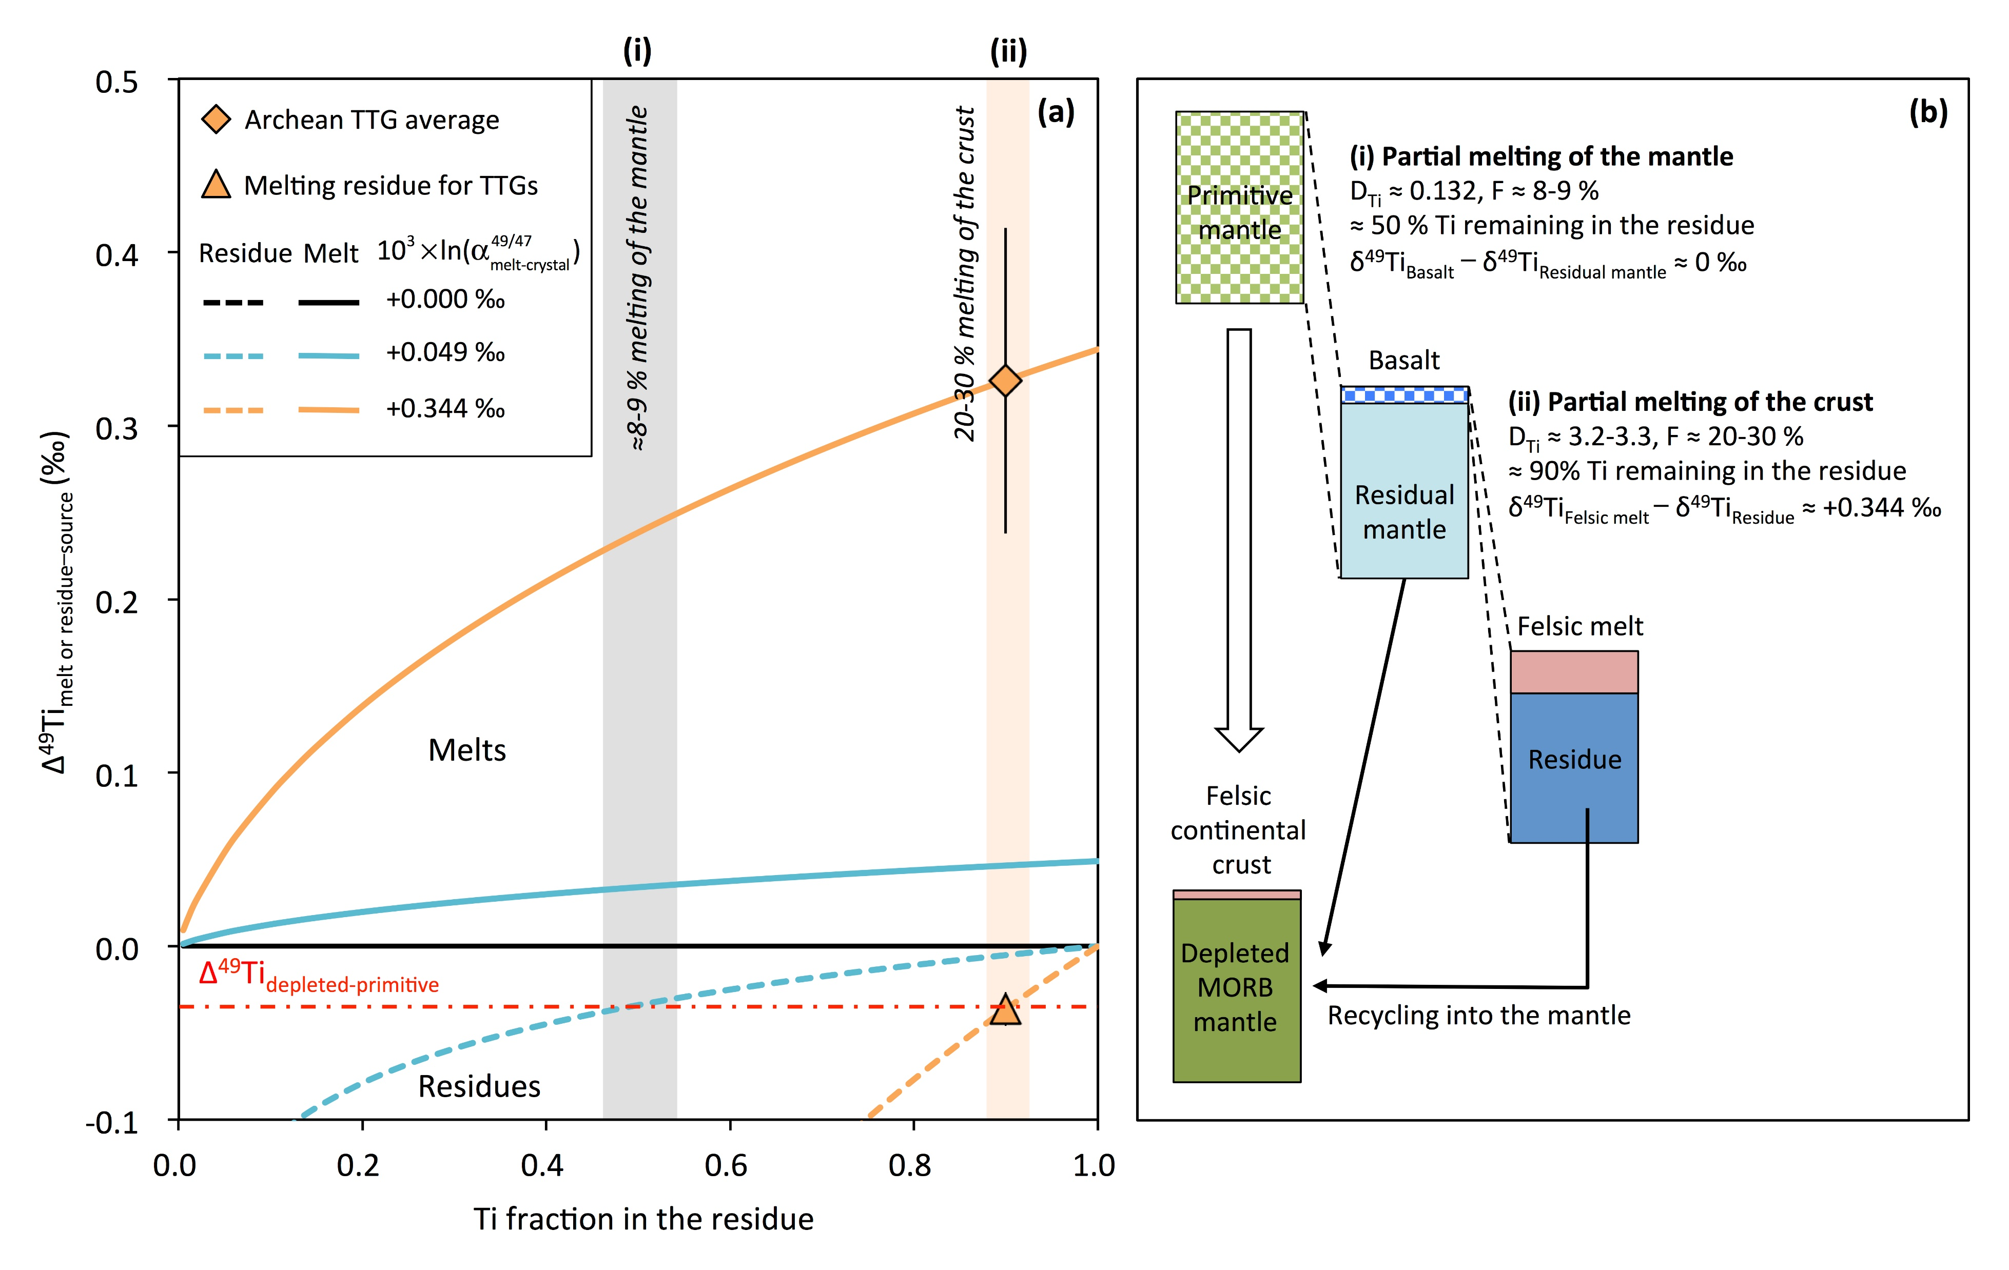
Deng et al.
Bridging the depleted MORB mantle and the continental crust using titanium isotopes
Figure 3 Modelling the Ti isotopic fractionations in the partial melts and residues from partial melting of the mantle or the crust. The grey area in (a) indicates the remaining Ti fraction in the residual mantle after ≈ 8-9 % partial melting (D_{Ti} ≈ 0.132; Prytulak and Elliott, 2007), i.e. process (i) illustrated in (b). The orange field in a shows the Ti fraction after 20-30 % partial melting of a basaltic crust to produce the felsic melts equivalent to tonalite-trondhjemite-granodiorite (TTGs) (D_{Ti} ≈ 3.2-3.3; Martin et al., 2014), i.e. process (ii) in b. The Δ⁴⁹Ti_{residue−source} values of TTGs and corresponding residues were calculated using the Ti isotope data of TTG samples from Greber et al. (2017b) and assuming E-MORBs as their sources.
© 2018 The Authors
Published by the European Association of Geochemistry
under Creative Commons License CC BY-NC-ND.
Deng et al. (2018) Geochem. Persp. Let. 9, 11-15 | doi: 10.7185/geochemlet.1831
Notes:
Figure 3 Modelling the Ti isotopic fractionations in the partial melts and residues from partial melting of the mantle or the crust. The grey area in (a) indicates the remaining Ti fraction in the residual mantle after ≈ 8-9 % partial melting (D_{Ti} ≈ 0.132; Prytulak and Elliott, 2007), i.e. process (i) illustrated in (b). The orange field in a shows the Ti fraction after 20-30 % partial melting of a basaltic crust to produce the felsic melts equivalent to tonalite-trondhjemite-granodiorite (TTGs) (D_{Ti} ≈ 3.2-3.3; Martin et al., 2014), i.e. process (ii) in b. The Δ⁴⁹Ti_{residue−source} values of TTGs and corresponding residues were calculated using the Ti isotope data of TTG samples from Greber et al. (2017b) and assuming E-MORBs as their sources.

