Slide 1
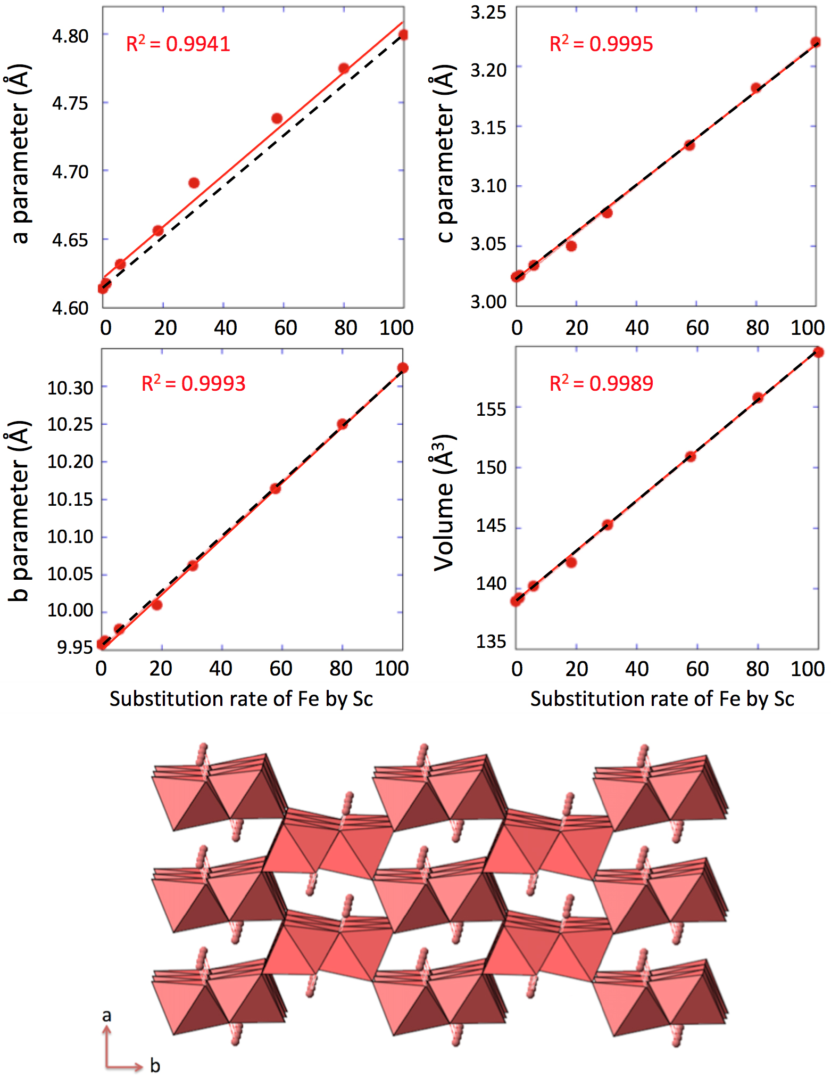
Levard et al.
Goethite, a tailor-made host for the critical metal scandium: The Fe_{x}Sc_{(1-x)}OOH solid solution
Figure 2 Top: Changes in cell parameters and in cell volume as a function of rate of substitution of Fe by Sc (numerical data for cell parameters and errors can be found in SI). Dashed lines represent ideal Vegard’s law behaviour. Bottom: Crystal structure of goethite. The octahedrons represent the Fe surrounded by 6 oxygen atoms. Spheres represent the hydrogen atoms.
© 2018 The Authors
Published by the European Association of Geochemistry
under Creative Commons License CC BY-NC-ND.
Levard et al. (2018) Geochem. Persp. Let. 9, 16-20 | doi: 10.7185/geochemlet.1832
Notes:
Figure 2 Top: Changes in cell parameters and in cell volume as a function of rate of substitution of Fe by Sc (numerical data for cell parameters and errors can be found in SI). Dashed lines represent ideal Vegard’s law behaviour. Bottom: Crystal structure of goethite. The octahedrons represent the Fe surrounded by 6 oxygen atoms. Spheres represent the hydrogen atoms.

