Slide 1
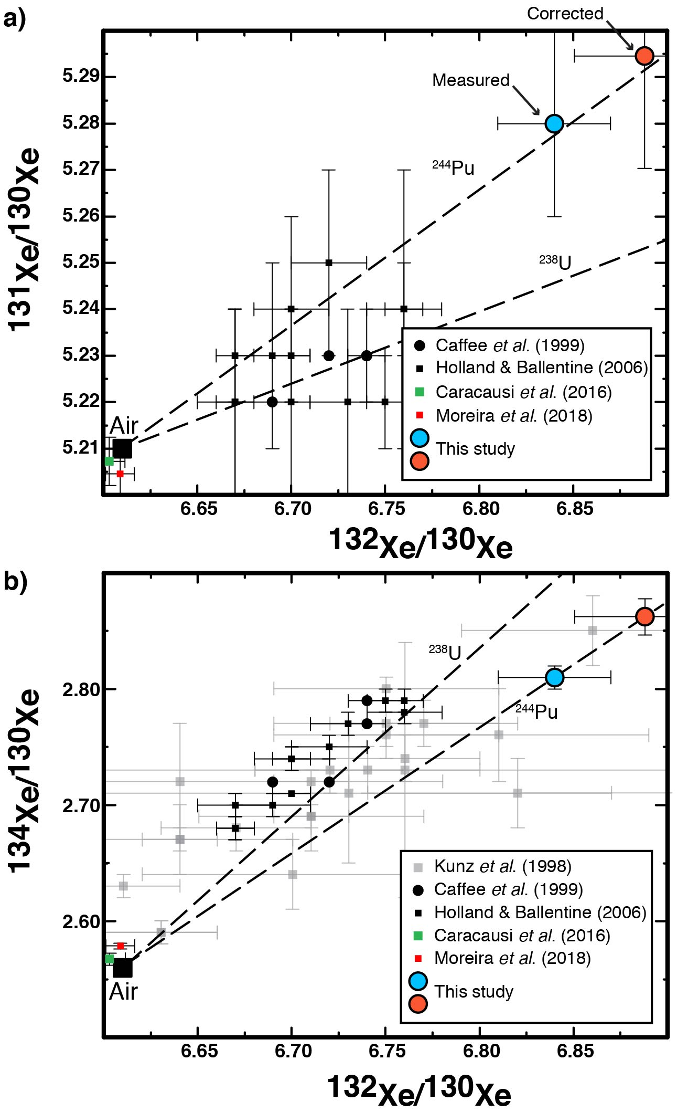
Péron and Moreira
Onset of volatile recycling into the mantle determined by xenon anomalies
Figure 2 Heavy xenon isotopic compositions for popping rock 2πD43. Measured data (blue dot) and corrected data for atmospheric contamination (orange dot) with a ¹²⁹Xe/¹³⁰Xe ratio of 7.6: (a) ¹³¹Xe/¹³⁰Xe and (b) ¹³⁴Xe/¹³⁰Xe versus ¹³²Xe/¹³⁰Xe. Data for sample 2πD43 from Kunz et al. (1998), for CO₂ well gases from Caffee et al. (1999) (black points), Holland and Ballentine (2006) (black square), and thermal springs from Caracausi et al. (2016) (green square) and Moreira et al. (2018) (red square) are shown. The trends of pure ²⁴⁴Pu- and ²³⁸U-derived xenon productions are also indicated. The source of sample 2πD43 seems to be more influenced by Pu-derived Xe than U-derived Xe, contrary to other MORBs (Tucker et al., 2012; Parai and Mukhopadhyay, 2015).
© 2018 The Authors
Published by the European Association of Geochemistry
under Creative Commons License CC BY-NC-ND.
Péron and Moreira (2018) Geochem. Persp. Let. 9, 21-25 | doi: 10.7185/geochemlet.1833
Notes:
Figure 2 Heavy xenon isotopic compositions for popping rock 2πD43. Measured data (blue dot) and corrected data for atmospheric contamination (orange dot) with a ¹²⁹Xe/¹³⁰Xe ratio of 7.6: (a) ¹³¹Xe/¹³⁰Xe and (b) ¹³⁴Xe/¹³⁰Xe versus ¹³²Xe/¹³⁰Xe. Data for sample 2πD43 from Kunz et al. (1998), for CO₂ well gases from Caffee et al. (1999) (black points), Holland and Ballentine (2006) (black square), and thermal springs from Caracausi et al. (2016) (green square) and Moreira et al. (2018) (red square) are shown. The trends of pure ²⁴⁴Pu- and ²³⁸U-derived xenon productions are also indicated. The source of sample 2πD43 seems to be more influenced by Pu-derived Xe than U-derived Xe, contrary to other MORBs (Tucker et al., 2012; Parai and Mukhopadhyay, 2015).

