Slide 1
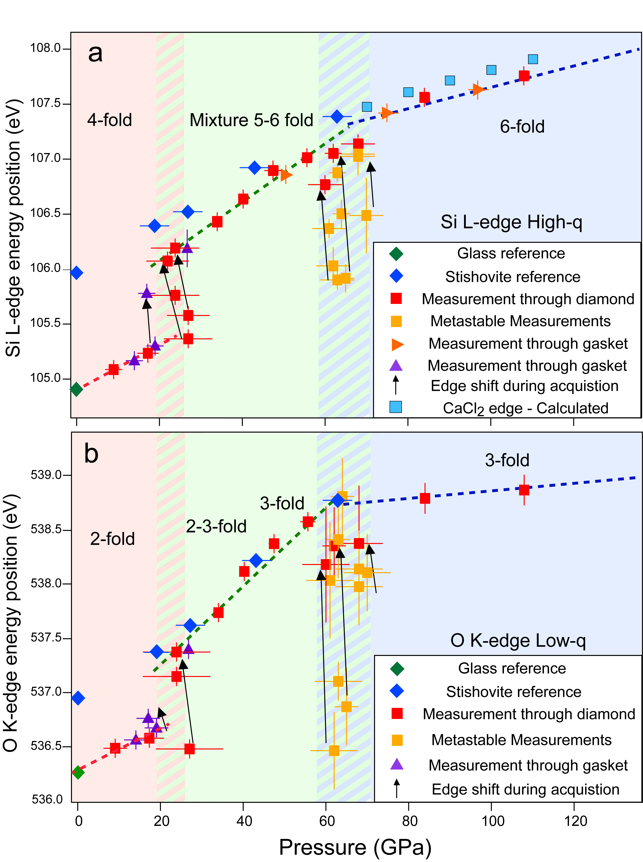
Petitgirard et al.
Magma properties at deep Earth’s conditions from electronic structure of silica
Figure 2 (a) Silicon L_{2,3}- and (b) Oxygen K-edge onset position versus pressure (GPa). Arrows show the evolution of the edge during the measurement at ~20 GPa and ~60 GPa.
© 2019 The Authors
Published by the European Association of Geochemistry
under Creative Commons License CC BY-NC-ND.
Petitgirard et al. (2019) Geochem. Persp. Let. 9, 32-37 | doi: 10.7185/geochemlet.1902
Notes:
Figure 2 (a) Silicon L_{2,3}- and (b) Oxygen K-edge onset position versus pressure (GPa). Arrows show the evolution of the edge during the measurement at ~20 GPa and ~60 GPa.

