Slide 1
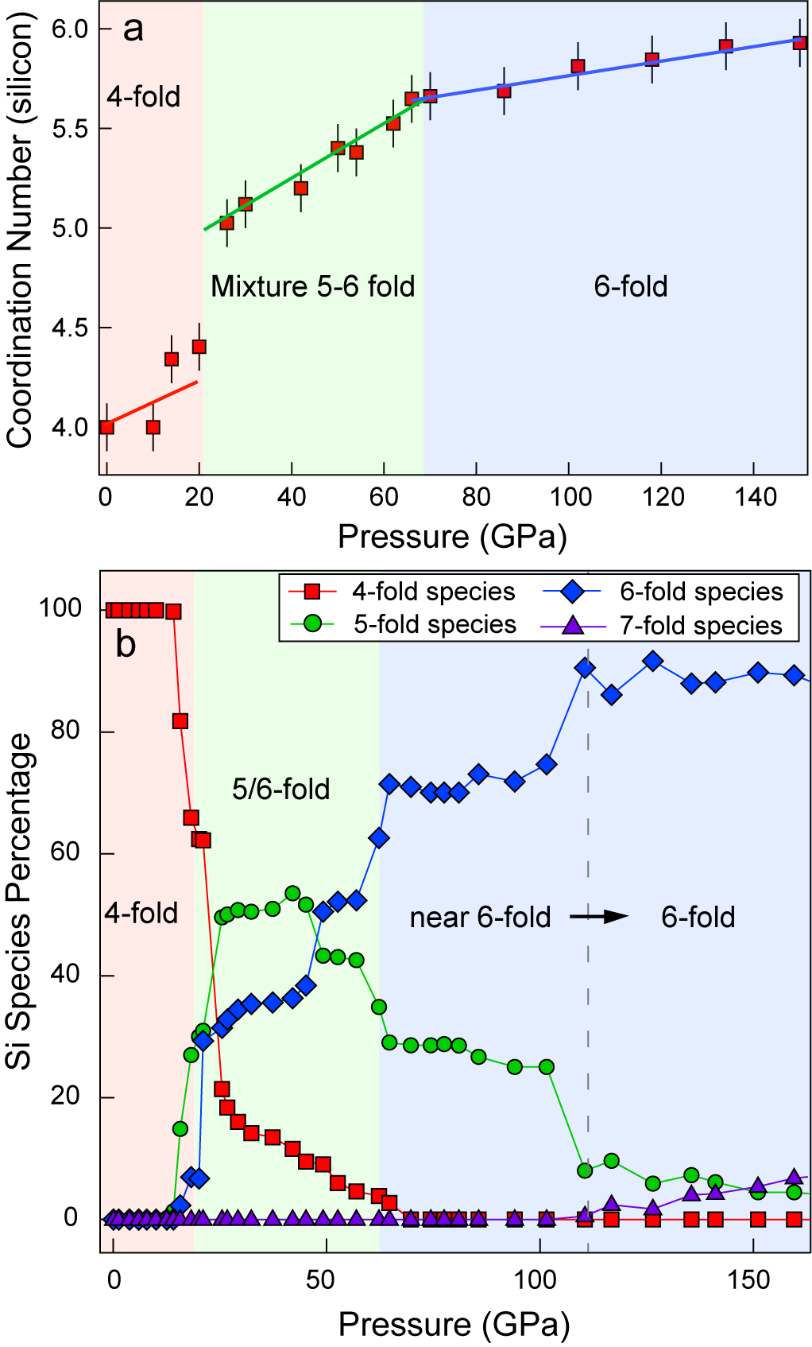
Petitgirard et al.
Magma properties at deep Earth’s conditions from electronic structure of silica
Figure 3 Coordination evolution of SiO₂ from MD. (a) Coordination of Si as a function of pressure. (b) Percentage of species ^{[4]}Si, ^{[5]}Si, ^{[6]}Si and ^{[7]}Si.
© 2019 The Authors
Published by the European Association of Geochemistry
under Creative Commons License CC BY-NC-ND.
Petitgirard et al. (2019) Geochem. Persp. Let. 9, 32-37 | doi: 10.7185/geochemlet.1902
Notes:
Figure 3 Coordination evolution of SiO₂ from MD. (a) Coordination of as a function of pressure. (b) Percentage of species ^{[4]}Si, ^{[5]}Si, ^{[6]}Si and ^{[7]}Si.

