Slide 1
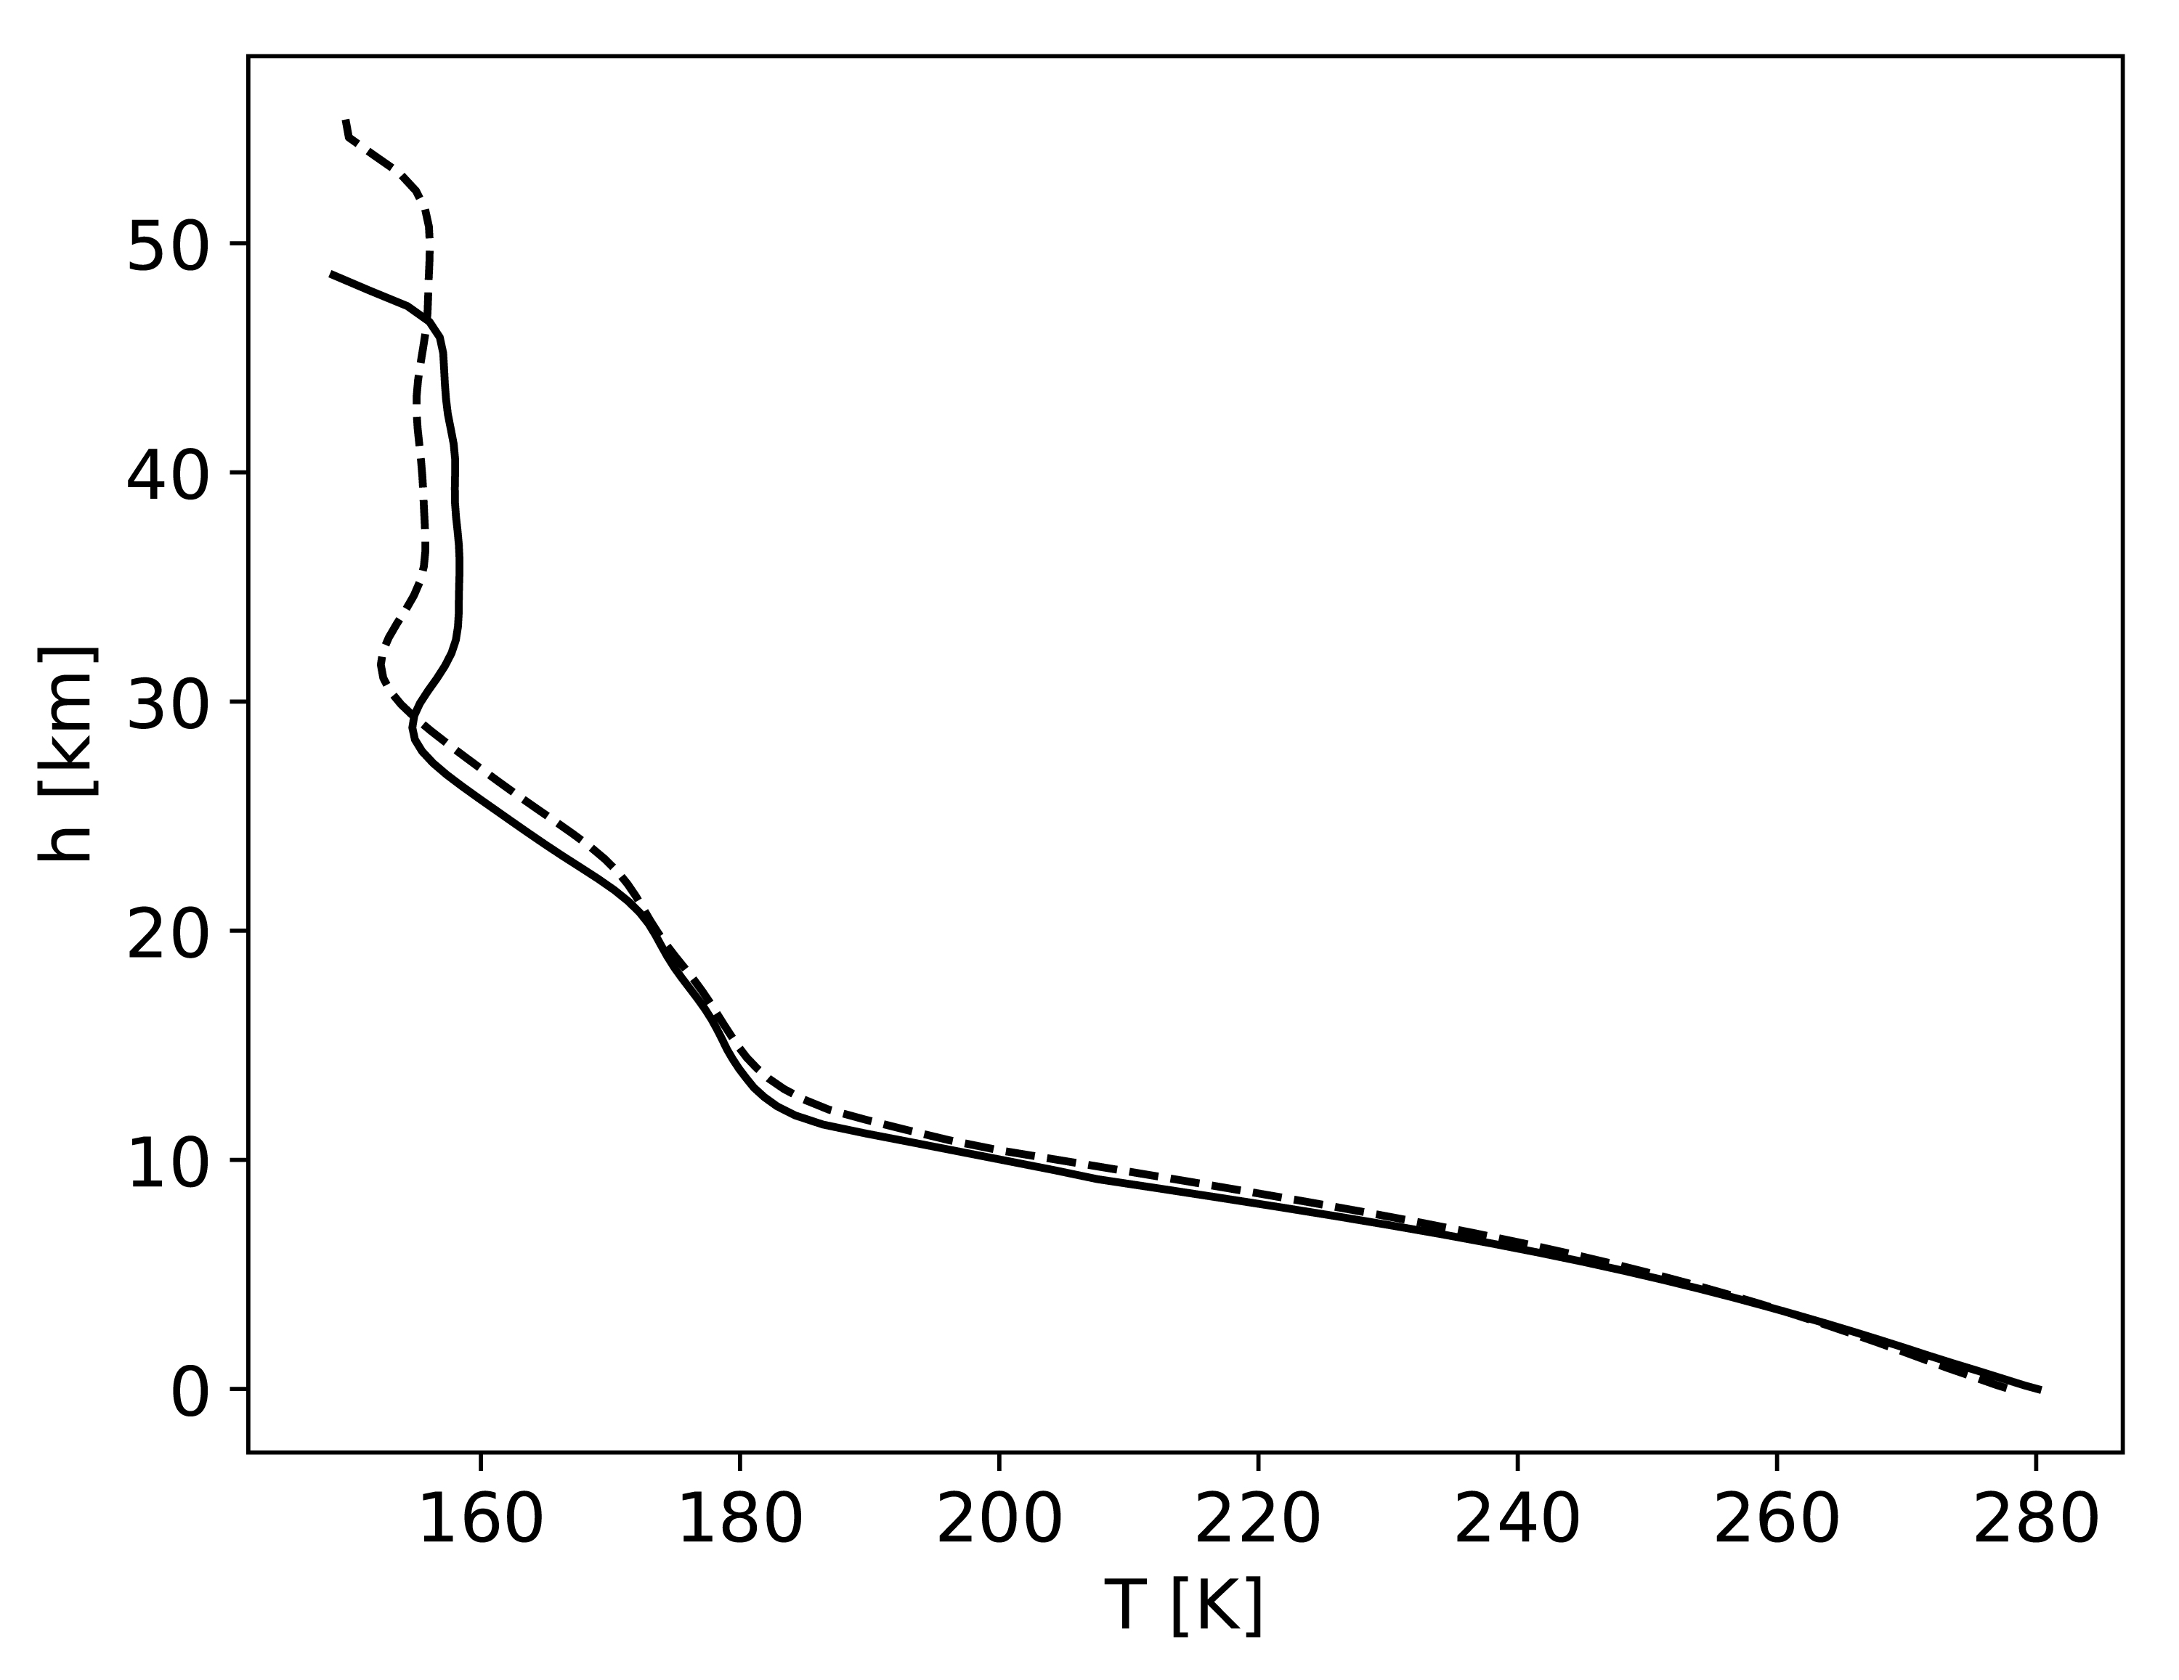
Rimmer et al.
Oxidised micrometeorites as evidence for low atmospheric pressure on the early Earth
Figure 1 Temperature profile for the Earth’s atmosphere with surface pressure of 0.3 bar composed of 33 % N₂, 33 % CO₂ and 33 % CO (dashed), and 33 % N₂, 66 % CO₂ (solid).
© 2019 The Authors
Published by the European Association of Geochemistry
under Creative Commons License CC BY-NC-ND.
Rimmer et al. (2019) Geochem. Persp. Let. 9, 38-42 | doi: 10.7185/geochemlet.1903
Notes:
Figure 1 Temperature profile for the Earth’s atmosphere with surface pressure of 0.3 bar composed of 33 % N₂, 33 % CO₂ and 33 % CO (dashed), and 33 % N₂, 66 % CO₂ (solid).

