Slide 1
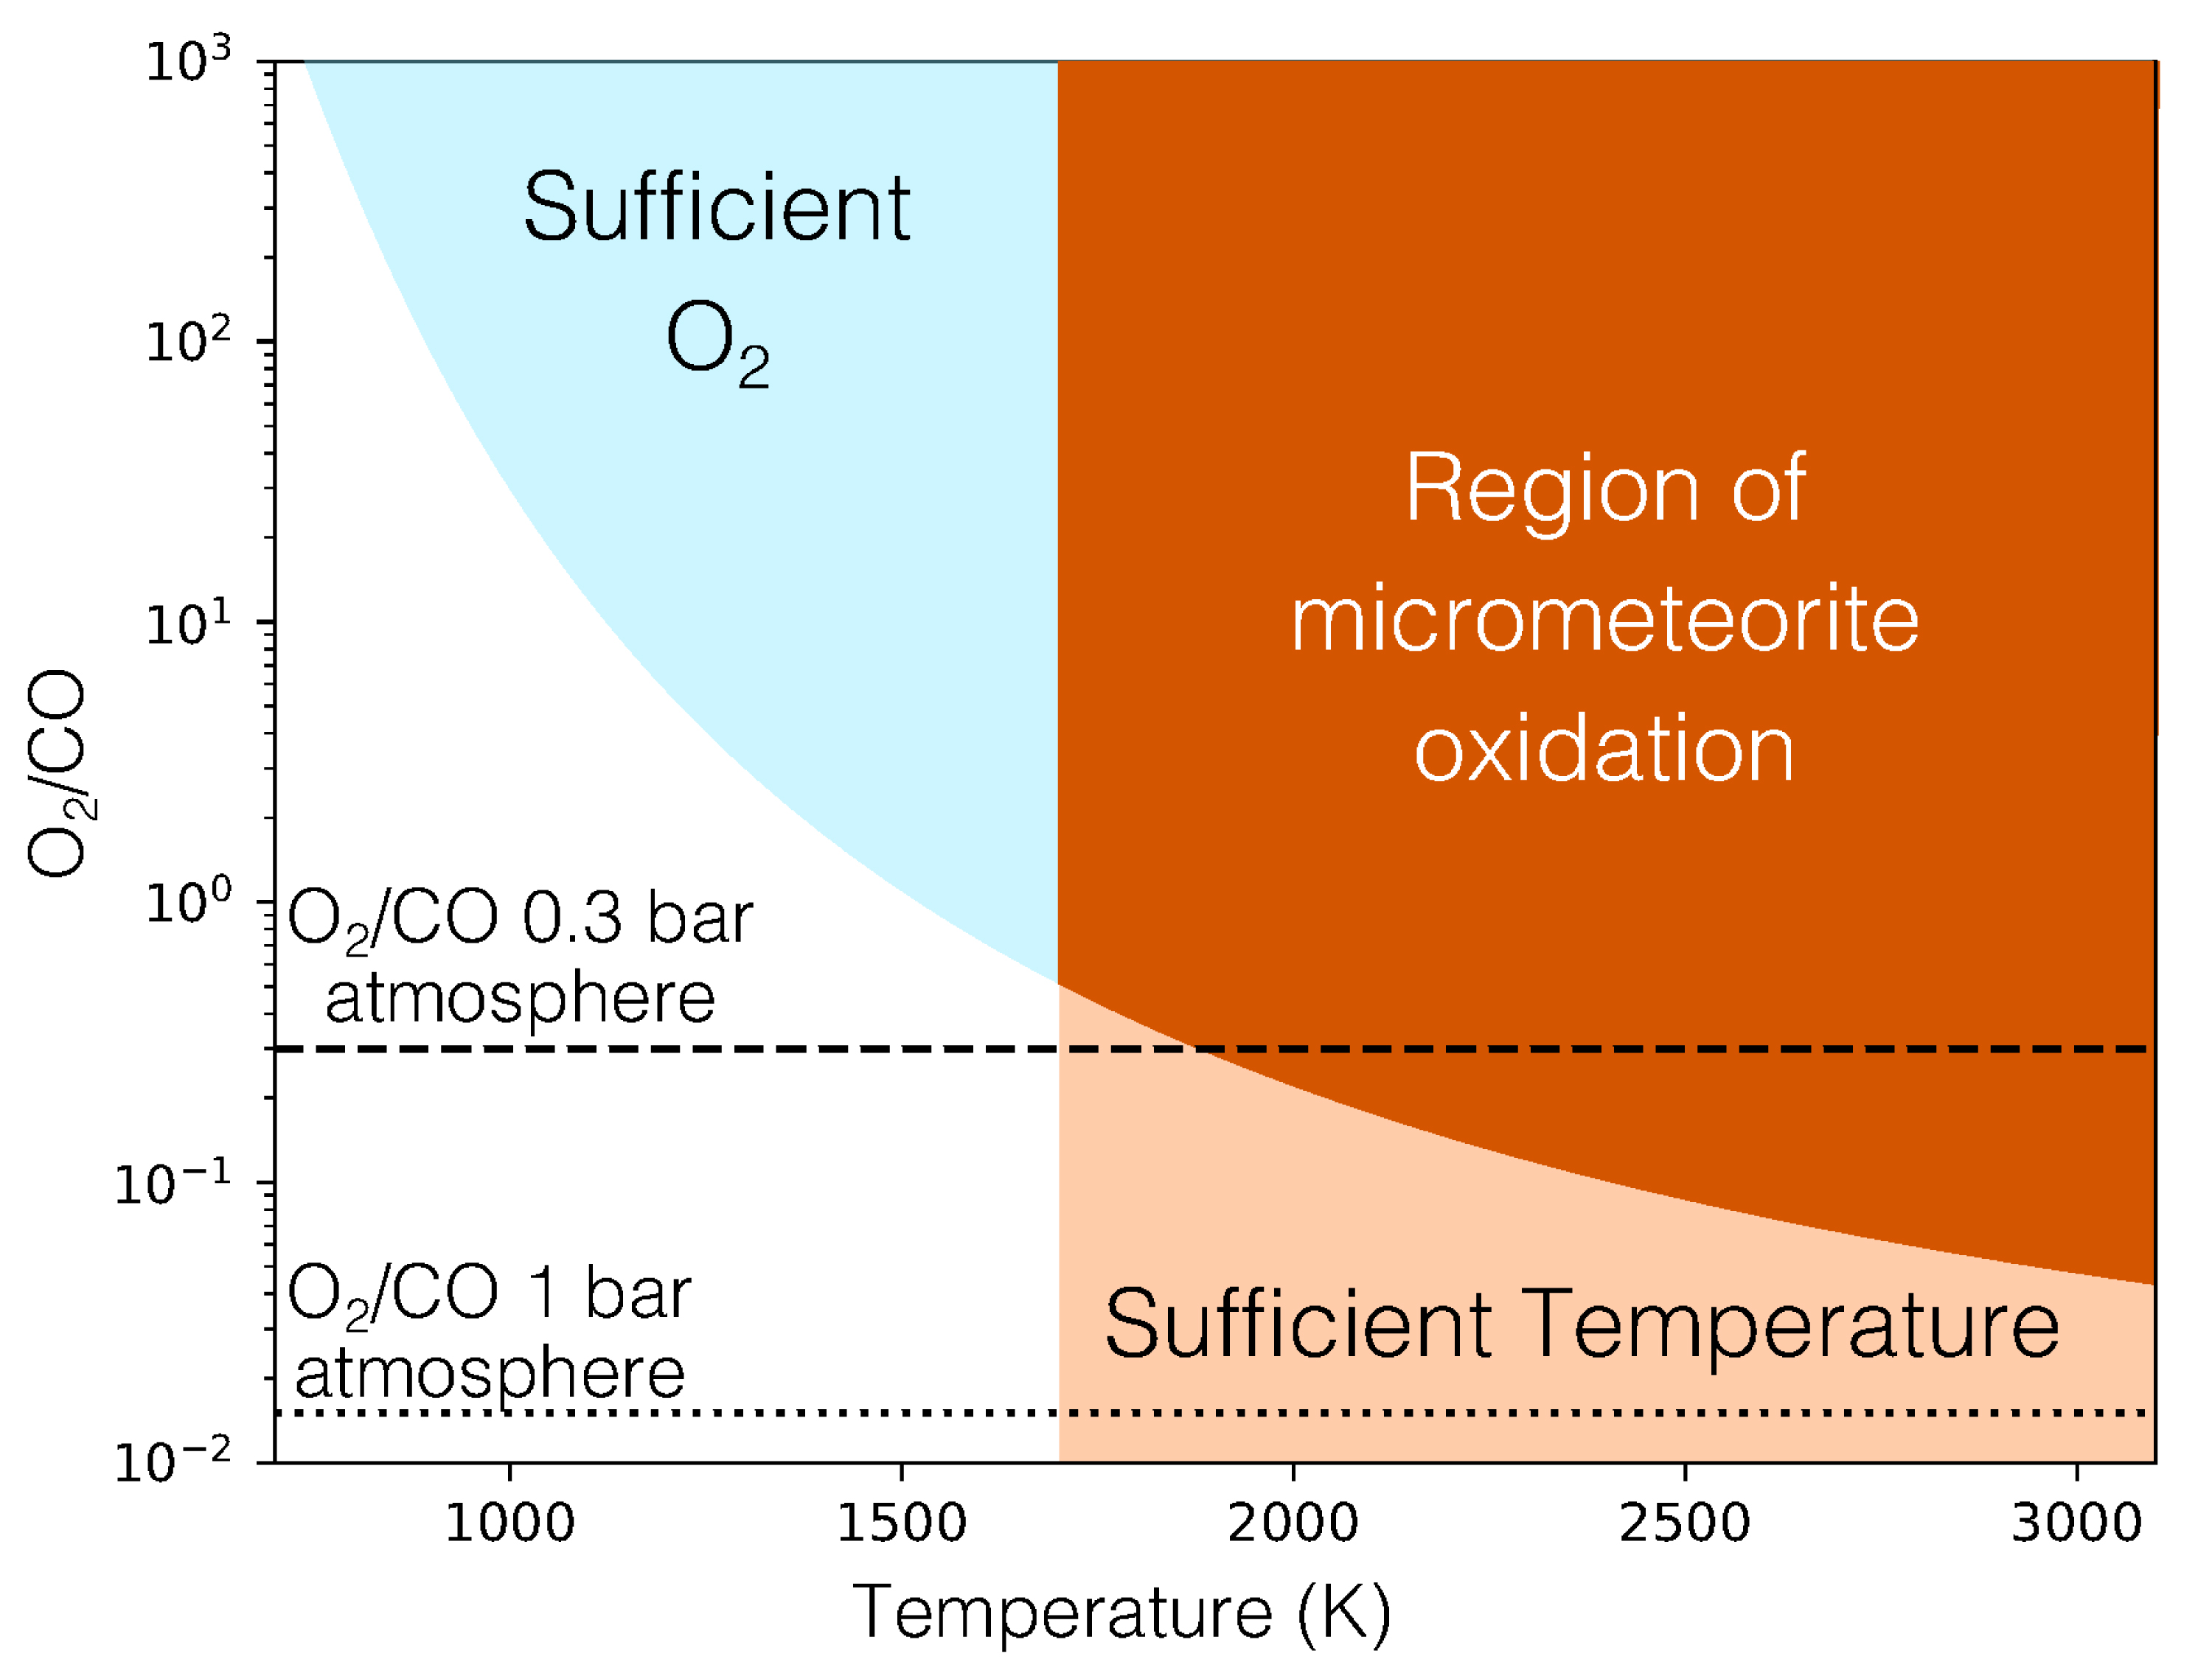
Rimmer et al.
Oxidised micrometeorites as evidence for low atmospheric pressure on the early Earth
Figure 3 The minimum O₂/CO ratio suggested by the observed iron oxidation in 2.7 Ga micrometeorites (Tomkins et al., 2016), as a function of the melting temperature T [K]. Shaded regions show where there is sufficient O₂ (light blue), sufficient temperature (light orange), and the overlap between these two regions (dark orange). The dotted line is the O₂/CO ratio in the upper atmosphere for an anoxic atmosphere with a 1 bar surface pressure, and the dashed line is the O₂/CO ratio in the upper atmosphere for an anoxic atmosphere with a 0.3 bar surface pressure.
© 2019 The Authors
Published by the European Association of Geochemistry
under Creative Commons License CC BY-NC-ND.
Rimmer et al. (2019) Geochem. Persp. Let. 9, 38-42 | doi: 10.7185/geochemlet.1903
Notes:
Figure 3 The minimum O₂/CO ratio suggested by the observed iron oxidation in 2.7 Ga micrometeorites (Tomkins et al., 2016), as a function of the melting temperature T [K]. Shaded regions show where there is sufficient O₂ (light blue), sufficient temperature (light orange), and the overlap between these two regions (dark orange). The dotted line is the O₂/CO ratio in the upper atmosphere for an anoxic atmosphere with a 1 bar surface pressure, and the dashed line is the O₂/CO ratio in the upper atmosphere for an anoxic atmosphere with a 0.3 bar surface pressure.

