Slide 1
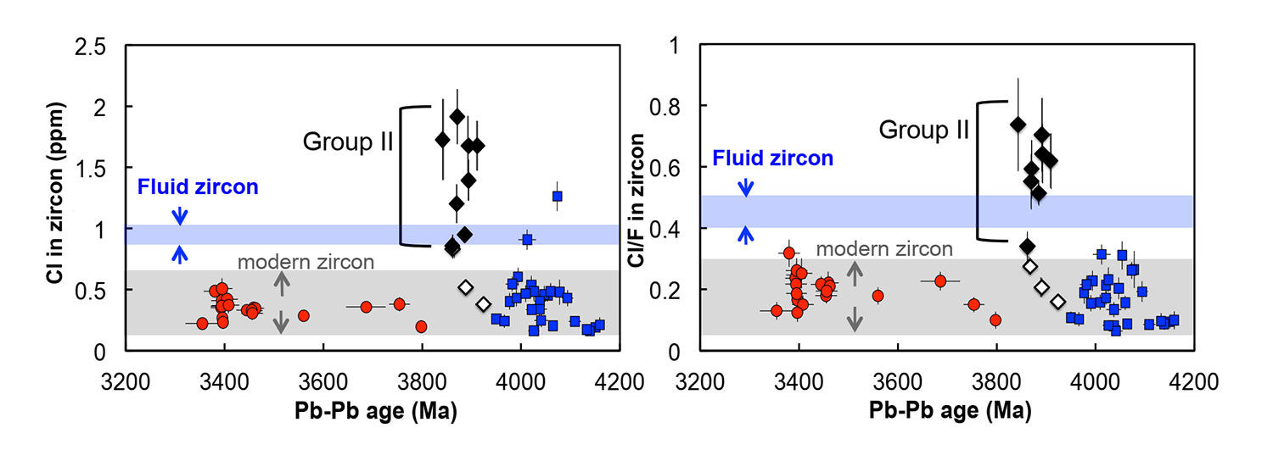
Tang et al.
Zircon halogen geochemistry: Insights into Hadean-Archean fluids
Figure 3 (a) Chlorine distribution and (b) Cl/F fractionation in Jack Hills zircons are mainly identical to the ranges determined from modern magmatic zircons in this study (red circles: <3.8 Ga zircons; white diamonds: 3.9–3.8 Ga Group I zircons; blue rectangles: >3.9 Ga zircons; grey bar: modern zircon ranges) except Group II zircons crystallised at 3.9–3.8 Ga (black diamonds). A synthetic zircon grown in an aqueous-rich fluid exhibits Cl content and Cl/F ratios (blue bars) that fall within the range of Group II.
© 2019 The Authors
Published by the European Association of Geochemistry
under Creative Commons License CC BY-NC-ND.
Tang et al. (2019) Geochem. Persp. Let. 9, 49-53 | doi: 10.7185/geochemlet.1905
Notes:
Figure 3 (a) Chlorine distribution and (b) Cl/F fractionation in Jack Hills zircons are mainly identical to the ranges determined from modern magmatic zircons in this study (red circles: <3.8 Ga zircons; white diamonds: 3.9–3.8 Ga Group I zircons; blue rectangles: >3.9 Ga zircons; grey bar: modern zircon ranges) except Group II zircons crystallised at 3.9–3.8 Ga (black diamonds). A synthetic zircon grown in an aqueous-rich fluid exhibits Cl content and Cl/F ratios (blue bars) that fall within the range of Group II.

