Slide 1
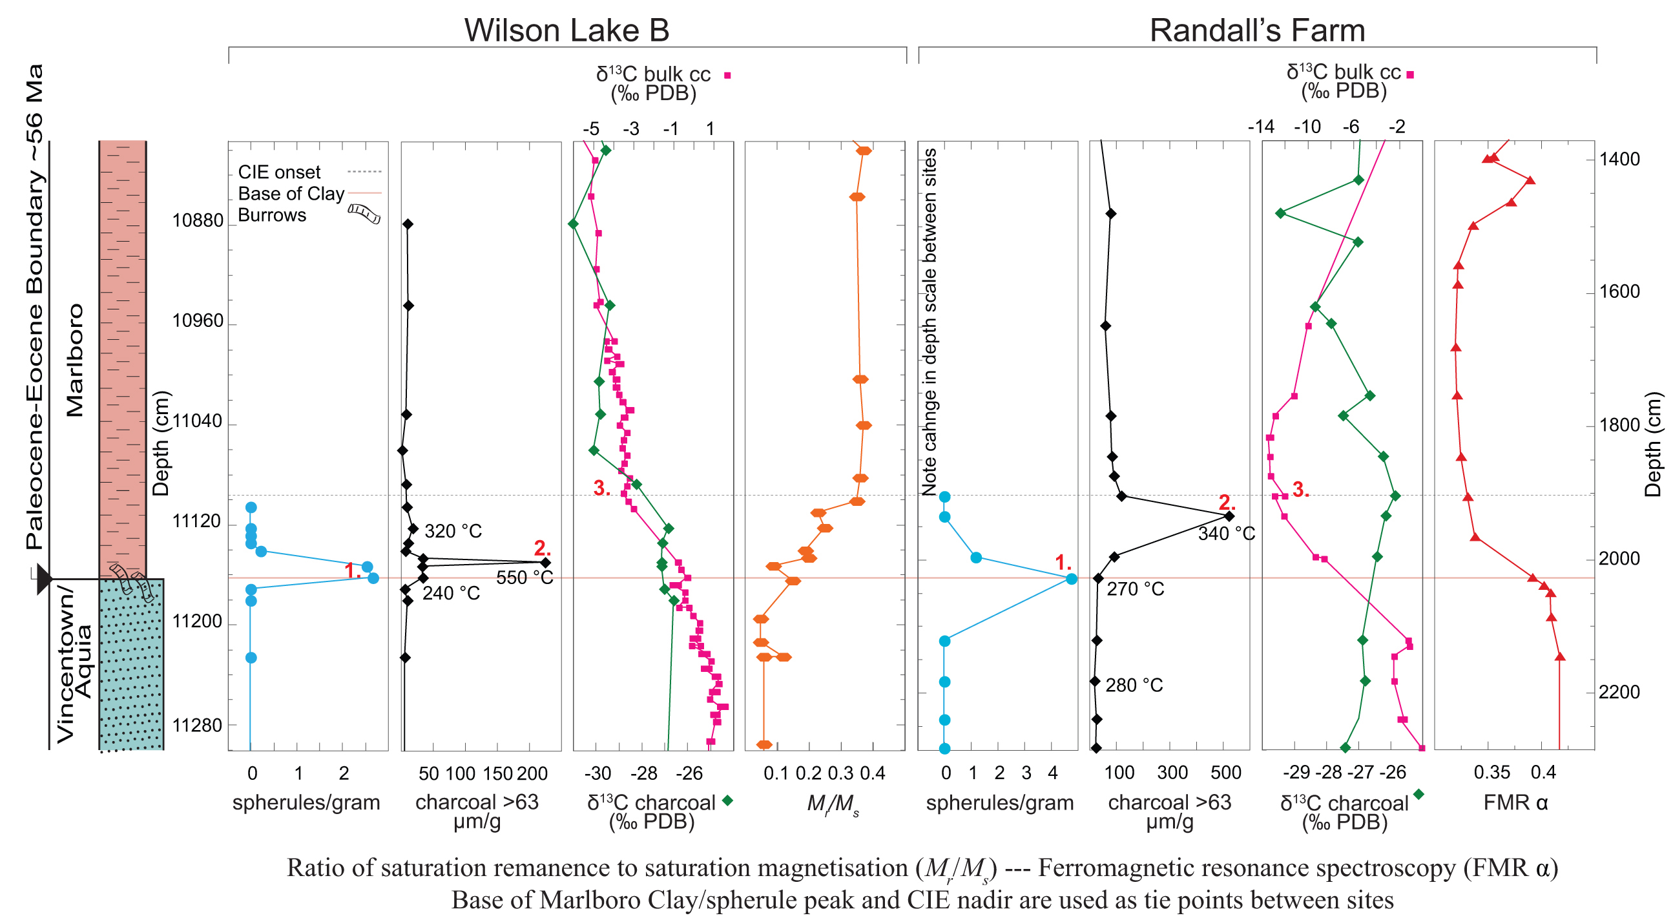
Fung et al.
Widespread and intense wildfires at the Paleocene-Eocene boundary
Figure 3 Charcoal abundance (# >63 μm/gram) and δ¹³C_{charcoal} (this study) plotted with δ¹³C_{bulk carbonate} and spherules/gram discovered at WL (Schaller et al., 2016) and RF (this study). Total depth range at RF is ~2 times WL, allowing for direct comparison. Note difference in isotope scale between WL and RF. R_{o} measurements, Mr/Ms at WL (Kent et al., 2017), and FMR α at RF (Kopp et al., 2009) are shown.
© 2019 The Authors
Published by the European Association of Geochemistry
under Creative Commons License CC BY-NC-ND.
Fung et al. (2019) Geochem. Persp. Let. 10, 1-6 | doi: 10.7185/geochemlet.1906
Notes:
Figure 3 Charcoal abundance (# >63 μm/gram) and δ¹³C_{charcoal} (this study) plotted with δ¹³C_{bulk carbonate} and spherules/gram discovered at WL (Schaller et al., 2016) and RF (this study). Total depth range at RF is ~2 times WL, allowing for direct comparison. Note difference in isotope scale between WL and RF. R_{o} measurements, Mr/Ms at WL (Kent et al., 2017), and FMR α at RF (Kopp et al., 2009) are shown.

