Slide 1
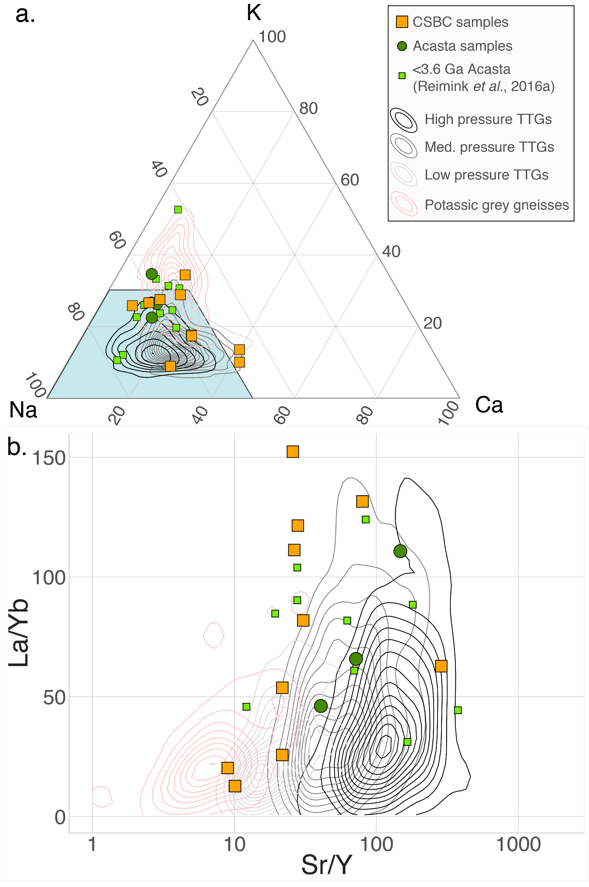
Reimink et al.
Onset of new, progressive crustal growth in the central Slave craton at 3.55 Ga
Figure 2 (a) Molar K-Na-Ca diagram. Orange squares are CSBC samples from this study. Green symbols are <3.6 Ga samples from the Acasta Gneiss Complex, small squares are samples measured by Reimink et al. (2016b) and dark green circles are samples added in this study. Contour density fields are high pressure TTGs (black), medium pressure TTGs (medium grey), low pressure TTGs (light grey), and potassic Archean grey gneisses (pink). Data used to construct these fields are taken from Moyen (2011). The blue field outlines sodic trondhjemites. (b) La/Yb versus Sr/Y for rocks from the Slave basement gneisses. Symbols as in (a).
© 2019 The Authors
Published by the European Association of Geochemistry
under Creative Commons License CC BY-NC-ND.
Reimink et al. (2019) Geochem. Persp. Let. 10, 8-13 | doi: 10.7185/geochemlet.1907
Notes:
Figure 2 (a) Molar K-Na-Ca diagram. Orange squares are CSBC samples from this study. Green symbols are <3.6 Ga samples from the Acasta Gneiss Complex, small squares are samples measured by Reimink et al. (2016b) and dark green circles are samples added in this study. Contour density fields are high pressure TTGs (black), medium pressure TTGs (medium grey), low pressure TTGs (light grey), and potassic Archean grey gneisses (pink). Data used to construct these fields are taken from Moyen (2011). The blue field outlines sodic trondhjemites. (b) La/Yb versus Sr/Y for rocks from the Slave basement gneisses. Symbols as in (a).

