Slide 1
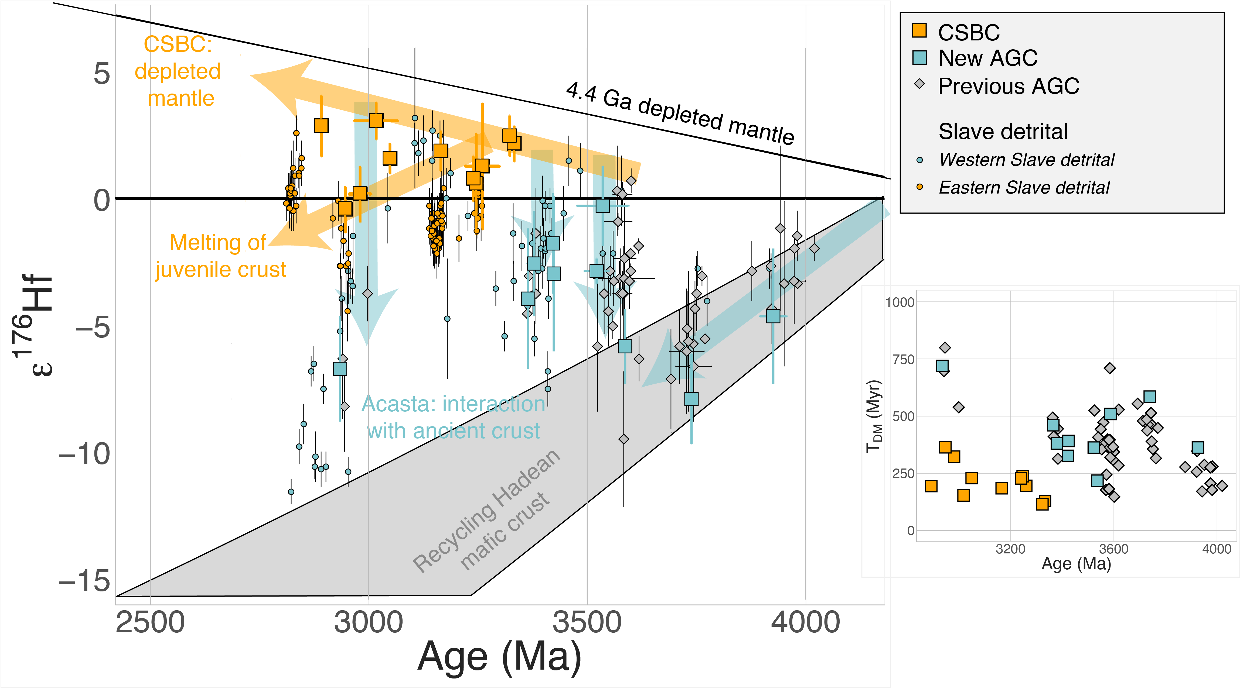
Reimink et al.
Onset of new, progressive crustal growth in the central Slave craton at 3.55 Ga
Figure 3 Zircon Hf isotope data from Slave basement gneisses. Orange symbols are analyses from the CSBC, blue are new analyses from the AGC, grey diamonds are a compilation of Acasta Hf isotope data (sources in the text), and small circles are single detrital zircon analyses from sediments of the Slave Craton Cover Group sequence (Pietranik et al., 2008). Note that detrital zircon analyses are grouped by sediment location (see Supplementary Information). Grey field is the evolution of Hadean mafic protocrust, while orange and blue lines show our interpretations (sloped lines for time-integrated isotope evolution, vertical lines for mixing) for systematic petrogenetic differences between the two portions…
© 2019 The Authors
Published by the European Association of Geochemistry
under Creative Commons License CC BY-NC-ND.
Reimink et al. (2019) Geochem. Persp. Let. 10, 8-13 | doi: 10.7185/geochemlet.1907
Notes:
Figure 3 Zircon Hf isotope data from Slave basement gneisses. Orange symbols are analyses from the CSBC, blue are new analyses from the AGC, grey diamondsare a compilation of Acasta Hf isotope data (sources in the text), and small circles are single detrital zircon analyses from sediments of the Slave Craton Cover Group sequence (Pietranik et al., 2008). Note that detrital zircon analyses are grouped by sediment location (see Supplementary Information). Grey field is the evolution of Hadean mafic protocrust, while orange and blue lines show our interpretations (sloped lines for time-integrated isotope evolution, vertical lines for mixing) for systematic petrogenetic differences between the two portions of the Slave basement gneisses. The Archean depleted mantle evolution line shown here is the connector line between a chondritic source at 4.4 Ga and modern MORB εHf values of +17. Calculated with respect to this model evolution for the depleted mantle, the inset shows the maximum crustal residence times (depleted mantle model ages calculated using a source ¹⁷⁶Lu/¹⁷⁷Hf of 0.015, and then subtracting the U-Pb crystallisation age from this model age) for all Slave craton Hf isotope data. The transition from long to short crustal residence times occurs at 3.6 Ga.

